Slide 1
FUTURE THERAPIES: THE FUTURE OF CLOSED LOOP INSULIN INFUSIONS
Pumps, Sensors and Patients .. Oh my!
Prof. J. Geoffrey Chase
Department of Mechanical Engineering
Centre for Bio-Engineering
University of Canterbury
Christchurch, New Zealand

Slide 2
A well known story in the ICU
Hyperglycaemia (High Blood Sugar) is prevalent in critical care & increases mortality
  Impaired insulin production + Increased insulin resistance = High Blood Glucose (BG)
  Average BG values > 10mmol/L are not uncommon
Tight Glycaemic Control (TGC) → better outcomes:
  Reduced mortality ~17-43% (6.1-7.75 mmol/L) [van den Berghe, Krinsley, Chase]
  Organ failure rate and severity reduced [Chase]
  Savings of $1500-3000 per patient treated [van den Berghe, Krinsley]
However, there is a catch...
  Several studies report increased risk of hypoglycaemia
  Optimal control requires high measurement frequency (1-2 hourly or better)
  Most TGC studies measure blood glucose1-4 hourly, more frequently only if BG is low
  Frequent measurement (even 1-2 hourly) uncommon due to the clinical effort [e.g. MacKenzie]
  The result is extremely variable control with longer measurement intervals

Slide 3
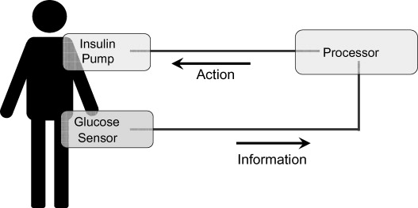
Closed Loop?
A control systems engineering expression
Created by 3 main elements
  A dynamic “plant” or “system” → The Patient
  Sensors to measure plant response → CGMs or Glucometers
  Actuators to give input → Infusion Pumps for insulin or nutrition
Feedback control?
  So, it’s really about the “processor” which is your protocol

Slide 4

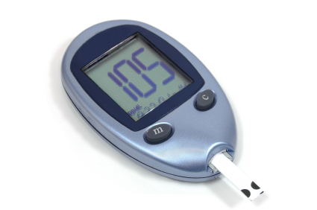
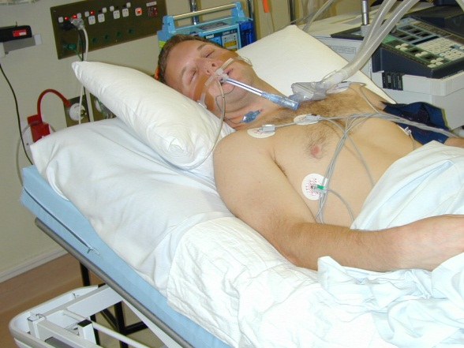
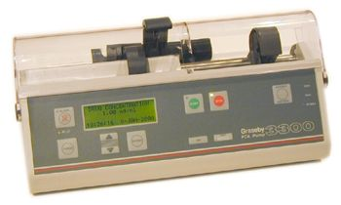
So, actually, the loop is already closed!
Unit BG Protocol: all have similar attributes
  Fixed dosing as function of BG
  Measurement interval
  Adjustment
  Often on paper, sometimes on computer
  Minimal effort (often)
  Variable performance + safety
Measured data
Patient management
Standard infuser equipment adjusted by nurses
“Nurse-in-the-loop” system. Standard ICU equipment and/or low-cost commodity hardware.
Interestingly, automated closed-loop control is viewed as a panacea that will cure all!

Slide 5
So, if the loop is closed … I’m confused … ?
Automation isn’t a “cures all” solution, it’s only as good as its elements (sensor, processor, input actuator)
We already close the loop and succeed (sometimes), fail (rarely) and get confused (most often) in glycemic control
One thing it can do is reduce:
  Variability in care (especially if fully automated)
  Concern, worry and effort in clinical staff (something taken care of)
At a cost of increased:
  Risk (especially if fully automated) due to blind following
  Emphasis on quality of processor/control protocol
  Technical oversight and capability required

Slide 6
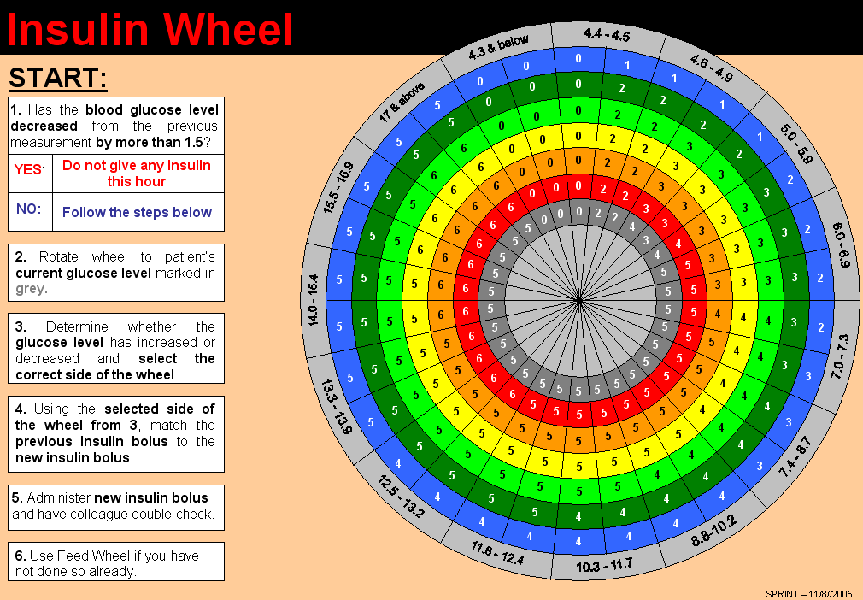
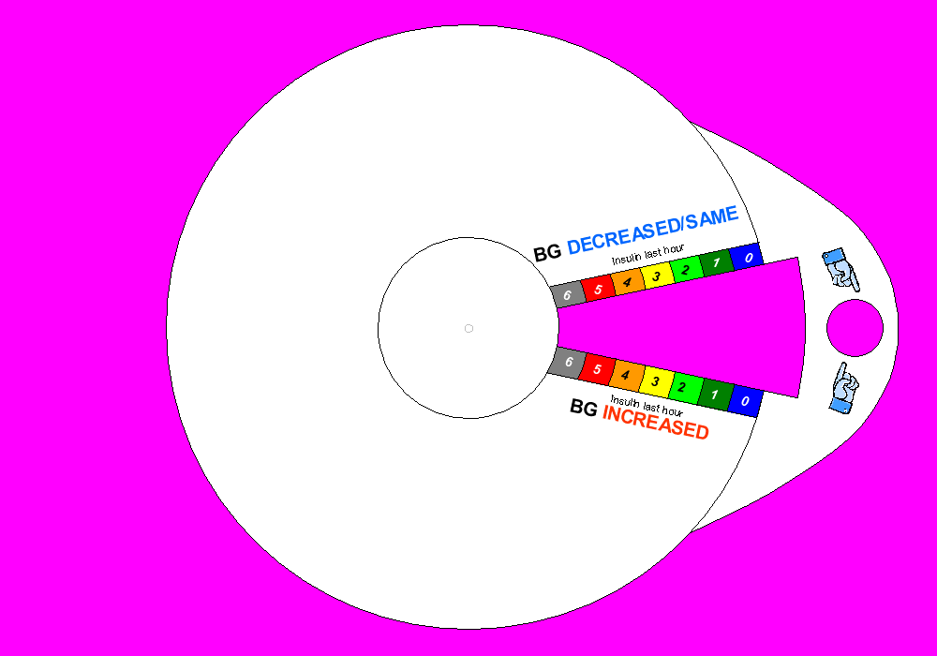
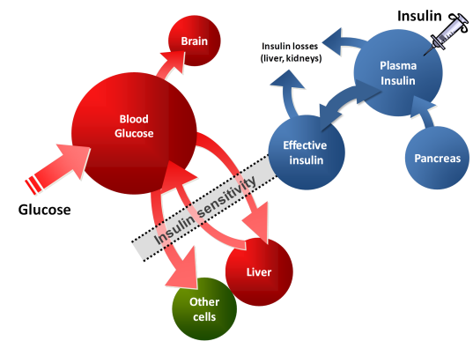
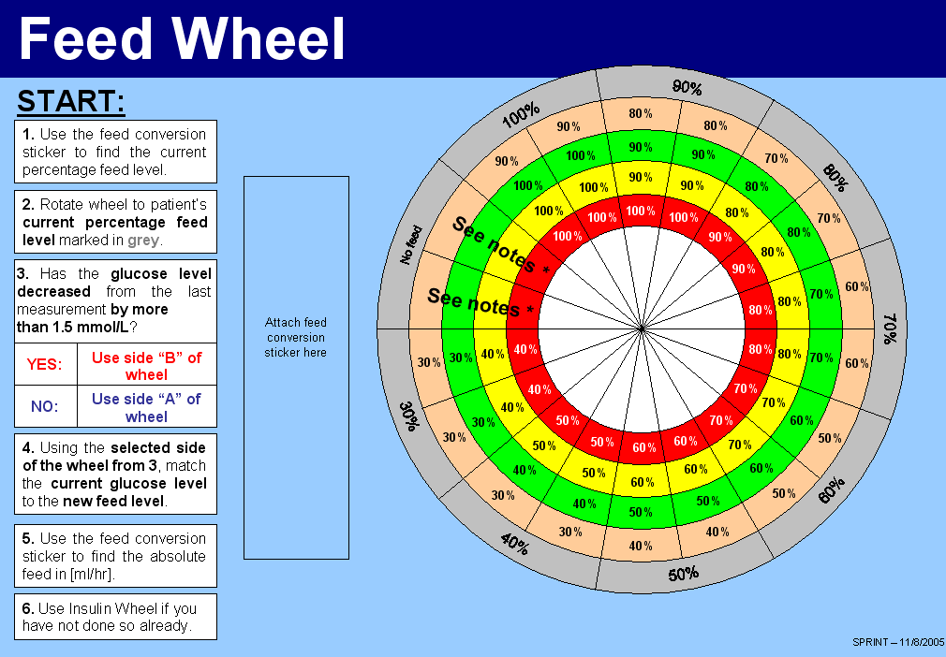
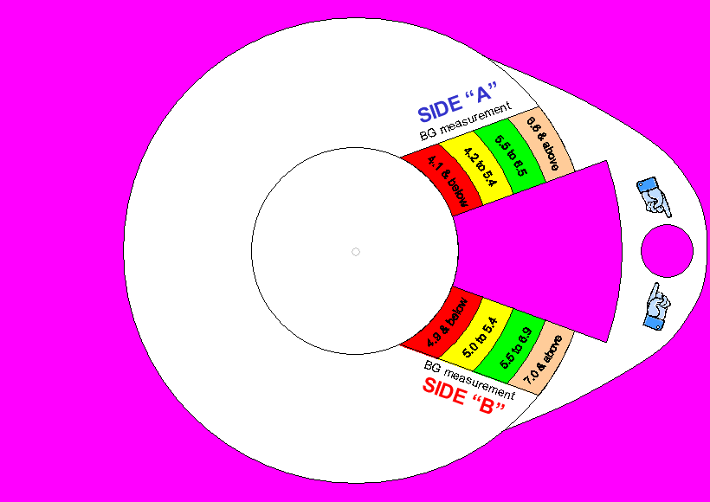
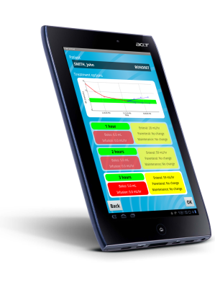
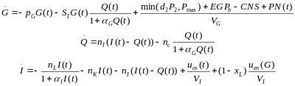
Another view then of the closed loop!
Decision Support System
Measured data
Identify and utilise “immeasurable” patient parameters, in this case, insulin sensitivity (SI)
Patient management
Standard infuser equipment adjusted by nurses
Still a “Nurse-in-the-loop” system, but with model-based guidance and ability to make visible underlying sensitivity that drives metabolic response. I.e. Better to tools to guide decisions, rather than taking them over = a best of both worlds solution.

Slide 7

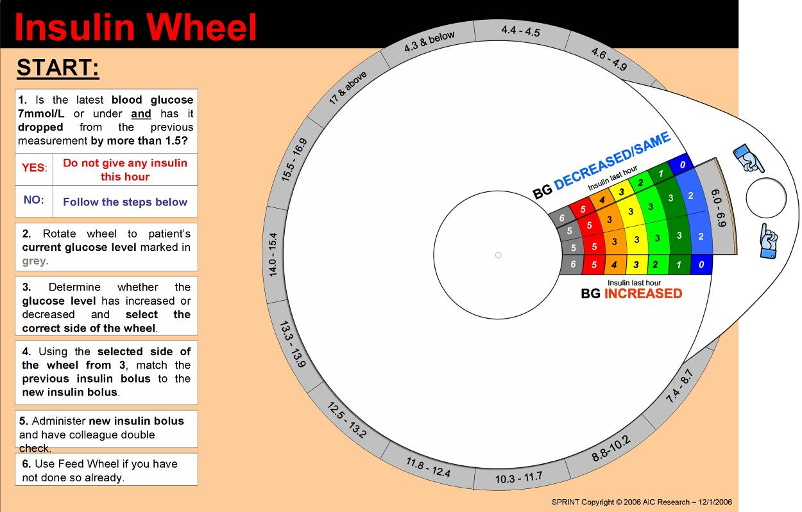
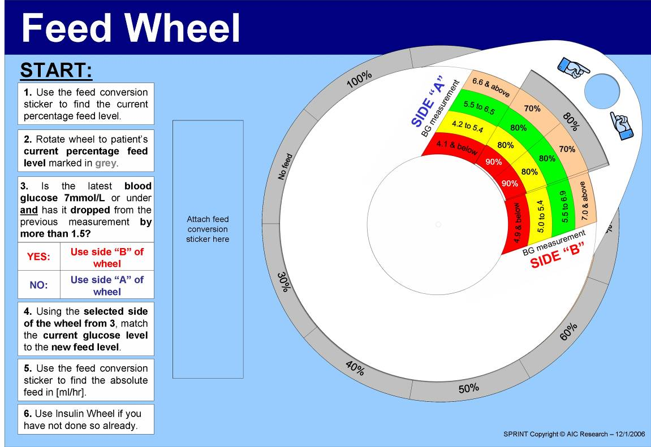
The “Processor”
AGC in Christchurch ICU
  SPRINT
  In August 2005, we introduced the paper based SPRINT tight glycaemic control protocol
  SPRINT achieved 86% of BG measurements within a 4.4-8.0 mmol/L band
  Mortality was reduced by up to 35%
  Reduced hypoglycaemia vs conventional
  The protocol required on average16 BG measurements per day
  STAR
  Over the following years, SPRINT evolved into the computer based STAR protocol (now used in ICU)
  STAR has achieved 89% of BG measurements within a 4.4-8.0 mmol/L band to date (~25 patients)
  The main advantage is the reduced hypoglycaemia from 2.9% to 0.9% (%BG < 4.0) and an expected 50% further reduction in severe hypoglycemia
  BG was measured 12 times per day on average
  To truly automate we might want to use CGMs rather than a nurse and a glucometer, and we would need to use STAR
  But, both work very well

Slide 8
What you want your system to do…
  Fixed dosing systems
  Typical care
  Adaptive control
  Engineering approach
Patient response to insulin
  Controller identifies and manages patient-specific variability
  Fixed protocol treats everyone much the same
Controller
  Variability flows through to BG control
  Variability stopped at controller
Blood Glucose levels
The real goal is to identify, diagnose and manage patient-specific variability directly. Without adding clinical effort or patient burden!
It is in this task that computerised protocols can add notable value

Slide 9
So, the elements and the issues?
Pumps are accurate to 0.1mL or less per hour
  Virtually no error and thus no real need to consider them today
Processors or protocols are good (or not!)
  Main issue is usually finding one that works within your clinical units workflow and clinical practice culture (and facilities)
So, what about the sensors
  Require manual data input that can have error (up to 10% but as low as 0.1%)
  Not easily hooked to a computer or protocol controller without the “nurse (remaining) in the loop”
  However, CGMs (continuous glucose monitors) may offer a solution
X
?

Slide 10
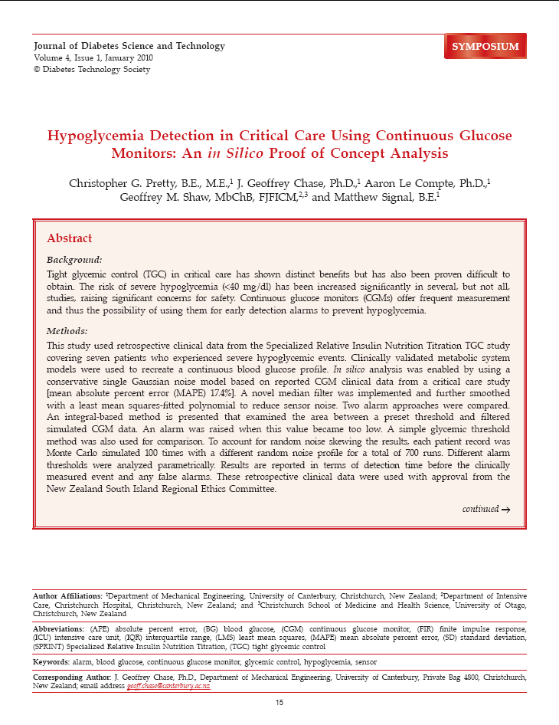
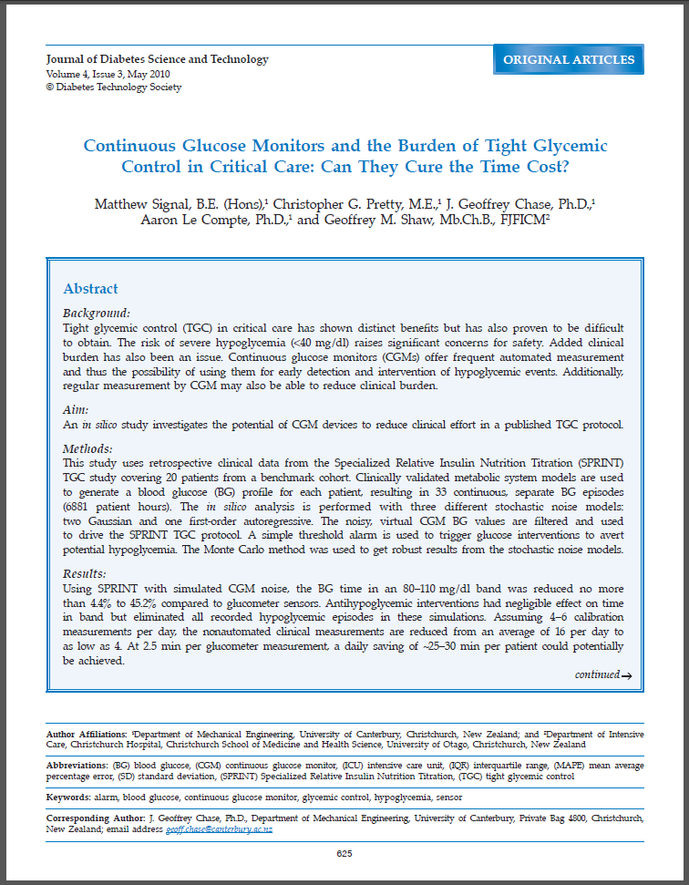

Integrating CGMs with SPRINT
One potential way of reducing nurse burden and maintaining (and even increasing) safety with TGC is to use continuous glucose monitors (CGMs)
Two in-silico studies published in 2010 found:
  The number of BG measurements required could be reduced from ~16 to 4-5 per patient, per day, while maintaining performance and safety of the control – a major workload reduction. [Signal et al. (2010) “Continuous Glucose Monitors and the Burden of Tight Glycemic Control in Critical Care: Can They Cure the Time Cost?,” Journal of Diabetes Science and Technology, 4:3]
  CGMs could potentially ‘trigger’ a dextrose bolus at the onset of hypoglycaemia, significantly increasing patient safety. [Signal et al. (2010) “Continuous Glucose Monitors and the Burden of Tight Glycemic Control in Critical Care: Can They Cure the Time Cost?,” Journal of Diabetes Science and Technology, 4:3]
  Alarming at the predicted onset of hypoglycaemia could give over 30+ mins of lead time before BG levels become dangerous. [Pretty et al. (2010) “Hypoglycemia Detection in Critical Care Using Continuous Glucose Monitors: An in Silico Proof of Concept Analysis,” Journal of Diabetes Science and Technology, 4:1]

Slide 11
So why don’t we use them already?
Sensor noise, sensor drift, lag and calibration procedures/algorithms (among other things) can all have a significant influence on the output of the CGM device
The device characteristics, the wide variety of illnesses in the ICU could prove problematic for a ‘one size fits all’ device:
  Chee et. al. showed that continuous glucose monitoring can be affected by peripheral oedema, and control suffered significantly in this study
  Lorencio et. al. reported that accuracy was significantly better in patients with septic shock in comparison with other patient cohorts (kinda the opposite of Chee!)
  Bridges et. al. stated that the most important utility of CGMs at this time may be to trigger standard BG checks to improve the safety of glycaemic control, which is what we think so we are not alone in this idea
  We need to be confident that CGMs are reliable before they can be used for clinical decision making and/or closed-loop BG control

Slide 12
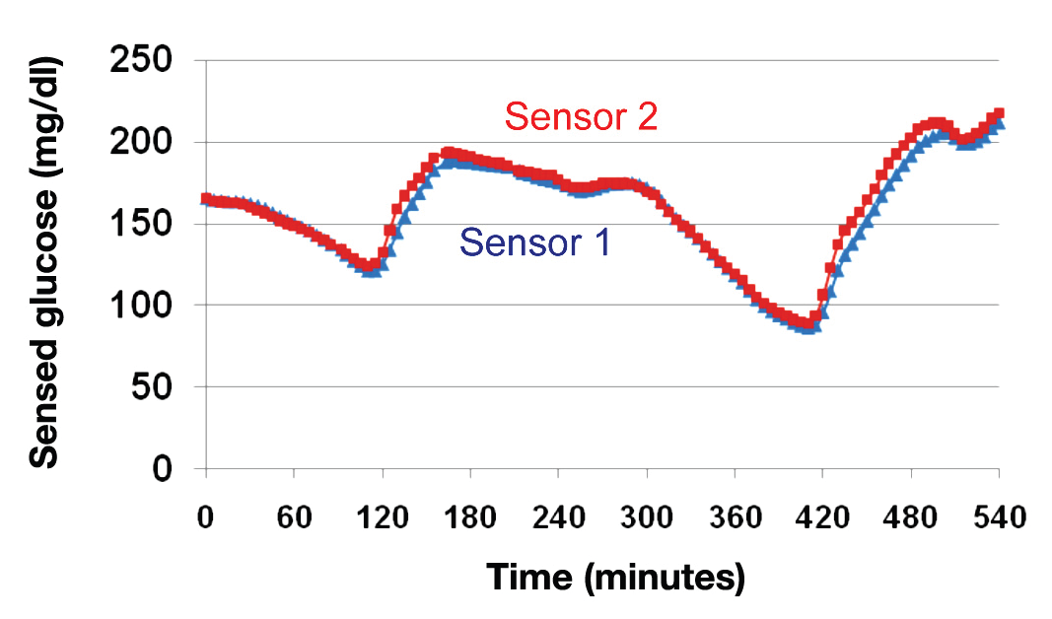
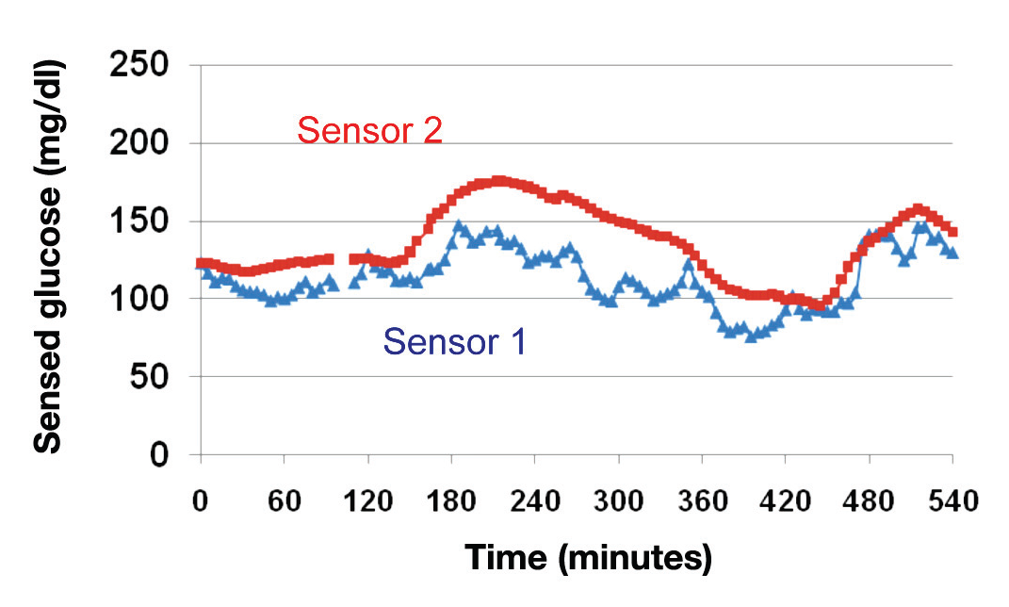
Multiple CGMs and redundancy
One method of reducing the impact of undesirable sensor characteristics is to use multiple CGMs → Reduce the impact of drift etc. but lag and noise are likely still present
A study by Jessica Castle and colleagues (2010) investigated this in type 1 diabetics (who the devices were designed for)
They reported that in approximately 25% of patients there was a large discrepancy between the two CGMs (> 7% MARD difference between them)
  Sometimes the sensors are almost superimposed
  Other times there is a large mismatch between sensors
  *Figures from: Castle, J and Ward, K (2010) “Amperometric Glucose Sensors: Sources of Error and Potential Benefit of Redundancy”

Slide 13
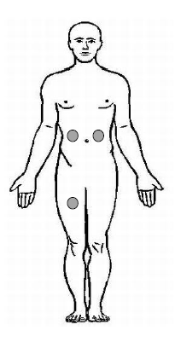
CGMs in ICU – Clinical Trial
Study outline:
Primary Aim: Assess the reliability of CGMs in the ICU
Secondary Aim: Assess the reliability of glucose meters in the ICU
Every time blood is drawn from the arterial line for blood gas analysis, samples are dropped onto 5 glucose meter strips (Optium Xceed, Abbott Diabetes Care) → 5 x blood gas vs glucometer
Study Goals:
Assess inter-site variability, inter-sensor variability and overall reliability of CGM
Determine whether currently available CGMs could be implemented with STAR (successfully)
Assess the reliability of glucose meters (glucometers) in the ICU
Observational Study
Patients are on STAR TGC protocol
Up to 50 patients
Up to 6 days monitoring per patient
Calibrate using arterial blood gas glucose measurements (radiometer ABL90 Flex)
Sensor
Sensor
Sensor

Slide 14
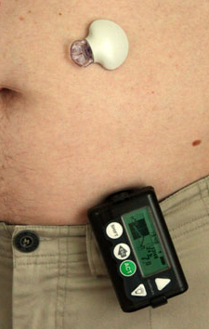
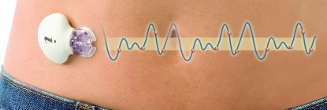
CGM devices used in this study
Two different CGM devices are tested in this study but with exact same sensor technology
Medtronic Guardian Real-Time CGM
Medtronic iPro2 CGM
Transmitter
iPro2
Sensor
Sensor
Guardian monitor
Uses the latest Enlite glucose sensor
Displays real-time glucose value
Manually enter calibration BG measurements 2-4 times daily
Uses the latest Enlite glucose sensor
Stores sensor glucose internally
Calibration BG measurements at least every 8 hours – Not real time
  *Figures sourced from Google for explanatory purposes only

Slide 15
Preliminary results
We have some preliminary results from the study
We have ethics approval to enrol up to 50 patients, the following results are from 5 patients who have been part of the study so far
Number of patients | 5
CGM monitoring period (days) | 4.7 [3.2 – 6.0]
Time between calibrations (hours) (min 2/day for device, but we aim for 3 or every 8 hours) | 7.6 [5.0 – 8.2]
Paired reference BG measurements | 557

Slide 16
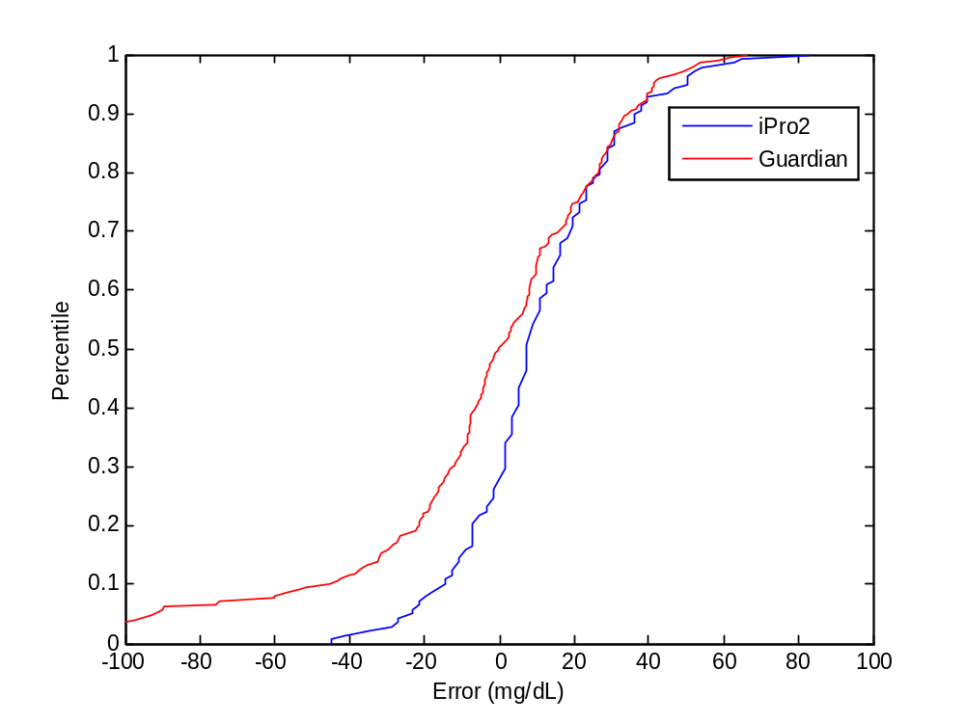
Preliminary results - CGMs
Inter-device variability: Guardian vs. iPro2 (both in abdomen)
iPro2 CGM performed better than the real-time Guardian CGM
Likely due to real-time calibration (Guardian, harder and doesn’t eliminate drift) vs retrospective calibration (iPro2, easier) – But, it’s the Guardian you would use for control!
N = ~550 CGM measurements
  Error between iPro2 and reference BG versus Error between Guardian and reference BG
  iPro2 error
  Median [IQR] = 7 [-4 – 22]
  Guardian error
  Median [IQR] = 2 [-14 – 9]

Slide 17
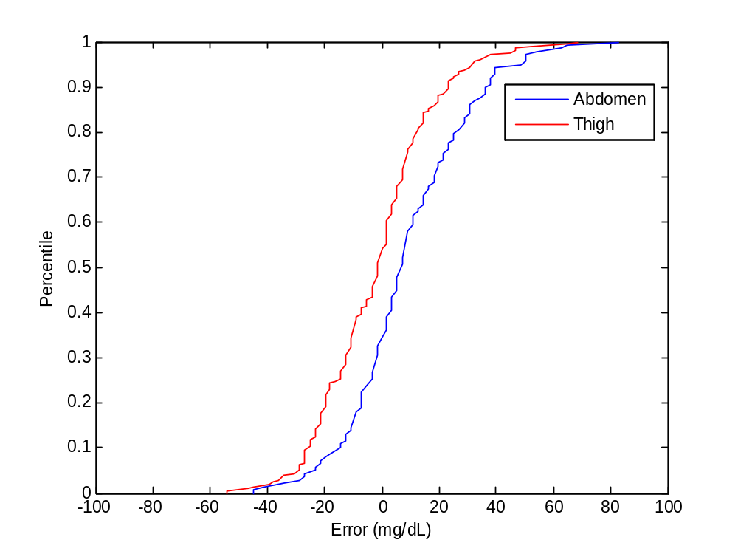
Preliminary results - CGMs
Inter-site variability: abdomen vs. thigh (both are retrospective calibrated iPro2 CGMs)
These CDF’s show that the thigh CGM reported lower than abdomen CGM
Similar shaped CDF’s → Shift potentially due to sensor location, needs further analysis and more patients
  Error between iPro2 (abdomen) and reference BG versus Error between iPro2 (thigh) and reference BG
  Abdomen error
  Median [IQR] = 7 [-4 – 22]
  Thigh error
  Median [IQR] = -2 [-14 – 9]

Slide 18
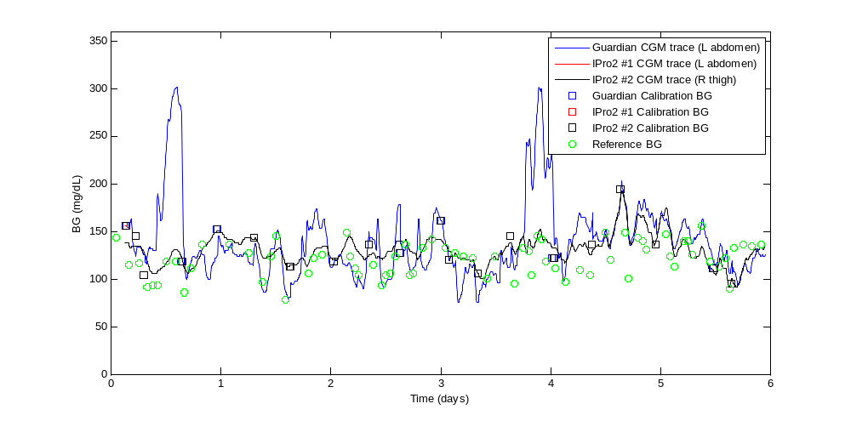
Case Study – Severe edema
Patient was ~55kg’s, but had ~18 Litres of (estimated) extra fluid on board
Clinical challenge → trying to keep the sensor base attached skin
The leaking fluid was so bad, we lost one sensor immediately after insertion (cannot re-insert), and after replacing, we lost a second sensor in a matter of hours
Blue trace (Guardian) → abdomen, black trace (iPro2) → thigh
  The Guardian (blue) trace is much more variable...
  But, it’s the real-time device
Big differences would affect dosing and thus safety

Slide 19
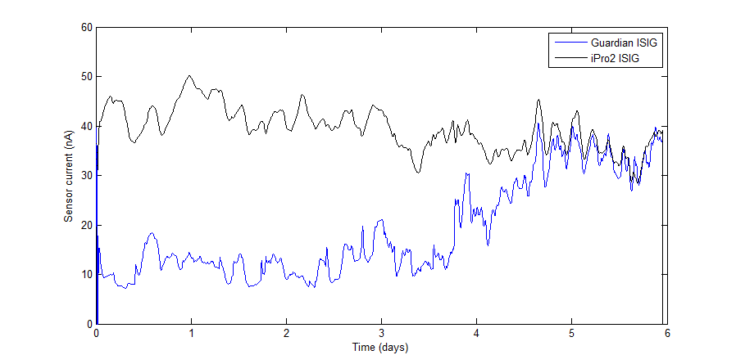
Case Study – Severe edema
If we look at the raw sensor output (electrical current) we get a ‘fair’ comparison with the calibration removed (the sensor hardware is the same)
Several day offset could be due to low sensitivity or edema ‘diluting’ glucose concentration
As patient condition improves, blue sensor signal increases (day 3 onward)
  Offset
  Abdomen with more fluid is lower. As condition improves and edema decreases they match again

Slide 20
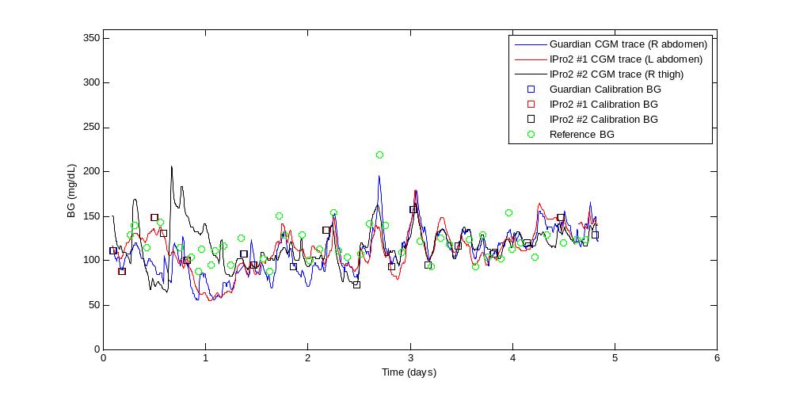
Case Study – No edema
Patient had very little (if any) extra fluid on board
The three sensors were very easy to insert and stayed in place for the duration of the study
We obtained three full CGM traces
Day 1 differences may be due to sensor initial calibration or wetting issues, or ??? The thigh iPro2 sensor is the one different. Abdomen is consistent. Could also be motion?
  Agreement between CGMs can change over time
  Poor agreement
  Good agreement

Slide 21
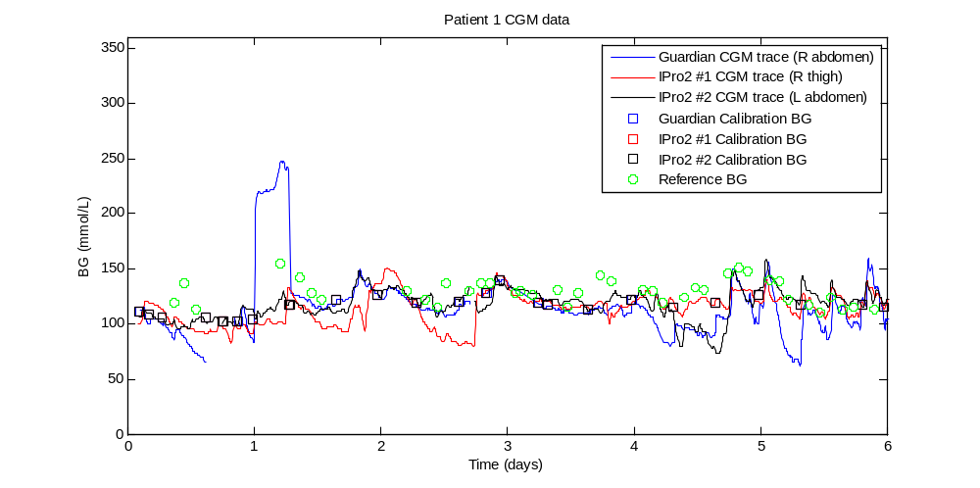
Sensor/Calibration artefacts
If CGMs are also to be used with a TGC protocol, the algorithm should be aware of anomalies in the trace → we don’t want to dose insulin off incorrect measurements
We also don’t want to miss dosing on correct measurements
McGarraugh et. al. (2009) reported false CGM hypoglycaemic events due to pressure being applied to the sensor
  Is this real?
  Has the sensor detected this? Or is it the calibration algorithm?
Abdomen
Thigh
Abdomen
Abdomen
Big differences would affect dosing and thus safety and performance

Slide 22
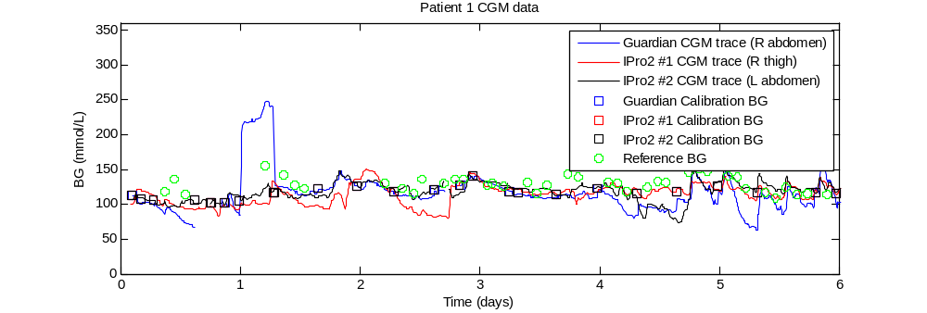
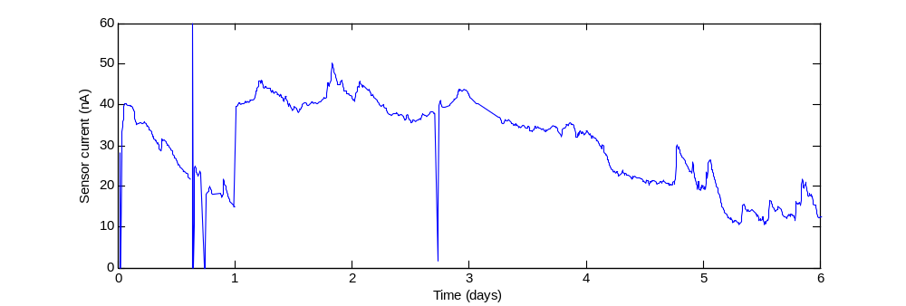
Looking at just one of those cases
  Calibration algorithm adjusts for change in sensitivity
  The sensor has reported the rise
  Sensor current for blue CGM trace
  The why of this is unknown. Something in its in situ situation, fouling, …??
  ‘Jump’ in sensitivity

Slide 23
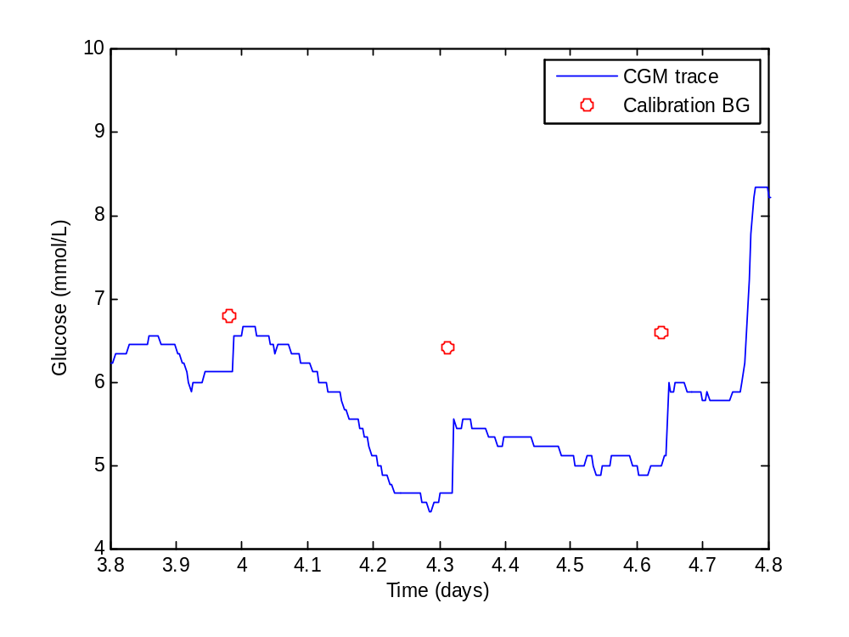
Case Study: CGM Drift
(From another study)
Sensor and/or calibration drift is a phenomenon that can occur when using a real-time calibration algorithm
When the next calibration measurement is entered into the device, it ‘jumps’ to correct some of the drift.
Not apparent in retrospectively calibrated device curves, but, as seen drift can/may affect dosing
There is an element of driving blind when this happens as there are no other “tell tales”
Downward drift

Slide 24

So, umm, about that technology…
The usual outcome when the technology works in unintended ways..

Slide 25
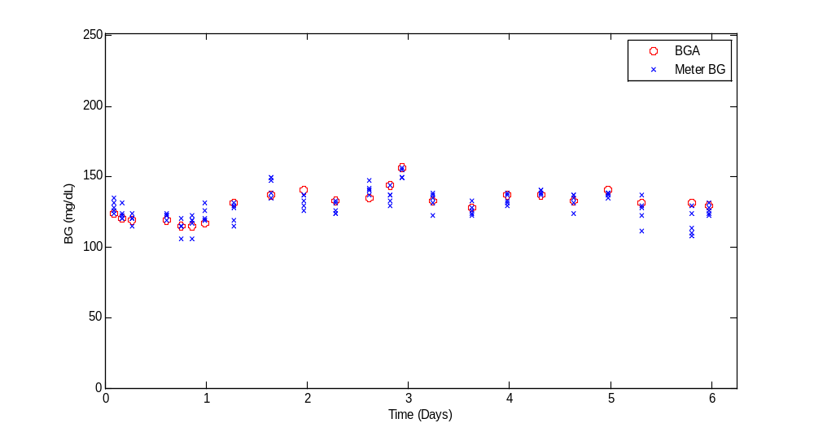
So what about glucometers?
“Everyone knows” they are just not up to the job..
For each calibration BG (arterial blood gas) there are 5 measurements from glucose meters
The glucometer used was the Optium Xceed (Abbott Diabetes Care)
An example of the relative spread of measurements for that one same patient!

Slide 26
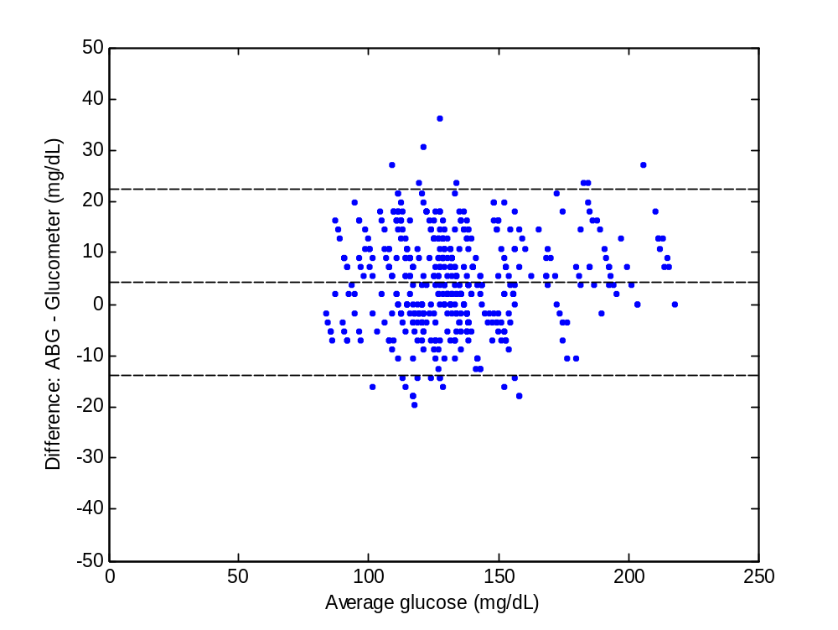
So what about glucometers?
From the 557 measurements over all patients so far collected (mean + 95% CI):
+/- 10 mg/dL has ~65% of data
  σ+1.96SD
  σ-1.96SD
Small bias likely due lognormal distribution, median is around 0

Slide 27
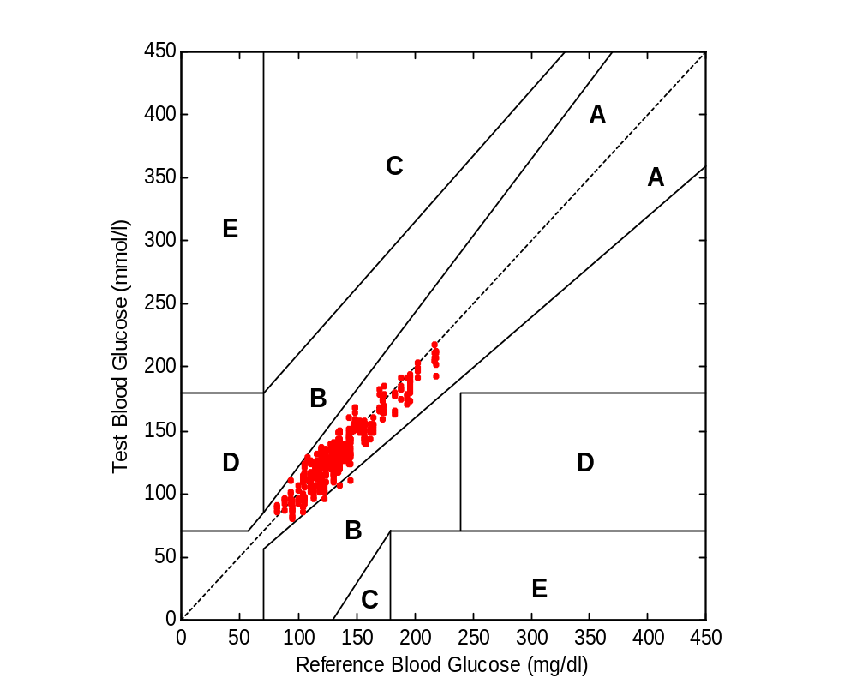
So what about glucometers?
From the 557 measurements we have collected so far:
Clarke error grid
Zone A | 99.3%
Zone B | 0.7%
Zone C | 0
Zone D | 0
Zone E | 0
  This is very different than some recent opinions...!!
  Note that it is central line blood
  One could adequately provide very good control with these measurements and a protocol that understood the sensor errors

Slide 28
Summary
The closed loop already exists, the questions about an automated closed loop really revolve around the quality of sensor measurements that are automated (i.e. CGMs)
Takeaways and Major Questions:
CGMs:
  Device calibration can have a significant affect on CGM accuracy (RT better than retro)
  Sensor location can affect CGM output → Thigh tends to report lower than abdomen
  Edema can make monitoring difficult for both the clinical staff and the device
  Agreement between multiple CGMs can change over time
    We are not sure of the root cause(s) yet: sensor vs. patient state
  Sensor artefacts or changes in sensitivity do occur and there could be many causes
Glucometers: a common off the shelf glucose meter appears to be accurate enough for use with GC protocols and much more accurate than some might believe
Overall: An automated closed loop is readily achievable, but perhaps not quite there yet.
The BIG question: automated closed loop is possible, but, is it necessary? There are technology solutions, but, the question itself is one about clinical practice, culture and workflow, and not one that technology itself answers.

Slide 29

Questions and Thank You for Listening

Slide 30
Clinical Takeaways
Clinical Takeaways:
Glucometers appear relatively reliable
There is some variability in CGM based on edema and location
Currently, the best use for CGMs would appear to be for alarms and specifying needs for measurement (“guard rails” on the control)

