Slide 1



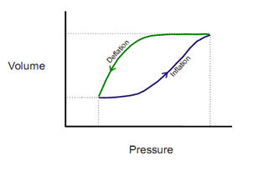
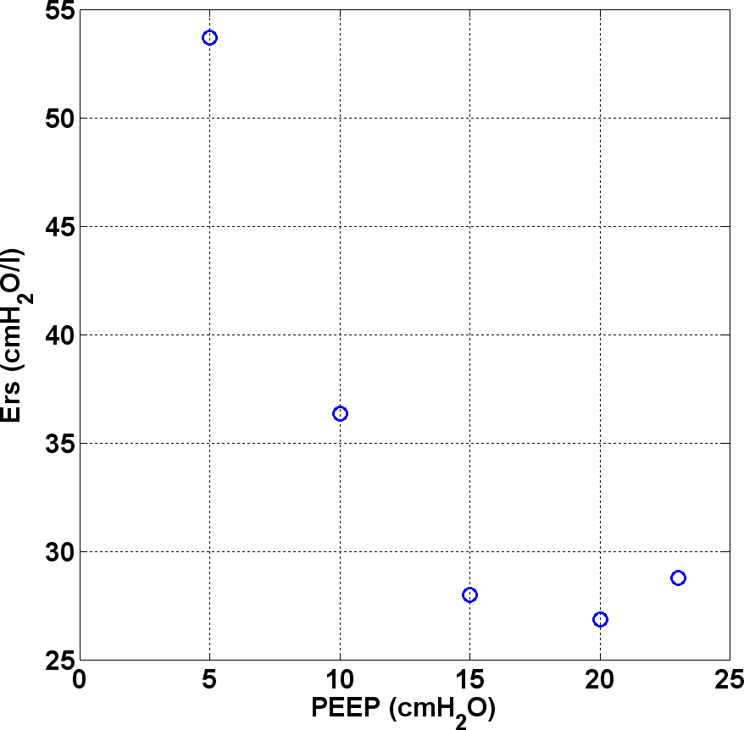
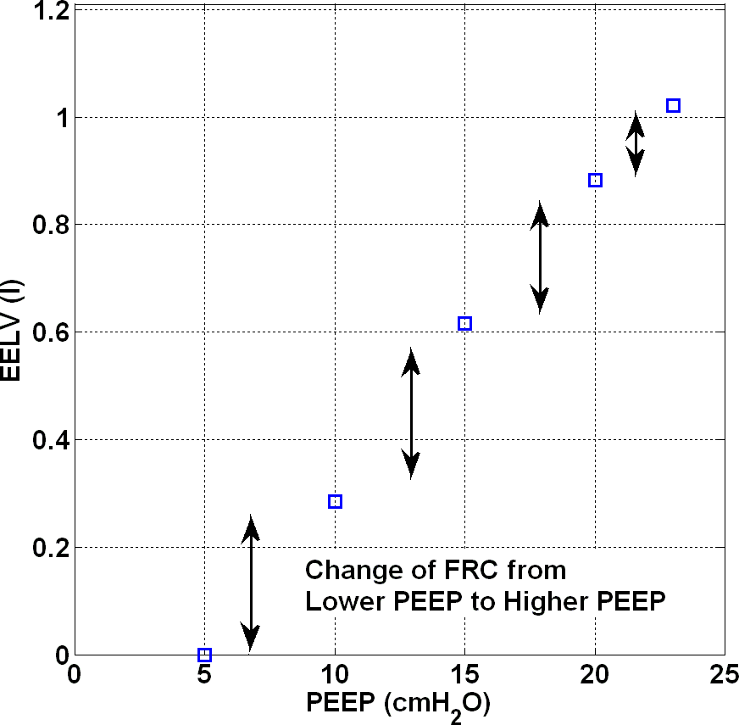
Respiratory System Elastance Monitoring during PEEP Titration
Yeong Shiong Chiew¹; J Geoffrey Chase¹; Geoffrey M Shaw^{1,2}; Thomas Desaive³
¹Mechanical Engineering, University of Canterbury, New Zealand
²Intensive Care Unit, Christchurch Hospital, New Zealand
³Hemodynamic Research Center, University of Liege, Belgium
Introduction
PEEP selection during mechanical ventilation (MV) for patients with acute lung injury (ALI) and acute respiratory distress syndrome (ARDS) remains a challenge for clinicians. Clinicians often rely on experience and intuition in setting MV, resulting in a more variable treatment and outcome.
We hypotheses that, monitoring patient-specific respiratory system elastance (Ers) during PEEP change may provide an insight to patients’ condition and thus, optimise PEEP selection
Methods
13 patients diagnosed with ALI/ARDS were eligible for the studies.
Patients were sedated and ventilated under volume control (Vt ~ 400-600ml) in SIMV model.
The patients underwent a step-wise PEEP increase (Steps of 5cmH2O) recruitment manoeuvre (RM) until peak airway pressure reaches 45cmH2O.
Continuous airway pressure and flow during RM were recorded using a pneumotachometer.
The change of patient’s respiratory system elastance (Ers=1/compliance) and end of expiratory lung volume (EELV) during RM were estimated and studied.
The trials were approved by New Zealand South Island Regional Ethics Committee.
Results and Discussion
Median [IQR] Ers over all patients was 34.0cmH2O/l [26.1-51.0], reflecting the heterogeneity of the patients and their response to PEEP. This outcome supports the idea that MV/PEEP should be individualised. During RM, patients’ Ers decreased with PEEP increase until a specific minimum and increase later at higher PEEP. The decreased of Ers suggest alveolar recruitment whereas increase of Ers at higher PEEP shows potential over-inflation.
An example is shown in Figure (a). A clear inflection/ minimum Ers can be found in (a) (Inflection around 15cmH2O) and minimum at PEEP 20cmH2O). This indicates a potential method to optimise PEEP selection for particular patient in terms of maximising recruitment and avoid overstretching. Figure (b) shows the change of same patient’s EELV with PEEP increase. As PEEP increases, the potentially recruitable collapsed lung decreases. The change of EELV at higher PEEP are lower comparatively, suggesting less alveoli can be recruited
(a)
(b)
Figure: Ers and EELV change with PEEP increase
Conclusion
The change of patient-specific Ers and EELV during minimally invasive PEEP titration provides an insight to the patient’s lung condition, thus could potentially be used as a method to individualise MV treatment and in particular, PEEP selection.

