Slide 1
LENS Cards
Perspective
LENS
Look at the facts through your unique LENS and think about how this perspective would connect the facts and what else it would know about them.
SCIENCE

Slide 2
LENS Cards
Perspective
LENS
Look at the facts through your unique LENS and think about how this perspective would connect the facts and what else it would know about them.
GEOPOLITICS

Slide 3
LENS Cards
Perspective
LENS
Look at the facts through your unique LENS and think about how this perspective would connect the facts and what else it would know about them.
COMMERCIAL
INTERESTS

Slide 4
LENS Cards
Perspective
LENS
Look at the facts through your unique LENS and think about how this perspective would connect the facts and what else it would know about them.
OPERATIONS/ LOGISTICS

Slide 5
LENS Cards
Perspective
LENS
Look at the facts through your unique LENS and think about how this perspective would connect the facts and what else it would know about them.
THE PUBLIC

Slide 6
LENS Cards
Perspective
LENS
Look at the facts through your unique LENS and think about how this perspective would connect the facts and what else it would know about them.
LENS
Look at the facts through your unique LENS and think about how this perspective would connect the facts and what else it would know about them.
LENS
Look at the facts through your unique LENS and think about how this perspective would connect the facts and what else it would know about them.
SCIENCE
GEOPOLITICS
COMMERCIAL
INTERESTS
Notes:
Less paper but requires manual separation (cutting).

Slide 7
LENS Cards
Perspective
LENS
Look at the facts through your unique LENS and think about how this perspective would connect the facts and what else it would know about them.
LENS
Look at the facts through your unique LENS and think about how this perspective would connect the facts and what else it would know about them.
OPERATIONS/ LOGISTICS
THE PUBLIC
Notes:
Less paper but requires manual separation (cutting).

Slide 8
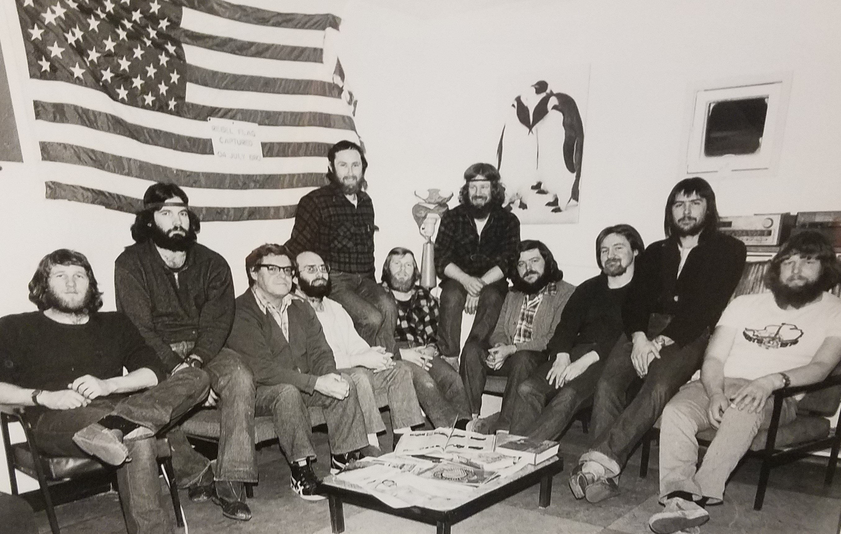
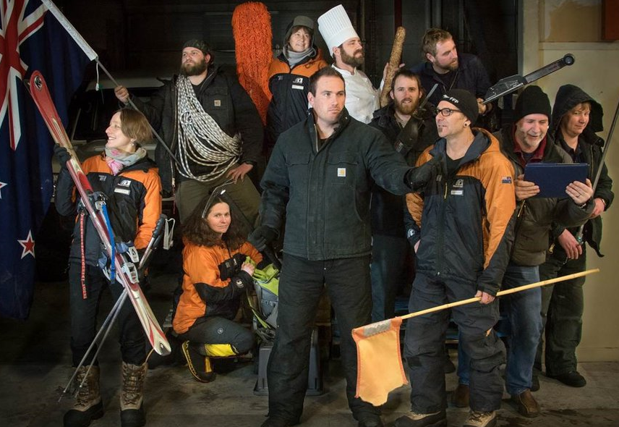
FACT Cards
category: DEMOGRAPHICS
DEMOGRAPHICS
T H E P A S T
WINTER 1980
33 stations
12 countries
~
Scott Base population 11
11 men, 0 women, 0 other
DEMOGRAPHICS
T H E P R E S E N T
WINTER 2019
42 stations
20 countries
~
Scott Base population 11
8 men, 3 women, 0 other
Side A
Side B
Side A photo source: Scott Base, Antarctica, 1980 Winterover crew
Side B photo source: adam.antarcticanz.govt.nz, 2015-2016 Winterover Crew, photographer: Anthony Powell
Base & Country numbers derived from https://en.wikipedia.org/wiki/Research_stations_in_Antarctica
Population numbers derived from photos.
Note: 2019 Statistics are mockups; base/countries are from 2014, and population from 2015-16.
Notes:
Same as the separate cards section, just paired with the relevant CHALLENGE card immediately after.

Slide 9
CHALLENGE Cards
DEMOGRAPHICS
DEMOGRAPHICS
T H E F U T U R E
WINTER 2049
Stations ?
Countries ?
~
Scott Base population: unknown
?

Slide 10
FACT Cards
category: DEMOGRAPHICS
DEMOGRAPHICS
T H E P A S T
WINTER 1980
SCOTT BASE
ROLES:
Science: 20%
Crew: 80%
Artists: 0%
Other: 0%
DEMOGRAPHICS
T H E P R E S E N T
WINTER 2019
SCOTT BASE
ROLES:
Science: 20%
Crew: 80%
Artists: 0%
Other: 0%
Side A
Side B
Fact details are mockups.
Notes:
Same as the separate cards section, just paired with the relevant CHALLENGE card immediately after.

Slide 11
CHALLENGE Cards
DEMOGRAPHICS
DEMOGRAPHICS
T H E F U T U R E
WINTER 2039
SCOTT BASE
ROLES:
Science: ? %
Crew: ? %
Artists: ? %
Other: ? %
?

Slide 12
FACT Cards
category: ECOLOGICAL PROCESSES
ECOLOGY
T H E P A S T
1979
PENGUIN POPULATIONS
~
Gentoo: 200,000
Chinstrap: 3,000,000
Adelie: 1,800,000
Emperor: 600,000
ECOLOGY
T H E P R E S E N T
2019
PENGUIN POPULATIONS
~
Gentoo: 400,000
Chinstrap: 2,000,000
Adelie: 2,150,000
Emperor: 400,000
Side A
Side B
Fact details are mockups.
Notes:
Same as the separate cards section, just paired with the relevant CHALLENGE card immediately after.

Slide 13
CHALLENGE Cards
ECOLOGICAL PROCESSES
ECOLOGY
T H E F U T U R E
2039
PENGUIN POPULATIONS
~
Gentoo: ?
Chinstrap: ?
Adelie: ?
Emperor: ?
?

Slide 14
FACT Cards
category: ECONOMICS
ECONOMICS
T H E P A S T
1979
Tourism Value $0
~
Primary Mode n/a
Avg Length of Stay: 0 days
ECONOMICS
T H E P R E S E N T
2019
Tourism Value $15M
~
Primary Mode: Cruise Ships
Avg Length of Stay 3 days
Side A
Side B
Fact details are mockups.
Notes:
Same as the separate cards section, just paired with the relevant CHALLENGE card immediately after.

Slide 15
CHALLENGE Cards
ECONOMICS
ECONOMICS
T H E F U T U R E
2039
Tourism Value Per Year ?
~
Primary Mode ?
Avg Length of Stay: ?
?

Slide 16
FACT Cards
category: ECONOMICS
ECONOMICS
T H E P A S T
1979
BIOPROSPECTING
Pending Krill Patents 0
ECONOMICS
T H E P R E S E N T
2019
BIOPROSPECTING
Pending Krill Patents 1000
Side A
Side B
Fact details are mockups.
Notes:
Same as the separate cards section, just paired with the relevant CHALLENGE card immediately after.

Slide 17
CHALLENGE Cards
ECONOMICS
ECONOMICS
T H E F U T U R E
2039
BIOPROSPECTING
Pending Patents ?
# of Species of Interest ?
?

Slide 18
FACT Cards
category: POLICIES
POLICIES
T H E P A S T
1979
GLOBAL
The Antarctic Treaty
POLICIES
T H E P R E S E N T
2019
GLOBAL
The Antarctic Treaty + Annexes
Madrid Protocol
CCAMLR
CCAS
Side A
Side B
Fact details are mockups.
Notes:
Same as the separate cards section, just paired with the relevant CHALLENGE card immediately after.

Slide 19
CHALLENGE Cards
POLICIES
POLICIES
T H E F U T U R E
2039
GLOBAL?
REGIONAL?
New?
Old?
?

Slide 20
FACT Cards
category: SOCIETAL
SOCIETAL
T H E P A S T
1979
ARTS & MEDIA:
Prose
Poetry
Photography
Film: Documentary & Animated
Paintings + Illustrations
Comic Books
SOCIETAL
T H E P R E S E N T
2019
ARTS & MEDIA:
Prose, Poetry
Photography
Film & Video: Narrative, Documentary, & Animated
Paintings + Illustrations
Comic Books
TV Series
Theatre, Musicals
Computer Games
Side A
Side B
Fact details are mockups.
Notes:
Same as the separate cards section, just paired with the relevant CHALLENGE card immediately after.

Slide 21
CHALLENGE Cards
SOCIETAL
SOCIETAL
T H E F U T U R E
2039
TYPES OF ART & MEDIA ?
?

Slide 22
FACT Cards
category: TECHNOLOGY
TECHNOLOGY
T H E P A S T
1979
COMMUNICATIONS:
Radio,
Snail Mail,
Voice via Satellite Uplink
TECHNOLOGY
T H E P R E S E N T
2019
COMMUNICATIONS:
Radio,
Snail Mail,
Satellite Phones
Satellite Internet
Email
Social Media
Side A
Side B
Fact details are mockups.
Notes:
Same as the separate cards section, just paired with the relevant CHALLENGE card immediately after.

Slide 23
CHALLENGE Cards
TECHNOLOGY
TECHNOLOGY
T H E F U T U R E
2039
Modes of Communication ?
?

Slide 24
FACT Cards
category: TECHNOLOGY
TECHNOLOGY
T H E P A S T
1979
TRANSPORTATION:
INTERCONTINENTAL
Ships
Airplanes
ON ICE
Hagglund
Skidoos, Helis
Sleds – Dog & Human
Skiis
TECHNOLOGY
T H E P R E S E N T
2019
TRANSPORTATION:
INTERCONTINENTAL
Ships
Airplanes
ON ICE
Hagglund, Buses
Skidoos, Helis
Sleds – Human
Skiis
Side A
Side B
Fact details are mockups.
Notes:
Same as the separate cards section, just paired with the relevant CHALLENGE card immediately after.

Slide 25
CHALLENGE Cards
TECHNOLOGY
TECHNOLOGY
T H E F U T U R E
2039
TRANSPORTATION
INTERCONTINENTAL ?
ON ICE ?
Land, Air, Sea
?

Slide 26
FACT Cards
category: SCIENCE
SCIENCE
T H E P A S T
1979
Glacialogy
Weather
Atmospherics
Zoology: Terrestrial & Marine Fauna
Physics
Social Science
SCIENCE
T H E P R E S E N T
2019
Glacialogy
Weather
Atmospherics
Climate Change
Zoology: Terrestrial & Marine Fauna
Physics
Astronomy
Social Science
Ecosystems
Side A
Side B
Fact details are mockups.
Notes:
Same as the separate cards section, just paired with the relevant CHALLENGE card immediately after.

Slide 27
CHALLENGE Cards
SCIENCE
SCIENCE
T H E F U T U R E
2039
Types of Research and/or Other Priorities ?
?

Slide 28
FACT Cards
category: DEMOGRAPHICS
DEMOGRAPHICS
40 YEARS BACK
1979 WINTER 2019
33 stations 42 stations
12 countries 20 countries
11 Scott Base population 11
11 men, 0 women, 0 other 8 men, 3 women, 0 other
DEMOGRAPHICS
T H E P R E S E N T
WINTER 2019
42 stations
20 countries
~
Scott Base population 11
8 men, 3 women, 0 other
Side A
alternative coupling: FACT+CHALLENGE combined card
Notes:
Alternative to having pairs of separate FACT and CHALLENGE cards.

Slide 29
CHALLENGE Cards
DEMOGRAPHICS
DEMOGRAPHICS
20 YEARS FORWARD
WINTER 2039
Stations ?
Countries ?
~
Scott Base population: unknown
Side B
?
alternative coupling: FACT+CHALLENGE combined card
Notes:
Alternative to having pairs of separate FACT and CHALLENGE cards.

Slide 30
FACT Cards
category: DEMOGRAPHICS
DEMOGRAPHICS
T H E P A S T
WINTER 1980
33 stations
12 countries
~
Scott Base population 11
11 men, 0 women, 0 other
DEMOGRAPHICS
T H E P R E S E N T
WINTER 2019
42 stations
20 countries
~
Scott Base population 11
8 men, 3 women, 0 other
Side A
Side B
Side A photo source: Scott Base, Antarctica, 1980 Winterover crew
Side B photo source: adam.antarcticanz.govt.nz, 2015-2016 Winterover Crew, photographer: Anthony Powell
Base & Country numbers derived from https://en.wikipedia.org/wiki/Research_stations_in_Antarctica
Population numbers derived from photos.
Note: 2019 Statistics are mockups; base/countries are from 2014, and population from 2015-16.

Slide 31
FACT Cards
category: DEMOGRAPHICS
DEMOGRAPHICS
T H E P A S T
WINTER 1980
SCOTT BASE
ROLES:
Science: 20%
Crew: 80%
Artists: 0%
Other: 0%
DEMOGRAPHICS
T H E P R E S E N T
WINTER 2019
SCOTT BASE
ROLES:
Science: 20%
Crew: 80%
Artists: 0%
Other: 0%
Side A
Side B
Fact details are mockups.

Slide 32
FACT Cards
category: ECONOMICS
ECONOMICS
T H E P A S T
1979
Tourism Value $0
~
Primary Mode n/a
Avg Length of Stay: 0 days
ECONOMICS
T H E P R E S E N T
2019
Tourism Value $15M
~
Primary Mode: Cruise Ships
Avg Length of Stay 3 days
Side A
Side B
Fact details are mockups.

Slide 33
FACT Cards
category: ECONOMICS
ECONOMICS
T H E P A S T
1979
BIOPROSPECTING
Pending Krill Patents 0
ECONOMICS
T H E P R E S E N T
2019
BIOPROSPECTING
Pending Krill Patents 1000
Side A
Side B
Fact details are mockups.

Slide 34
FACT Cards
category: ECOLOGICAL PROCESSES
ECOLOGY
T H E P A S T
1979
PENGUIN POPULATIONS
~
Gentoo: 200,000
Chinstrap: 3,000,000
Adelie: 1,800,000
Emperor: 600,000
ECOLOGY
T H E P R E S E N T
2019
PENGUIN POPULATIONS
~
Gentoo: 400,000
Chinstrap: 2,000,000
Adelie: 2,150,000
Emperor: 400,000
Side A
Side B
Fact details are mockups.

Slide 35
FACT Cards
category: POLICIES
POLICIES
T H E P A S T
1979
GLOBAL
The Antarctic Treaty
POLICIES
T H E P R E S E N T
2019
GLOBAL
The Antarctic Treaty + Annexes
Madrid Protocol
CCAMLR
CCAS
Side A
Side B
Fact details are mockups.

Slide 36
FACT Cards
category: SOCIETAL
SOCIETAL
T H E P A S T
1979
ARTS & MEDIA:
Prose
Poetry
Photography
Film: Documentary & Animated
Paintings + Illustrations
Comic Books
SOCIETAL
T H E P R E S E N T
2019
ARTS & MEDIA:
Prose, Poetry
Photography
Film & Video: Narrative, Documentary, & Animated
Paintings + Illustrations
Comic Books
TV Series
Theatre, Musicals
Computer Games
Side A
Side B
Fact details are mockups.

Slide 37
FACT Cards
category: SCIENCE
SCIENCE
T H E P A S T
1979
Glacialogy
Weather
Atmospherics
Zoology: Terrestrial & Marine Fauna
Physics
Social Science
SCIENCE
T H E P R E S E N T
2019
Glacialogy
Weather
Atmospherics
Climate Change
Zoology: Terrestrial & Marine Fauna
Physics
Astronomy
Social Science
Ecosystems
Side A
Side B
Fact details are mockups.

Slide 38
FACT Cards
category: TECHNOLOGY
TECHNOLOGY
T H E P A S T
1979
COMMUNICATIONS:
Radio,
Snail Mail,
Voice via Satellite Uplink
TECHNOLOGY
T H E P R E S E N T
2019
COMMUNICATIONS:
Radio,
Snail Mail,
Satellite Phones
Satellite Internet
Email
Social Media
Side A
Side B
Fact details are mockups.

Slide 39
FACT Cards
category: TECHNOLOGY
TECHNOLOGY
T H E P A S T
1979
TRANSPORTATION:
INTERCONTINENTAL
Ships
Airplanes
ON ICE
Hagglund
Skidoos, Helis
Sleds – Dog & Human
Skiis
TECHNOLOGY
T H E P R E S E N T
2019
TRANSPORTATION:
INTERCONTINENTAL
Ships
Airplanes
ON ICE
Hagglund, Buses
Skidoos, Helis
Sleds – Human
Skiis
Side A
Side B
Fact details are mockups.

Slide 40
CHALLENGE Cards
DEMOGRAPHICS
DEMOGRAPHICS
T H E F U T U R E
WINTER 2039
Stations ?
Countries ?
~
Scott Base population: unknown
DEMOGRAPHICS
T H E F U T U R E
WINTER 2039
SCOTT BASE
ROLES:
Science: ? %
Crew: ? %
Artists: ? %
Other: ? %
?
?
Notes:
Less paper but requires manual separation (cutting).

Slide 41
CHALLENGE Cards
ECOLOGICAL
ECONOMICS PROCESSES POLICIES
ECONOMICS
T H E F U T U R E
2039
Tourism Value Per Year ?
~
Primary Mode ?
Avg Length of Stay: ?
ECONOMICS
T H E F U T U R E
2039
BIOPROSPECTING
Pending Patents ?
# of Species of Interest ?
ECOLOGY
T H E F U T U R E
2039
PENGUIN POPULATIONS
~
Gentoo: trend?
Chinstrap: trend?
Adelie: trend?
Emperor: trend?
POLICIES
T H E F U T U R E
2039
GLOBAL?
REGIONAL?
New?
Old?
?
?
?
?
Notes:
Less paper but requires manual separation (cutting).

Slide 42
CHALLENGE Cards
TECHNOLOGY SOCIETAL SCIENCE
TECHNOLOGY
T H E F U T U R E
2039
Modes of Communication ?
TECHNOLOGY
T H E F U T U R E
2039
TRANSPORTATION
INTERCONTINENTAL ?
ON ICE ?
Land, Air, Sea
SOCIETAL
T H E F U T U R E
2039
TYPES OF ART & MEDIA ?
SCIENCE
T H E F U T U R E
2039
Types of Research and/or Other Priorities ?
?
?
?
?
Notes:
Less paper but requires manual separation (cutting).

