Slide 1
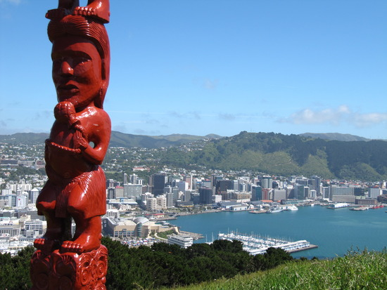
Teaching Māori histories: The New Zealand Tomorrow’s Schools reforms (1984-89) and the New Zealand history (curriculum) wars - 1984-2019
Australasian Association for Research in Education Conference: Educating for a Socially just World. Brisbane, Queensland, December 1-5, 2019.
Dr Richard Manning: University of Canterbury, New Zealand.

Slide 2
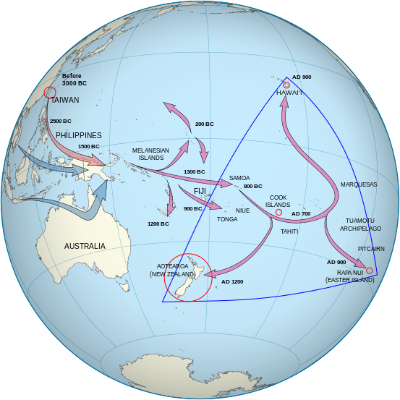
Overview
Setting the scene
Taha Māori or Pākehā capture?
“PC” gone mad?: The 90’s and new millennium mythology of privilege
Tudor Stuart England Day: James Belich (2002); a new NZ curriculum (2007), and the findings of Manning (2009)
A new history curriculum (2010) and the Ōtorohanga College petition (History repeats itself)
Conclusion: Questions that remain unanswered

Slide 3
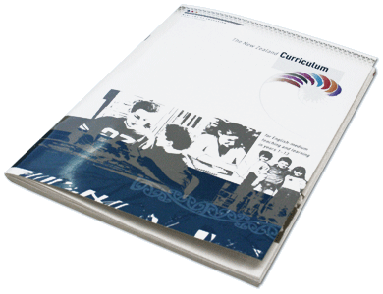
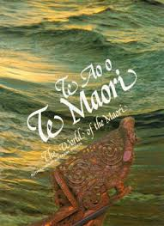
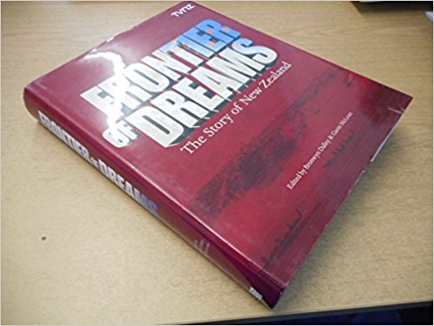
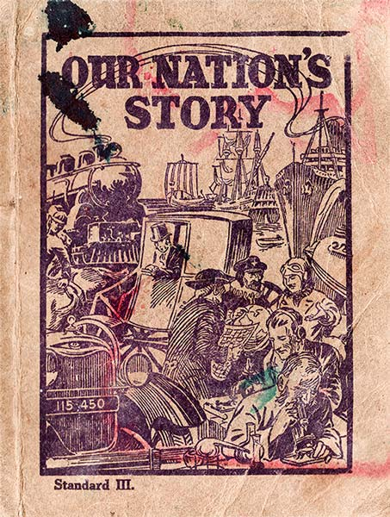
Setting the scene:
The status of Māori histories in schools 1877-1983 (a brief historical overview)
Implications?

Slide 4
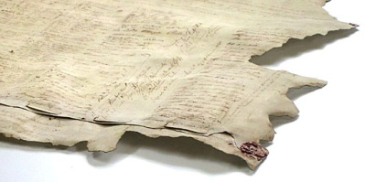
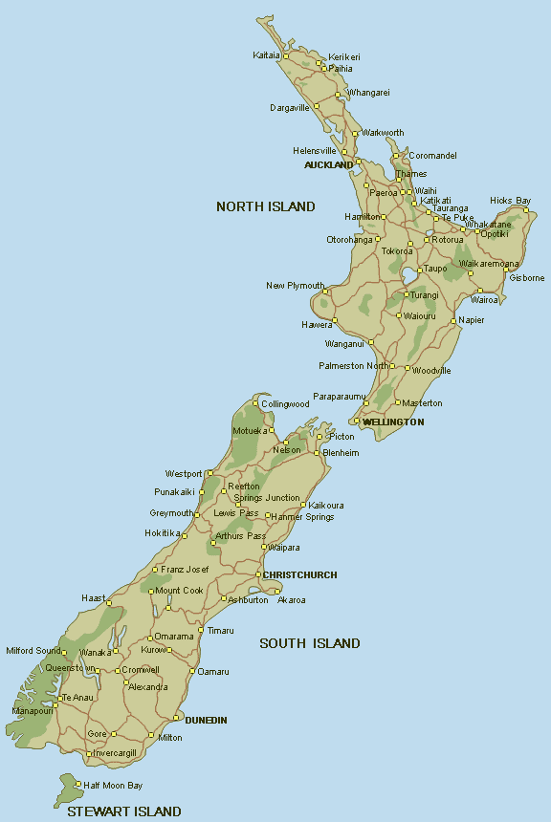
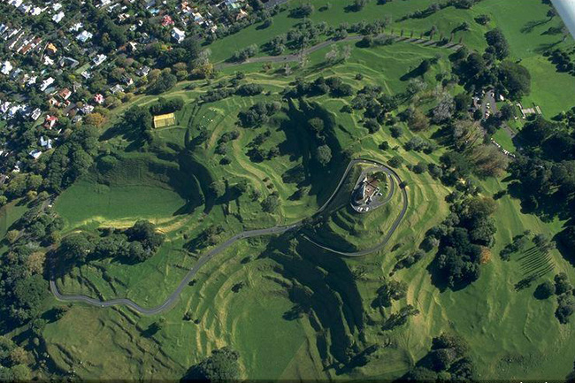
Tomorrow’s Schools: Taha Maōri/Pākehā Capture?
Māori aspirations
The mixed responses of teachers and bureaucrats

Slide 5
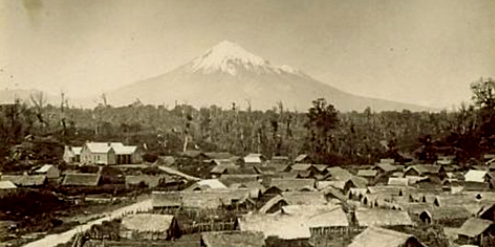
“PC” gone mad?: The ‘new right’ zeitgeist of the 1990s/early 21st Century
Lobbyists
Media commentators
Teachers

Slide 6
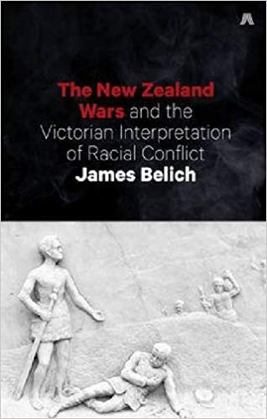
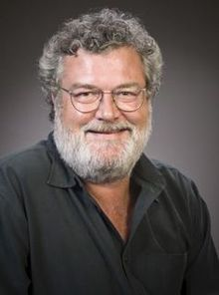
Tudor Stuart England Day (2002), a new NZ Curriculum (2007) and Manning’s doctoral reseach findings (2009):
James Belich’s assertion re. a “national disgrace” (Feb, 2002)
The Ministry of Education responds
The responses of leading teachers of history
The hole in the Ministry’s argument (Manning, 2009)

Slide 7
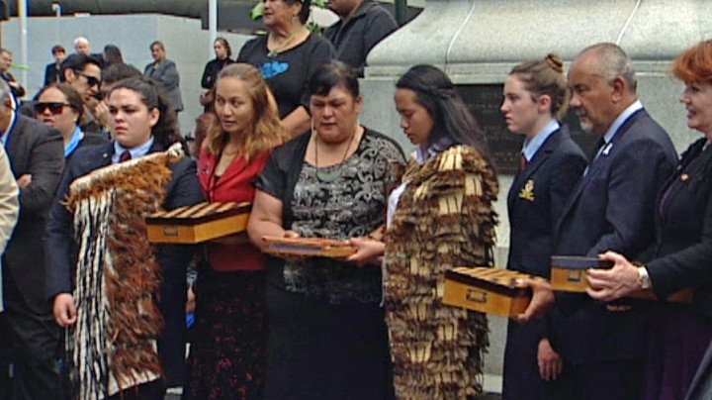
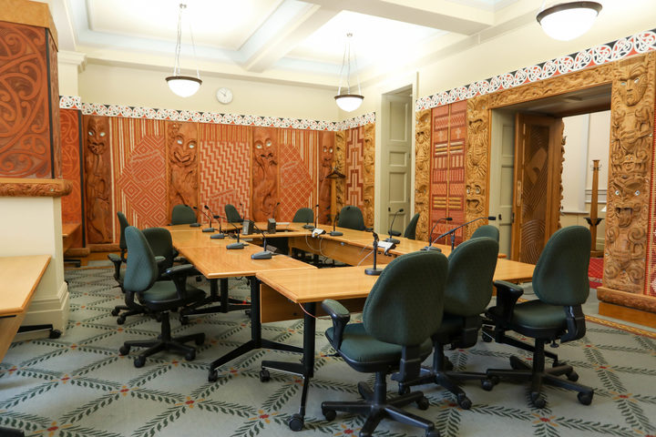
The Ōtorohanga College petition (History repeats itself?):
* The petition and the Government’s response (echoes of Manning, 2009?)
* Māori Affairs Select Committee (2018): Manning & Cooper
* The PM’s announcement2019: A compulsory curriculum (2022-)

Slide 8
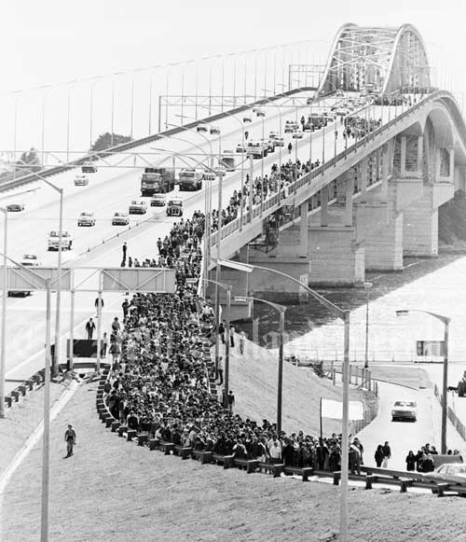
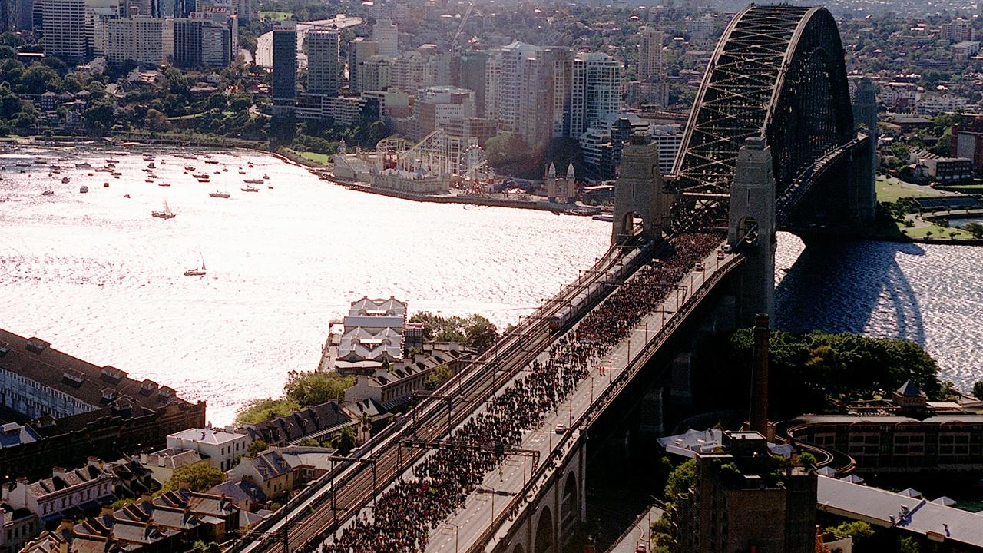
Conclusion: Questions that remain unanswered:
* Questions moving forward on both sides of the Tasman Sea:
(‘Who’, ‘what’, ‘how’, ‘where’ , ‘when’ and why?)

