Slide 1


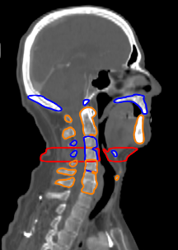
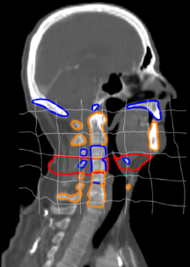
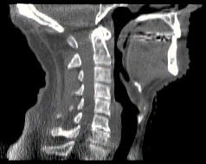
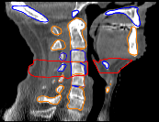
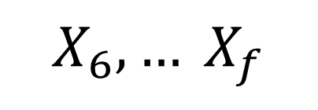
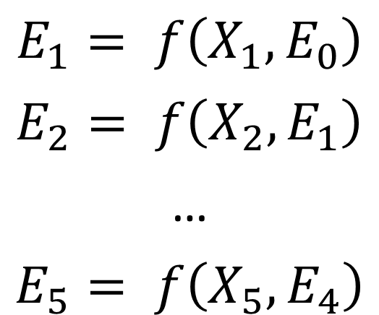

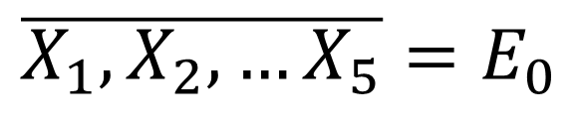
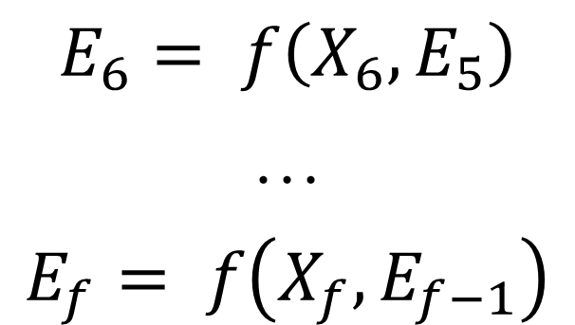
Monitoring anatomical changes of individual patients using statistical process control during head-and-neck radiotherapy
N Lowther^{1,2}, D Hamilton¹, H Kim¹, J Evans¹ S Marsh² and R Louwe¹
¹Wellington Blood and Cancer Centre, Capital & Coast DHB, Wellington, New Zealand
²School of Physical and Chemical Sciences, University of Canterbury, Christchurch, New Zealand
PURPOSE
METHODS AND MATERIALS
Reduced toxicity while maintaining loco-regional control rates have been reported when reducing planning target volume (PTV) margins for head-and-neck radiotherapy (HNRT) [1,2].
However, an individual patient’s positioning reproducibility and deformations must be well controlled to enable safe margin reduction. This retrospective feasibility study investigated the application of deformable image registration (DIR) and Exponentially Weighted Moving Average (EWMA) Statistical Process Control (SPC) charts [3] to monitor and quantify individual patient non-rigid deformations during treatment.
This retrospective study included 12 patients who underwent a planning computed tomography (pCT) and daily on-treatment cone beam computed tomography (CBCT) to verify their positioning. DIR of the pCT-to-CBCTs was performed and metrics detailing the relative position of nine bony anatomy (BA) structures of the head and neck region, the volume of a pre-defined neck region V^{neck} (Fig. 1) and the shrinkage and shift of the parotid glands (PG) were recorded.
The average metrics were used to construct EWMA charts [3]. The EWMA charts were subsequently used to investigate and monitor trends in patient positioning reproducibility and soft tissue changes of various structures (Fig. 2). The 90% confidence limits for both the EWMA trends and the SPC process limits were obtained using a comprehensive uncertainty analysis. These confidence limits were used to confirm whether a trend breached either an SPC limit or an a priori set clinical limit of 2 mm at a previous fraction or not.
Conducted for treatment week 1
$$E_{1}= f\left(X_{1},E_{0}\right)$$
$$E_{2}= f\left(X_{2},E_{1}\right)$$
…
$$E_{5}= f\left(X_{5},E_{4}\right)$$
$$\overline{X_{1},X_{2},…X_{5}}=E_{0}$$
Base of skull
Maxilla
a)
b)
Occipital
Trend monitoring from the start of treatment week 2
$$E_{6}= f\left(X_{6},E_{5}\right)$$
…
$$E_{f}= f\left(X_{f},E_{f−1}\right)$$
C1-C3
Mandible
$$X_{6},… X_{f}$$
C3-C5
c)
d)
$V^{neck}$
Hyoid
Fig 2: Workflow detailing the EWMA statistics monitoring procedure based on DIR. (a) The pCT is deformed to match the anatomical configurations of each CBCT of treatment week 1; (b) Deformed pCT contours propagated to the CBCTs are used to calculate metrics X_{f} for fractions 1-5. The average metric is defined as E₀ and used to calculate the EWMA statistics E₁… E₅; (c-d) At the beginning of treatment week two, propagation of deformed contours and EWMA calculations are conducted on a fraction-by-fraction basis.
C5-C7
Larynx
Fig 1: Definition of BA structures and neck volume V^{neck} in the central sagittal plane. The superior end of the occipital bone contour was defined as to just include the external occipital protuberance.
RESULTS
Trends in patient positioning reproducibility relative to the first week of treatment that were outside SPC process limits before the end of treatment week 4 occurred in 54% of cases. Only 24% of these cases could be confirmed at a 90% confidence level before the end of treatment. Using an a priori clinical limit of 2 mm, absolute changes in patient pose were detected in 39% of cases, of which 82% were confirmed. Soft tissue trends outside SPC process limits occurring before the end of treatment week 4 could be confirmed in 90% of cases.
Fig 3: Example of the EWMA charts used in this study of the mandible deviation for patient 3. (a) DIR derived EWMA chart including uncertainty analysis and corrected for initial deformation E_{0.} The EWMA statistic exceeds the upper process limit at fraction 18, but is not confirmed at the 90% level of confidence before the last fraction; (b) DIR derived EWMA chart including observed E₀ for the purpose of comparing the trend with a 2 mm clinical limit.
CONCLUSIONS
Structure specific action thresholds enabled detection of systematic anatomical changes during the first four weeks of treatment
Investigation of the dosimetric impact of the systematic anatomical changes is needed to show the efficacy of SPC to timely indicate required treatment adaptation
REFERENCES
[1] Navran A, Heemsbergen W, Janssen T, Hamming-Vrieze O, Jonker M, Zuur C, et al. The impact of margin reduction on outcome and toxicity in head and neck cancer patients treated with image-guided volumetric modulated arc therapy (VMAT). Radiother Oncol 2018. doi:10.1016/j.radonc.2018.06.032.
[2] Chen AM, Yu Y, Daly ME, Farwell DG, Benedict SH, Purdy JA. Long-term experience with reduced planning target volume margins and intensity-modulated radiotherapy with daily image-guidance for head and neck cancer. Head Neck 2013;36:1766–72. doi:10.1002/hed.
[3] Borror CM, Montgomery DC, Runger GC. Robustness of the EWMA Control Chart to Non-normality. J Qual Technol 1999;31:309–16. doi:10.1353/dic.2009.0000.

