Slide 1
IR spectroscopy to molecular structure, conformations & bonding
Deborah Crittenden
University of Canterbury

Slide 2
How do H-bonds hold wood together?
1. What is the structure of cellulose?
2. What is the hydrogen bonding pattern in cellulose?
3. What are the relative strengths of the hydrogen bonds?
4. What influence does the surrounding environment have on the strength and bonding patterns of the hydrogen bonds?

Slide 3
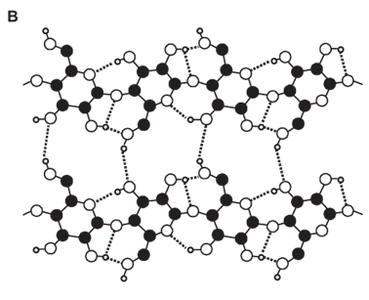
How do H-bonds hold wood together?
1. X-ray crystallography (crystalline cellulose 1b)

Slide 4
How do H-bonds hold wood together?
2. What is the hydrogen bonding pattern in cellulose?
3. What are the relative strengths of the hydrogen bonds?
⟹ IR spectroscopy?

Slide 5
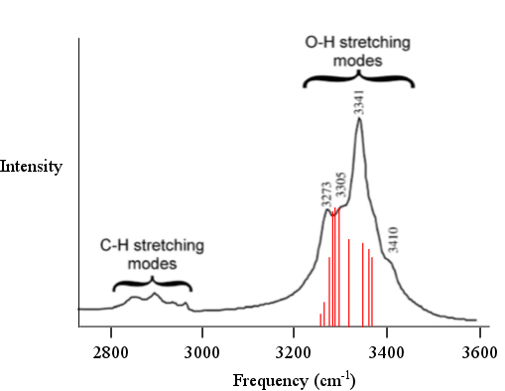
How do H-bonds hold wood together?

Slide 6
Harmonic normal modes
Harmonic approximation – assume energy changes quadratically with displacement along normal modes of vibration
Normal mode approximation – assume that vibrations along each normal mode occur independently of one another
Notes:
1 kJ/mol = 83.593 cm-1
0.01 kJ/mol = 0.8393 cm-1

Slide 7
Harmonic normal modes
Harmonic approximation – assume energy changes quadratically with displacement along normal modes of vibration
Normal mode approximation – assume that vibrations along each normal mode occur independently of one another
Neither of these approximations are valid for O-H bond stretching in cellulose!
Notes:
1 kJ/mol = 83.593 cm-1
0.01 kJ/mol = 0.8393 cm-1

Slide 8
Beyond the normal mode approximation
 | NMode | VSCF | VPT2 | TOSH | VCI
Absolute energies | ✓ | ✓ | ✓ | ✗ | ✓
Transition energies | ✓ | ✓ | ✓ | ✓ | ✓
Captures anharmonicity | ✗ | ✗ | ✓ | ✓ | ✓
Captures mode-mode coupling | ✗ | ✓ | ✓ | ✓ | ✓
Universally applicable | ✓ | ✓ | ✗ | ✓ | ✓
PES description | harmonic | complete | complete | QFF | complete
Maximum accuracy | low | low-med | med-high | med-high | high
Computational cost | low | depends on PES description |  |  | high

Slide 9
Beyond the harmonic approximation
Hard! Requires construction of at least a quartic force field
But… perhaps we can cheat?

Slide 10
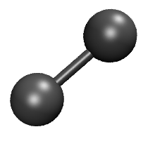
Simple model system
(R-R_{e})²

Slide 11
Simple model system
(R-R_{e})²
(R⁻¹-R_{e}⁻¹)²

Slide 12
Simple model system
(R-R_{e})²
(R⁻¹-R_{e}⁻¹)²

Slide 13
Zero-point energy (H₂, kJ/mol)
Harmonic (R-R_{e})² | 26.32
Quadratic (R⁻¹-R_{e}⁻¹)² | 25.99
Exact | 25.96

Slide 14
0→1 transition energy (H₂, kJ/mol)
Harmonic (R-R_{e})² | 52.65
Quadratic (R⁻¹-R_{e}⁻¹)² | 48.82
Exact | 49.75
Notes:
Shifted quartic & exact results agree to within 0.4 kJ/mol (some fortuitous cancellation of errors there but that’s OK). 0.4 kJ/mol ~ 35 cm-1.
For higher accuracy, can look at taking larger steps along NM coords & interpolating. But this is a pretty good start.

Slide 15
Simple model system

Slide 16
Zero-point energy (H₂, kJ/mol)
Harmonic (R-R_{e})² | 26.32
~ Quartic (R-R_{e})⁴ | 26.34
~ Sextic (R-R_{e})⁶ | 26.07
~ Octic (R-R_{e})⁸ | 26.01
~ Decic (R-R_{e})¹⁰ | 26.00
Quadratic (R⁻¹-R_{e}⁻¹)² | 25.99
Exact | 25.96

Slide 17
0→1 transition energy (H₂, kJ/mol)
Harmonic (R-R_{e})² | 52.65
~ Quartic (R-R_{e})⁴ | 52.02
~ Sextic (R-R_{e})⁶ | 49.90
~ Octic (R-R_{e})⁸ | 49.18
~ Decic (R-R_{e})¹⁰ | 48.95
Quadratic (R⁻¹-R_{e}⁻¹)² | 48.82
Exact | 49.75
Notes:
Shifted quartic & exact results agree to within 0.4 kJ/mol (some fortuitous cancellation of errors there but that’s OK). 0.4 kJ/mol ~ 35 cm-1.
For higher accuracy, can look at taking larger steps along NM coords & interpolating. But this is a pretty good start.

Slide 18
But…
Transforming coordinates to get 10th order derivatives is tedious
Wavefunction shifts to longer R due to anharmonicity
Expanding inverse bondlength surface about R₀ may help (R₀ = R_{e} + R_{off})
R_{off} ∝ d³V/dR³, n

Slide 19
Simple model system

Slide 20
Simple model system

Slide 21
Zero-point energy (H₂, kJ/mol)
Harmonic (R-R_{e})² | 26.32
~ Quartic (R-R_{e})⁴ | 26.34 | 26.01
~ Sextic (R-R_{e})⁶ | 26.07 | 26.00
~ Octic (R-R_{e})⁸ | 26.01 | 25.99
~ Decic (R-R_{e})¹⁰ | 26.00 | 25.99
Quadratic (R⁻¹-R_{e}⁻¹)² | 25.99
Exact | 25.96

Slide 22
0→1 transition energy (H₂, kJ/mol)
Harmonic (R-R_{e})² | 52.65
~ Quartic (R-R_{e})⁴ | 52.02 | 49.35
~ Sextic (R-R_{e})⁶ | 49.90 | 49.08
~ Octic (R-R_{e})⁸ | 49.18 | 48.95
~ Decic (R-R_{e})¹⁰ | 48.95 | 48.92
Quadratic (R⁻¹-R_{e}⁻¹)² | 48.82
Exact | 49.75
Notes:
Shifted quartic & exact results agree to within 0.4 kJ/mol (some fortuitous cancellation of errors there but that’s OK). 0.4 kJ/mol ~ 35 cm-1.
For higher accuracy, can look at taking larger steps along NM coords & interpolating. But this is a pretty good start.

Slide 23
0→1 transition energy (H₂, cm⁻¹)
Harmonic (R-R_{e})² | 4401
~ Quartic (R-R_{e})⁴ | 4348 | 4126
~ Sextic (R-R_{e})⁶ | 4171 | 4103
~ Octic (R-R_{e})⁸ | 4111 | 4092
~ Decic (R-R_{e})¹⁰ | 4091 | 4089
Quadratic (R⁻¹-R_{e}⁻¹)² | 4081 | 4088
Exact | 4159
Notes:
Shifted quartic & exact results agree to within 0.4 kJ/mol (some fortuitous cancellation of errors there but that’s OK). 0.4 kJ/mol ~ 35 cm-1.
For higher accuracy, can look at taking larger steps along NM coords & interpolating. But this is a pretty good start.

Slide 24
0→1 transition energy (H₂, cm⁻¹)
method | ApproximateQuartic | Approximate Quartic with offset | Exact PES
VPT2 | 3948 | 4075 | 4075
TOSH | 4171 | - | -
VCI | 4348 | 4126 | 4159

Slide 25
Polyatomic molecules
Complete set of all inverse bondlengths
Extract ‘optimal’ nonredundant set (Singular Values Decomposition of Wilson B-matrix – contains partial derivatives of all redundant internal coordinates with respect to Cartesian displacements)
Construct 2nd derivative matrix in inverse bondlength coordinates
Reconstruct exact 2nd and approximate 3rd, 4th derivative matrices in Cartesian coordinates

Slide 26
Water – bond stretch

Slide 27
Water – angle bend

Slide 28
Polyatomic molecules
Inverse bond length coordinates aren’t great for angle bending
Describe angle bending potential as:
(cos θ – cos θ_{e})²
(θ – θ_{e})²

Slide 29
Water – angle bend

Slide 30
Water – angle bend

Slide 31
Summary
PES construction no longer a roadblock to accurate IR frequency calculations
Offset quartic forcefield (automated construction) accurate to within 10s of cm⁻¹
Including out of plane bending & dihedral angle terms challenging but doable
Aim to release code by mid-2014
Notes:
1 kJ/mol = 83.593 cm-1
0.01 kJ/mol = 0.8393 cm-1

Slide 32
Acknowledgements
Marat Sibaev
Dr Clemens Altaner
University of Canterbury Doctoral Scholarships Scheme
Notes:
1 kJ/mol = 83.593 cm-1
0.01 kJ/mol = 0.8393 cm-1

