Slide 1

Development of a computational framework for the prediction of free-ion activities, ionic equilibria and solubility in dairy liquids
Ken Morison & Pariya Noeparvar
Chemical and Process Engineering
University of Canterbury
MADP, September 2017

Slide 2
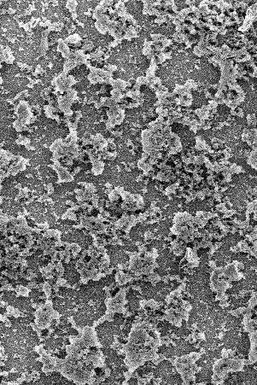
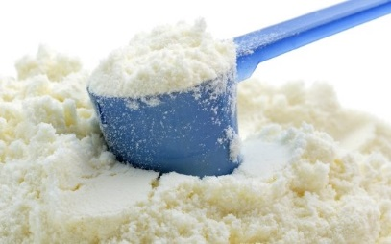
Background
When milk, whey, whey permeate or milk protein concentrates are concentrated, calcium phosphate exceeds the solubility limit.
This leads to fouling, and/or changes in the solubility of the dried products.
Fouling from simulated whey

Slide 3
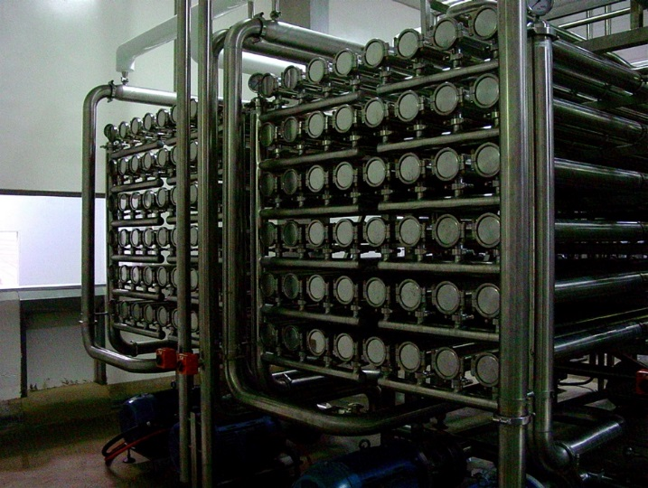
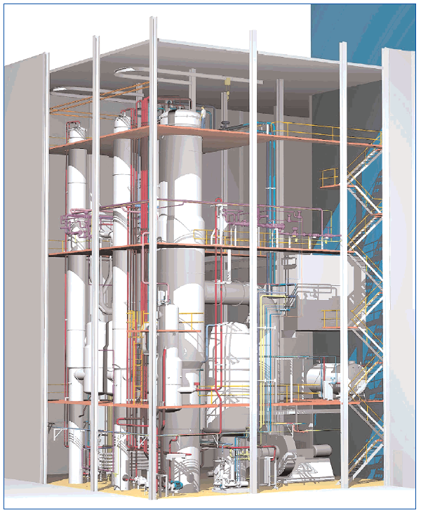
Aim
To develop a robust method for predicting the state of minerals in milk concentrated by reverse osmosis or evaporation
  To develop a robust method for predicting the state of minerals in solution
  To develop a robust method for predicting precipitation and dissolution dynamics

Slide 4
Components of the model
The behaviour of mineral in milk depends on their activity, not on concentration. Any good model needs:
Free ion activity coefficients but without 100’s of parameters
Ion-pair equilibria
Solubility
Precipitation and dissolution dynamics
Numerical methods

Slide 5
Ion Activities
Numerous equations are available.
We require equations suitable for:
  Electrolytes
  Multiple ions (Na⁺, K⁺, Ca²⁺, Mg²⁺, H⁺, Cl⁻, CO₃²⁻, PO₄³⁻, etc)

Slide 6
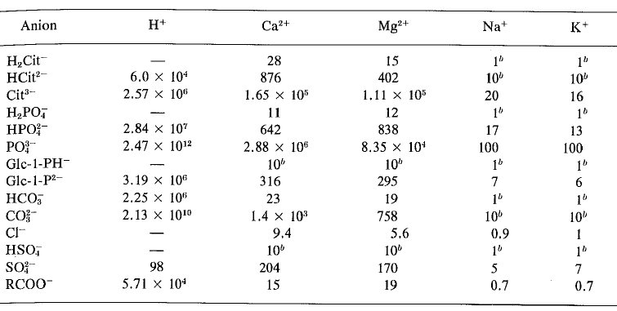
Multiple Ions (Holt, Dalgleish, Jenness, 1981)
Equilibrium association/dissociation constants, K_{a} are available

Slide 7
Ion Activities
Numerous equations are available.
We require equations suitable for:
  Electrolytes
  Multiple ions (Na⁺, K⁺, Ca²⁺, Mg²⁺, H⁺, Cl⁻, CO₃²⁻, PO₄³⁻, etc)
  Free ions and ion pairs (e.g. CaCl⁺, CaCit⁻ )
  High concentrations (concentrated milk, whey, permeate)
  Lactose (non-electrolyte)

Slide 8
Ion Activities
Numerous equations are available.
We require equations suitable for:
  Electrolytes
  Multiple ions (Na⁺, K⁺, Ca²⁺, Mg²⁺, H⁺, Cl⁻, CO₃²⁻, PO₄³⁻, etc)
  Free ions and ion pairs (e.g. CaCl⁺, CaCit⁻)
  High concentrations (concentrated milk, whey, permeate)
  Lactose (non-electrolyte)
Options
  Debye-Hückel, Extended Debye-Hückel, Davies,
  Non-Primitive Mean Spherical Approximation, MSA (Blum), Unrestricted Primitive MSA, etc.

Slide 9
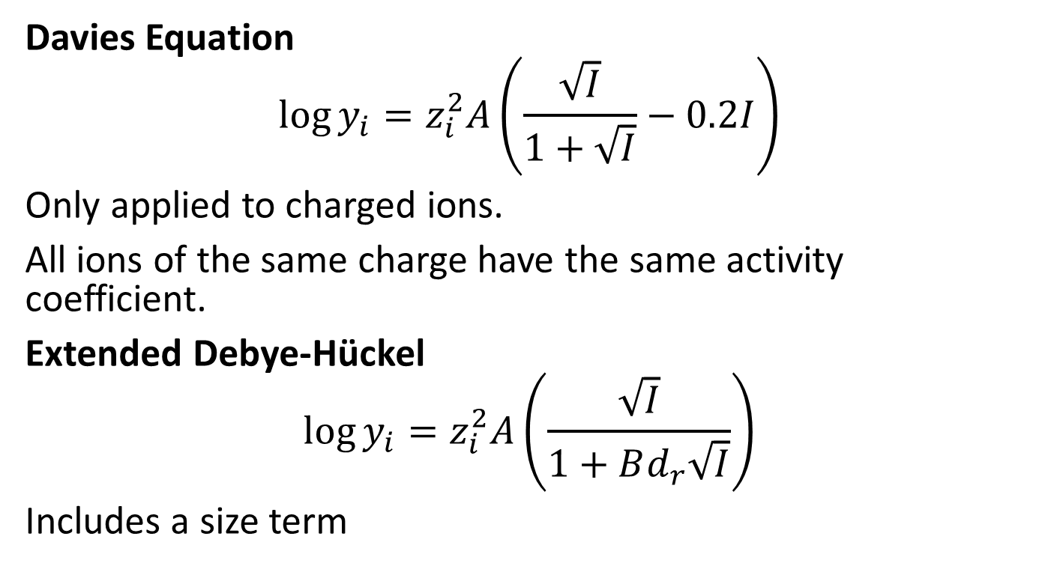
Davies Equation
Davies Equation
$$\log{y_{i}}=z_{i}^{2}A\left(\frac{\sqrt{I}}{1+\sqrt{I}}−0.2I\right)$$
Only applied to charged ions.
All ions of the same charge have the same activity coefficient.
Extended Debye-Hückel
$$\log{y_{i}}=z_{i}^{2}A\left(\frac{\sqrt{I}}{1+Bd_{r}\sqrt{I}}\right)$$
Includes a size term

Slide 10
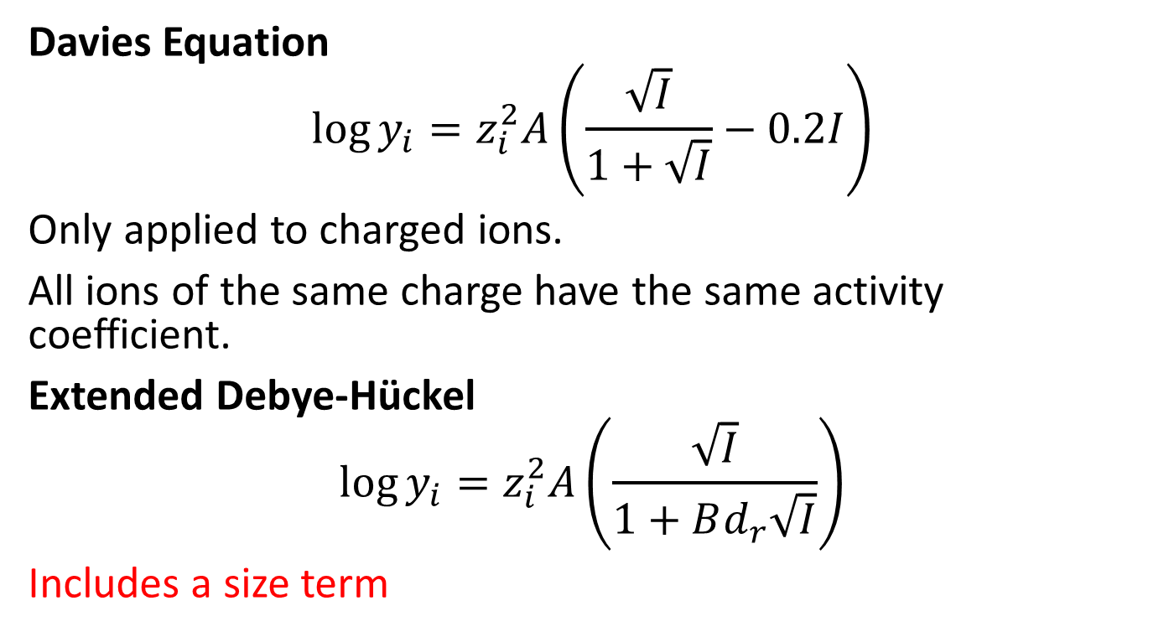
Davies Equation
Davies Equation
$$\log{y_{i}}=z_{i}^{2}A\left(\frac{\sqrt{I}}{1+\sqrt{I}}−0.2I\right)$$
Only applied to charged ions.
All ions of the same charge have the same activity coefficient.
Extended Debye-Hückel
$$\log{y_{i}}=z_{i}^{2}A\left(\frac{\sqrt{I}}{1+Bd_{r}\sqrt{I}}\right)$$
Includes a size term

Slide 11
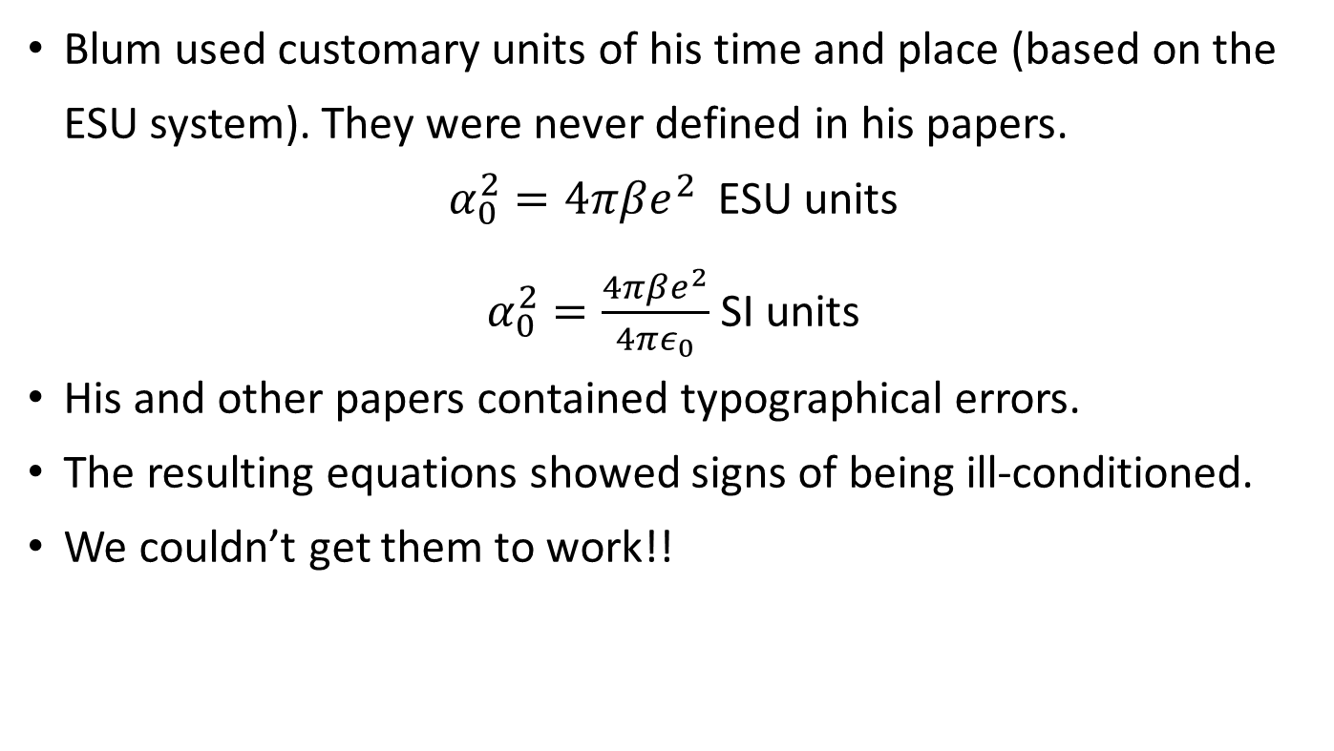
Blum and co-workers:
Primitive MSA model
Blum used customary units of his time and place (based on the ESU system). They were never defined in his papers.
$α_{0}^{2}=4πβe^{2}$ESU units
$α_{0}^{2}=\frac{4πβe^{2}}{4πε_{0}}$ SI units
His and other papers contained typographical errors.
The resulting equations showed signs of being ill-conditioned.
We couldn’t get them to work!!

Slide 12
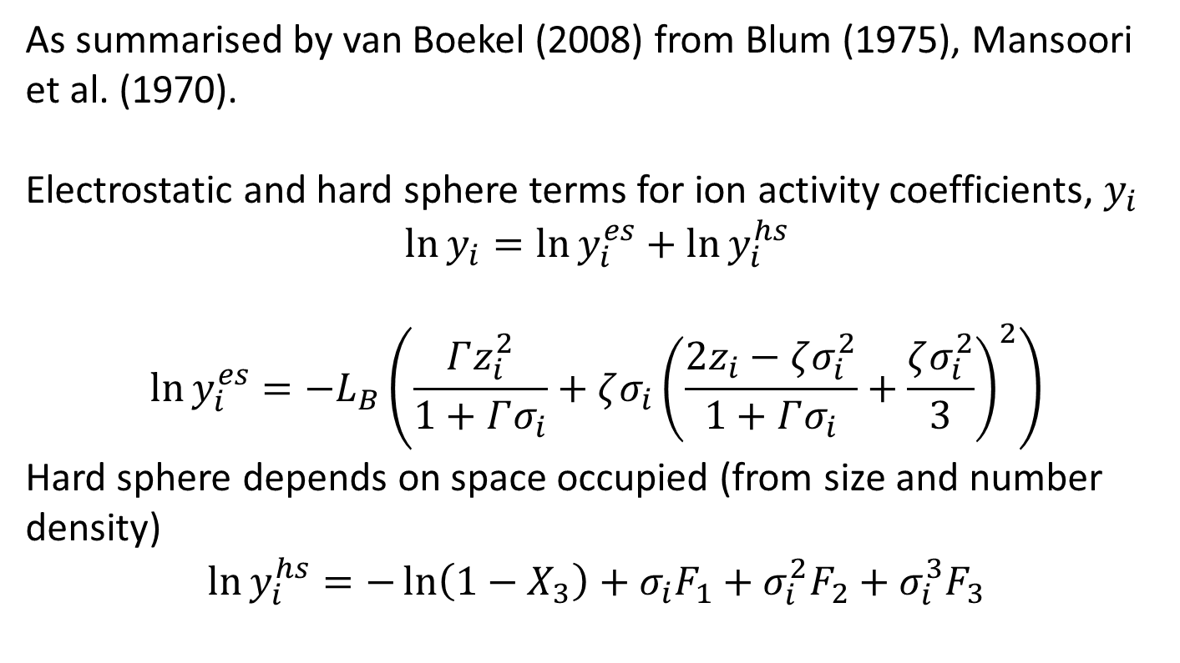
Mean Spherical Approximation Ion Activities
As summarised by van Boekel (2008) from Blum (1975), Mansoori et al. (1970).
Electrostatic and hard sphere terms for ion activity coefficients, $y_{i}$
$$\ln{y_{i}}=\ln{y_{i}^{es}}+\ln{y_{i}^{hs}}$$
$$\ln{y_{i}^{es}}=−L_{B}\left(\frac{Γz_{i}^{2}}{1+Γσ_{i}}+ζσ_{i}{\left(\frac{2z_{i}−ζσ_{i}^{2}}{1+Γσ_{i}}+\frac{ζσ_{i}^{2}}{3}\right)}^{2}\right)$$
Hard sphere depends on space occupied (from size and number density)
$$\ln{y_{i}^{hs}}=−\ln\left(1−X_{3}\right)+σ_{i}F_{1}+σ_{i}^{2}F_{2}+σ_{i}^{3}F_{3}$$

Slide 13
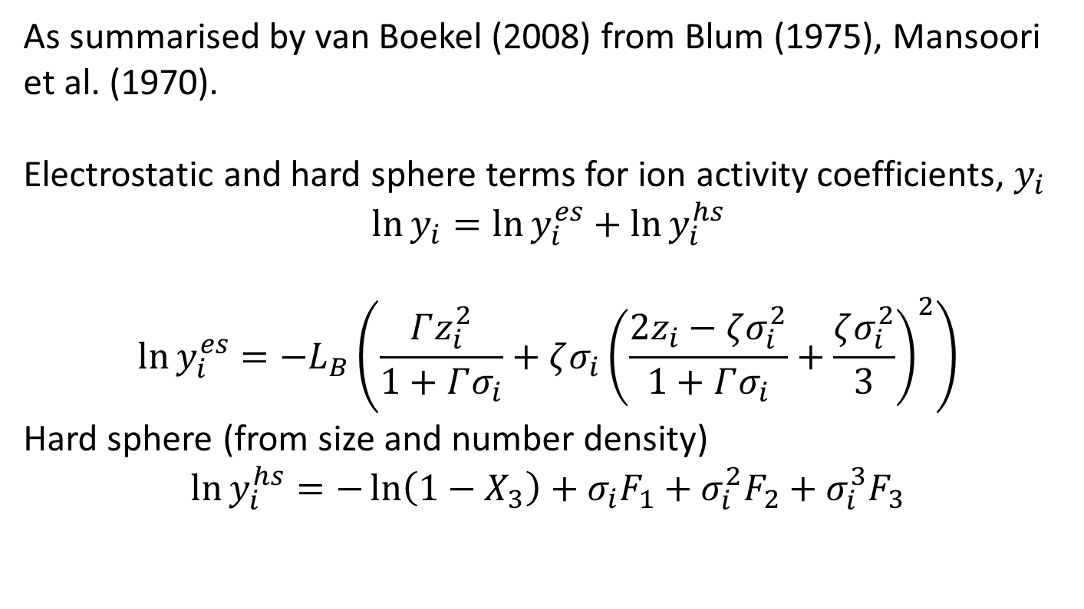
MSA Ion Activities
Important for high concentrations and the contribution of non-electrolytes, e.g., lactose.
As summarised by van Boekel (2008) from Blum (1975), Mansoori et al. (1970).
Electrostatic and hard sphere terms for ion activity coefficients, $y_{i}$
$$\ln{y_{i}}=\ln{y_{i}^{es}}+\ln{y_{i}^{hs}}$$
$$\ln{y_{i}^{es}}=−L_{B}\left(\frac{Γz_{i}^{2}}{1+Γσ_{i}}+ζσ_{i}{\left(\frac{2z_{i}−ζσ_{i}^{2}}{1+Γσ_{i}}+\frac{ζσ_{i}^{2}}{3}\right)}^{2}\right)$$
Hard sphere (from size and number density)
$$\ln{y_{i}^{hs}}=−\ln\left(1−X_{3}\right)+σ_{i}F_{1}+σ_{i}^{2}F_{2}+σ_{i}^{3}F_{3}$$
Diameter is only fitting parameter for each ion

Slide 14
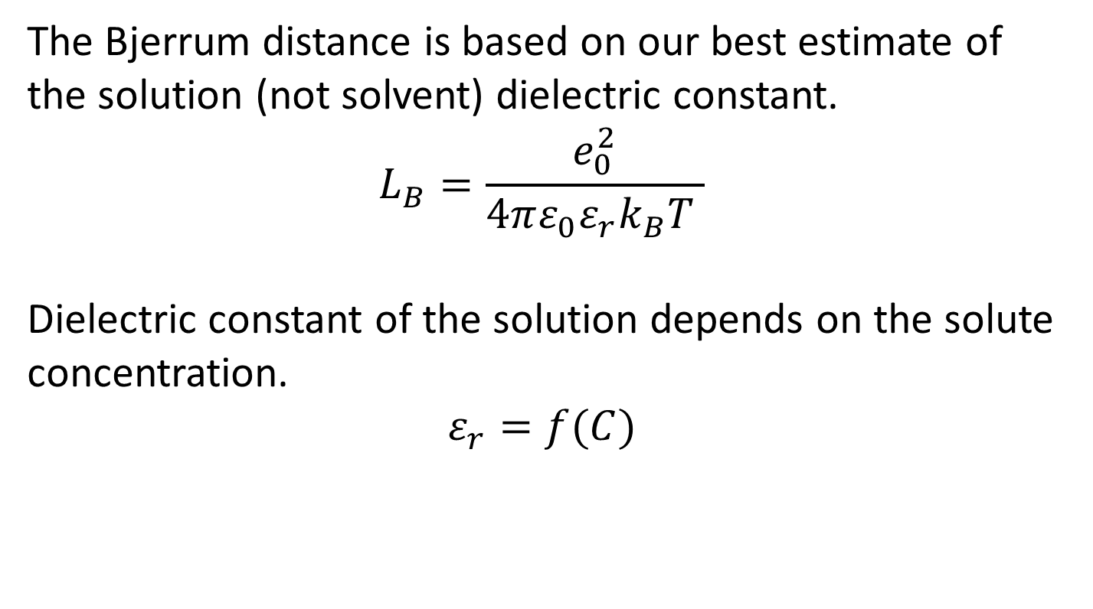
MSA Ion Activities
The Bjerrum distance is based on our best estimate of the solution (not solvent) dielectric constant.
$$L_{B}=\frac{e_{0}^{2}}{4πε_{0}ε_{r}k_{B}T }$$
Dielectric constant of the solution depends on the solute concentration.
$$ε_{r}=f(C)$$

Slide 15
Numerical Methods
Newton’s method was used to solve ion equilibria equations (up to 100 equations)
Variables were bounded
“Relaxation” (fractional steps) was used
Reasonable initial guesses required
Euler’s method or Heun’s (Modified Euler’s) method was used, with Newton’s method to solve the differential equations for precipitation dynamics.

Slide 16
Does the model make any difference?
Is the MSA model different from the Davies or Extended Debye-Hückel model?

Slide 17
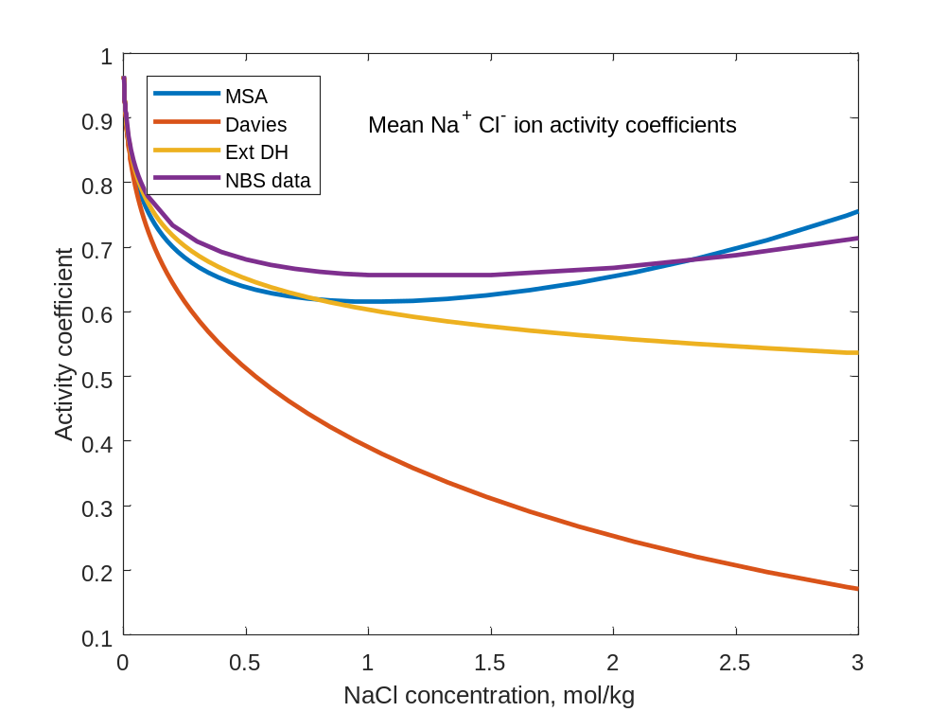
Does the model make any difference? Yes
Davies model is inadequate at higher concentrations.
Extended Debye-Hückel is OK
MSA is better but not perfect.
More parameter checking required.

Slide 18
Does the model make any difference? Yes
Davies model is inadequate at higher concentrations.
Extended Debye-Hückel is OK
MSA is better but not perfect.
More parameter checking required.
Hard Sphere contribution

Slide 19
Validation
Activities and water activities of NaCl, CaCl₂ and H₂SO₄ solutions 
pH of buffers 
Ion concentration vs pH 

Slide 20
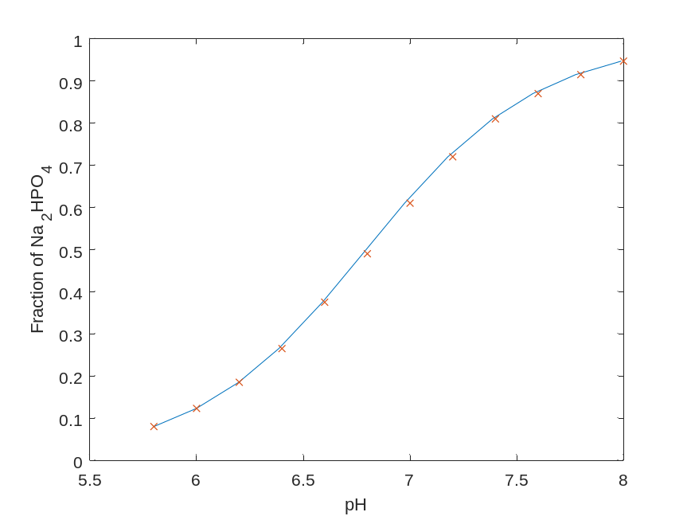
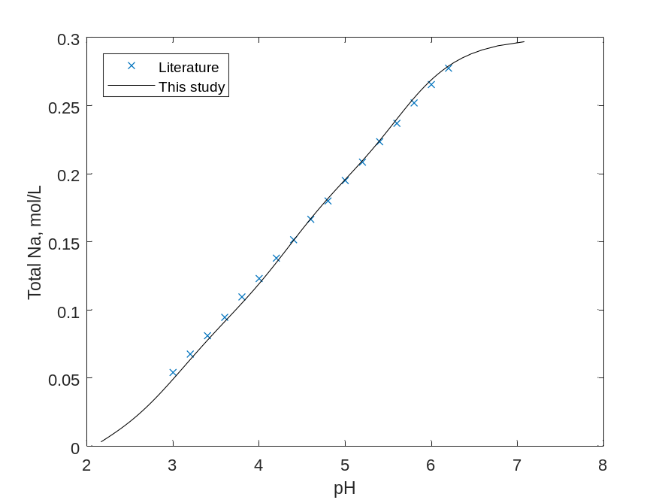
Validation: Phosphate & Citrate Buffers
Na₂HPO₄ + NaH₂PO₄ and Na₃Citrate + Citric acid
http://www.sigmaaldrich.com/life-science/core-bioreagents/biological-buffers/learning-center/buffer-reference-center.html

Slide 21
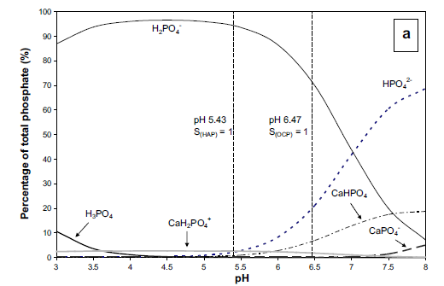
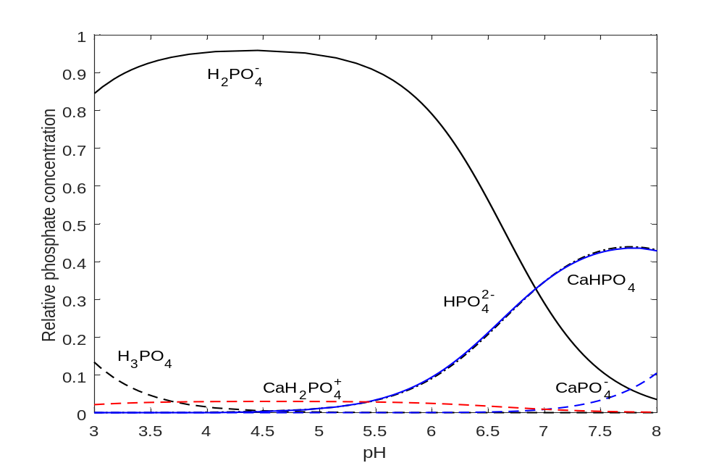
Phosphate equilibria
Model from Rice et al. Int Dairy J (2010) Current work

Slide 22
Phosphate equilibria
Model from Rice et al. Int Dairy J (2010) Current work

Slide 23
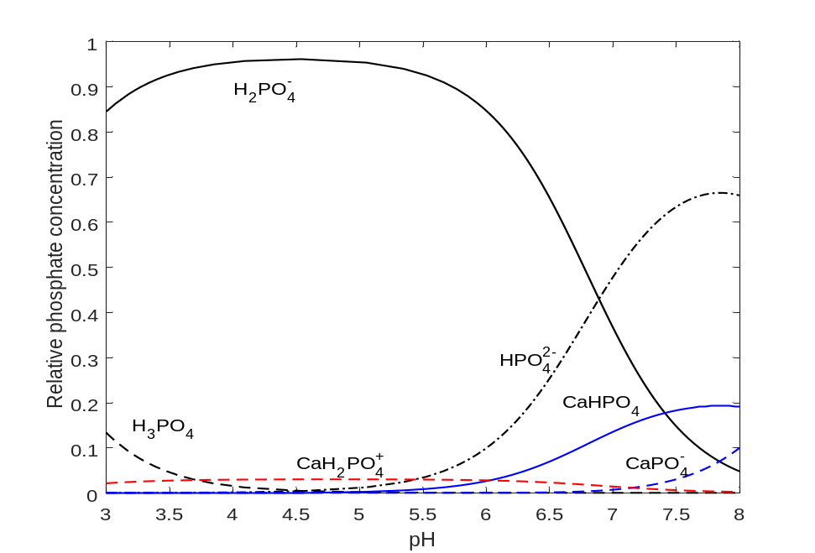
With adjustments to K_{a} of CaPO₄⁻ and CaHPO₄
Model from Rice et al. Int Dairy J (2010) Current work

Slide 24
Difficulties
The literature values of association constants, K_{a}, and solubility products, K_{sp}, are based on Davies or Extended Debye-Hückel activity models.
New values of K_{a} and K_{sp} should be determined for the MSA activity.
Will K_{a} and K_{sp} be constant at high concentration?

Slide 25
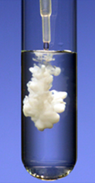
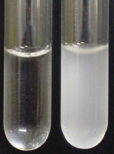
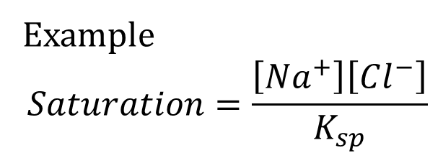
Precipitation and dissolution models
In chemistry classes precipitation is fast.
In the Ca-H-PO₄ system precipitation is slow (minutes
to days).
Example
$$Saturation=\frac{\left[Na^{+}\right]\left[Cl^{−}\right]}{K_{sp}}$$

Slide 26
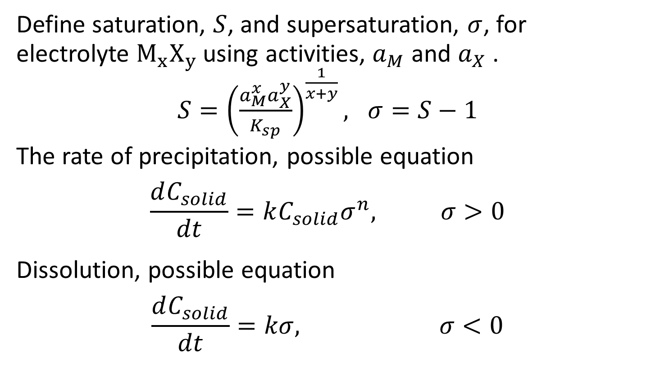
Precipitation and dissolution models
Define saturation, $S$, and supersaturation, $σ$, for electrolyte $M_{x}X_{y}$using activities, $a_{M}$ and $a_{X}$ .
${S=\left(\frac{a_{M}^{x}a_{X}^{y}}{K_{sp}}\right)}^{\frac{1}{x+y}}, σ=S−1$
The rate of precipitation, possible equation
$$\frac{dC_{solid}}{dt}=kC_{solid}σ^{n}, σ>0$$
Dissolution, possible equation
$$\frac{dC_{solid}}{dt}=kσ, σ<0$$

Slide 27
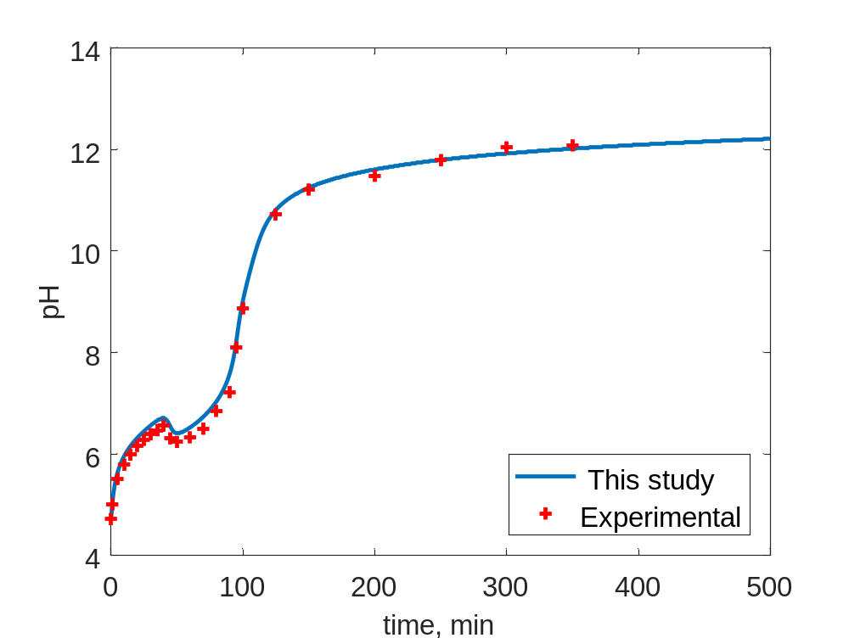
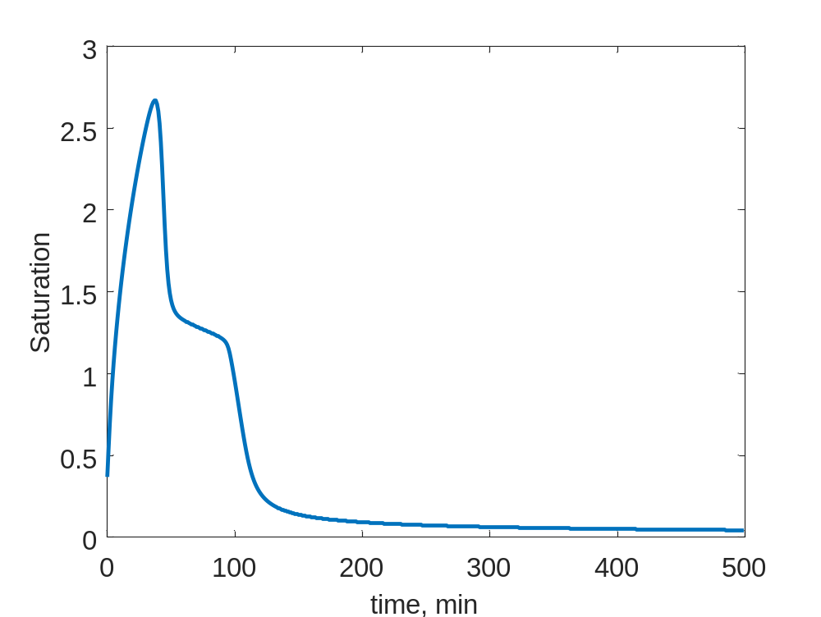
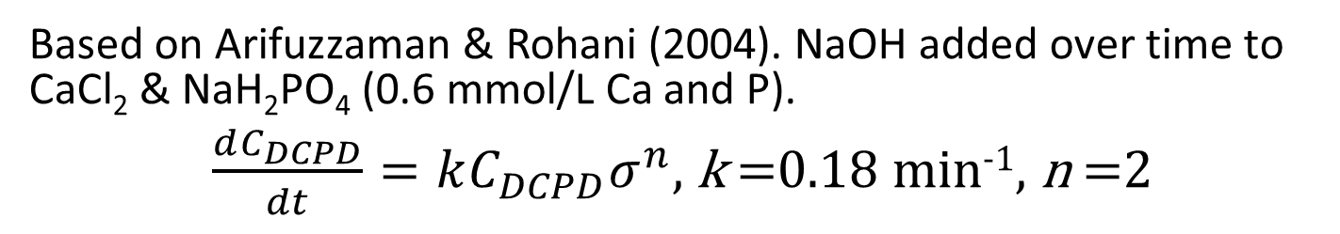
Validation: Precipitation of CaHPO₄
Based on Arifuzzaman & Rohani (2004). NaOH added over time to CaCl₂ & NaH₂PO₄ (0.6 mmol/L Ca and P).
$\frac{dC_{DCPD}}{dt}=kC_{DCPD}σ^{n}$, k =0.18 min⁻¹, n =2
Saturation of DCPD (dicalcium phosphate dihydrate
Original K_{a}, K_{sp}. Only k was fitted

Slide 28
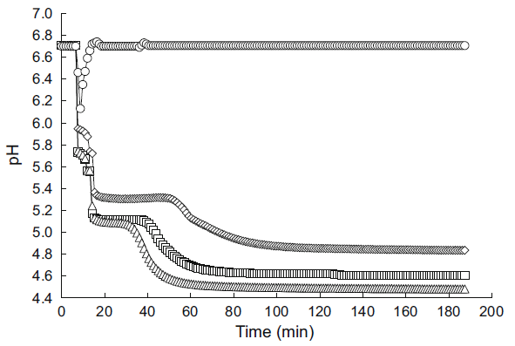
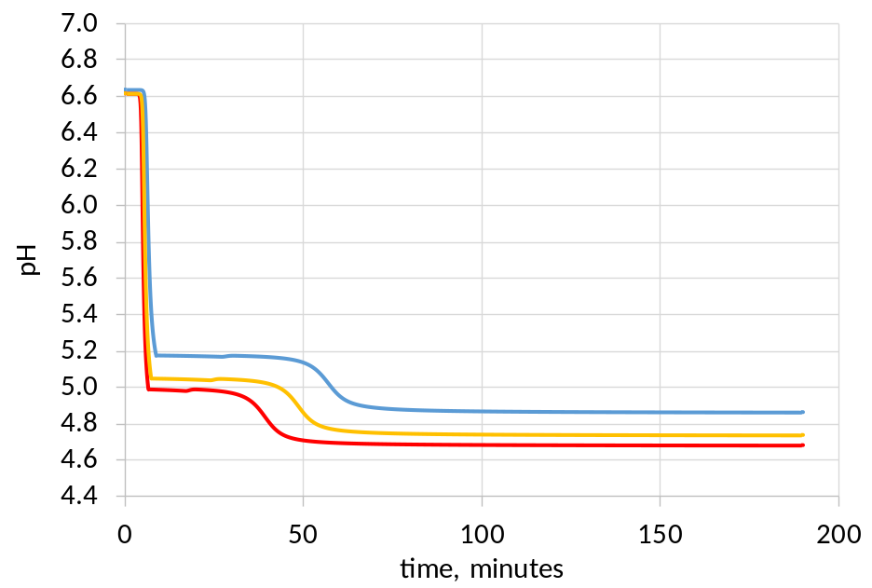
Validation: modelled as DCPA to DCPD
Mekmene et al. (2009). Time response after mixing CaCl₂, NaH₂PO₄ and NaOH.
20 mmol/L PO₄
Ca:P 1, 1.5, 2.0
Some fitting of K_{sp} and k values was required
Dicalcium phosphate anhydrous precipitates quickly then redissolves to form dehydrate?

Slide 29
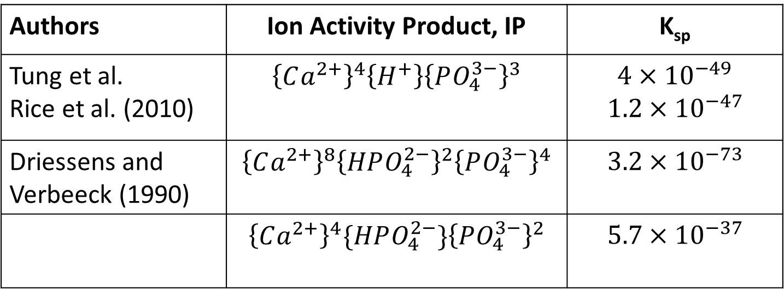
Many Different Solubility Products
Octacalciumphosphate (OCP) Ca₈(HPO₄)₂(PO₄)₄
{ } indicates activity.
Authors | Ion Activity Product, IP | K_{sp}
Tung et al. Rice et al. (2010) | $${\left\{Ca^{2+}\right\}}^{4}\left\{H^{+}\right\}{\left\{PO_{4}^{3−}\right\}}^{3}$$ | $4×{10}^{−49}$ $$1.2×{10}^{−47}$$
Driessens and Verbeeck (1990) | $${\left\{Ca^{2+}\right\}}^{8}{\left\{HPO_{4}^{2−}\right\}}^{2}{\left\{PO_{4}^{3−}\right\}}^{4}$$ | $$3.2×{10}^{−73}$$
 | $${\left\{Ca^{2+}\right\}}^{4}\{HPO_{4}^{2−}\}{\left\{PO_{4}^{3−}\right\}}^{2}$$ | $$5.7×{10}^{−37}$$

Slide 30
Milk
Many cations, anions and ion-pairs
Lactose
Simulate ions concentration of
  Serum minerals
  Serum + lactose = whey permeate

Slide 31
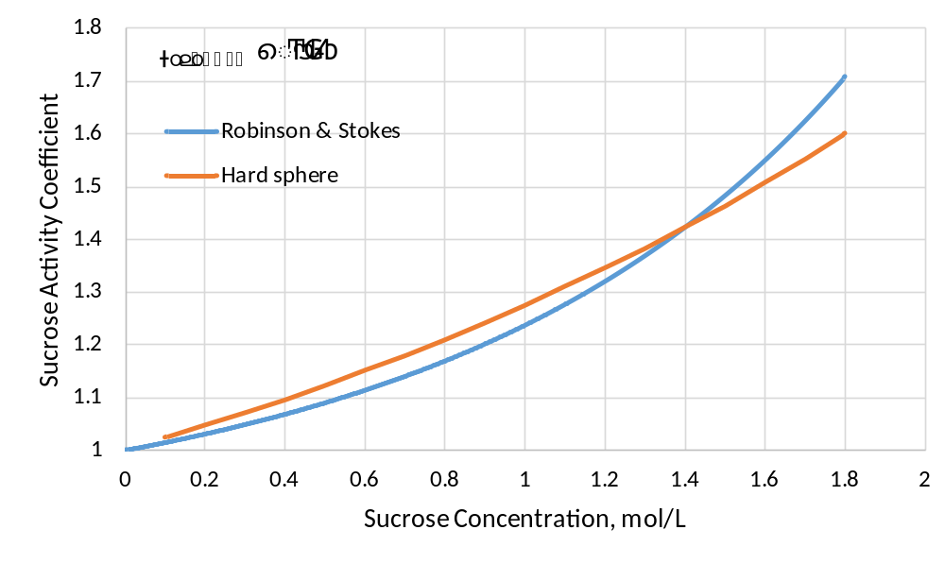
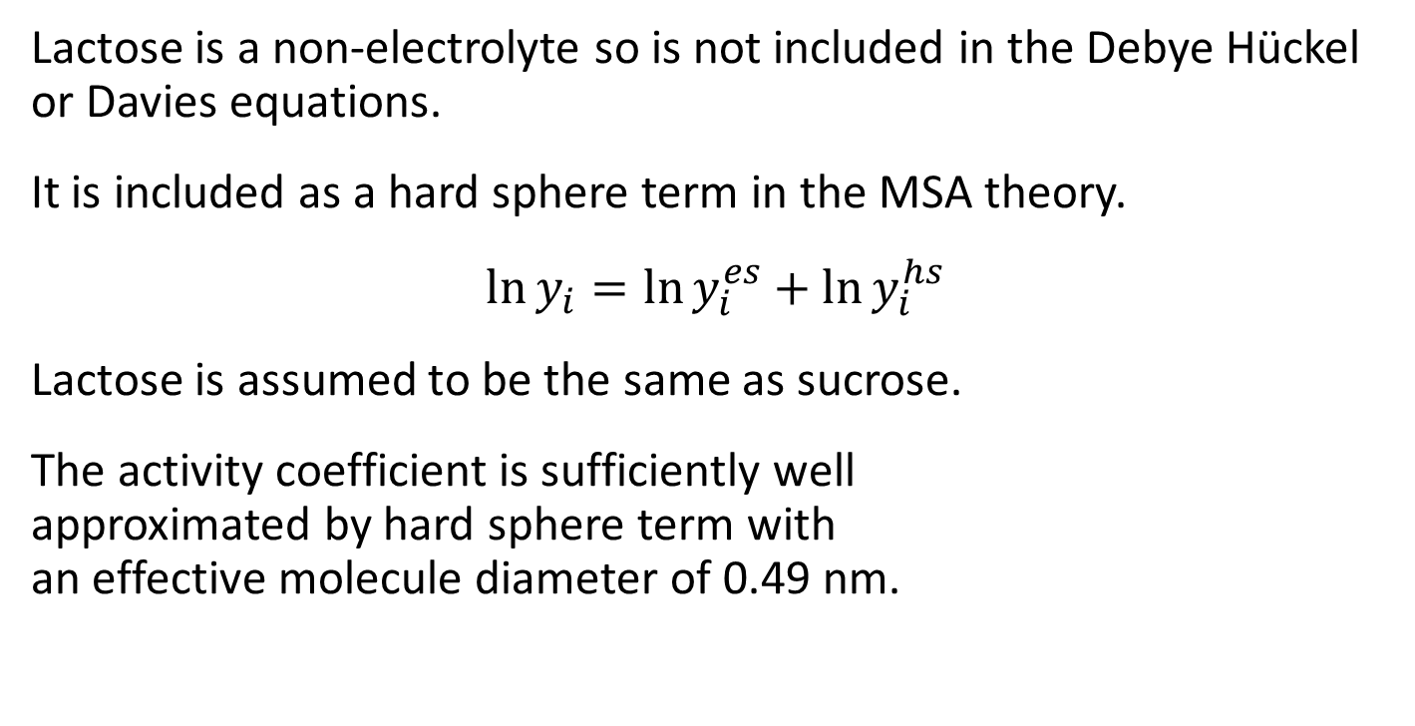
Lactose activity
Lactose is a non-electrolyte so is not included in the Debye Hückel or Davies equations.
It is included as a hard sphere term in the MSA theory.
$$\ln{y_{i}}=\ln{y_{i}^{es}}+\ln{y_{i}^{hs}}$$
Lactose is assumed to be the same as sucrose.
The activity coefficient is sufficiently well
approximated by hard sphere term with
an effective molecule diameter of 0.49 nm.

Slide 32
Lactose activity
Lactose is a non-electrolyte so is not included in the Debye Hückel or Davies equations.
It is included as a hard sphere term in the MSA theory.
$$\ln{y_{i}}=\ln{y_{i}^{es}}+\ln{y_{i}^{hs}}$$
Lactose is assumed to be the same as sucrose.
The activity coefficient is sufficiently well
approximated by hard sphere term with
an effective molecule diameter of 0.49 nm.

Slide 33
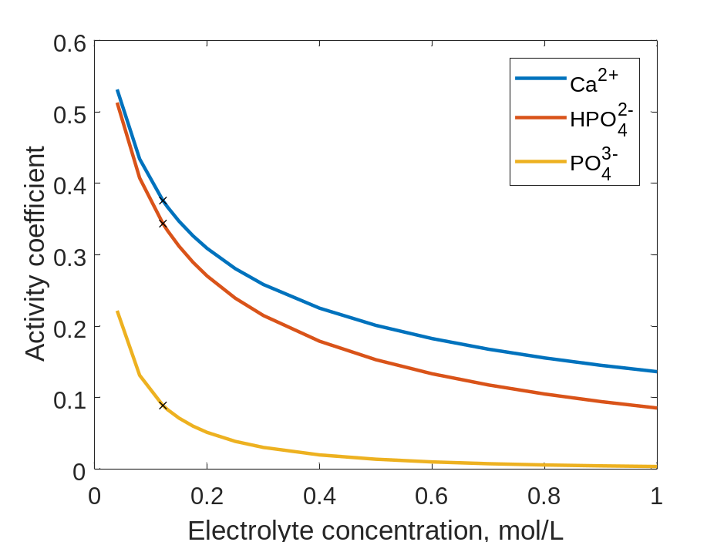
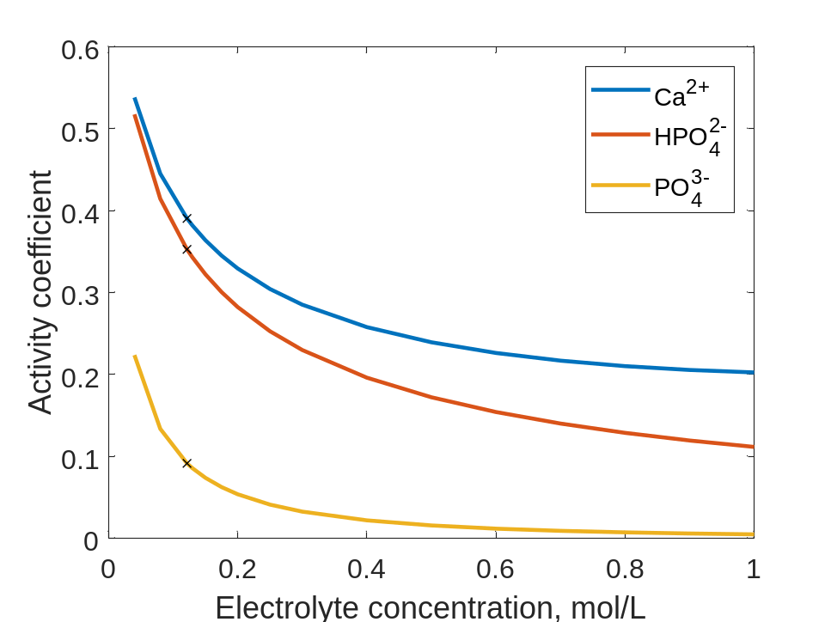
Effect of lactose during concentration
Milk minerals
No lactose
Milk minerals
+ lactose
X indicates normal concentration in milk

Slide 34
Effect of lactose during concentration
Milk minerals
No lactose
Milk minerals
+ lactose
X indicates normal concentration in milk

Slide 35
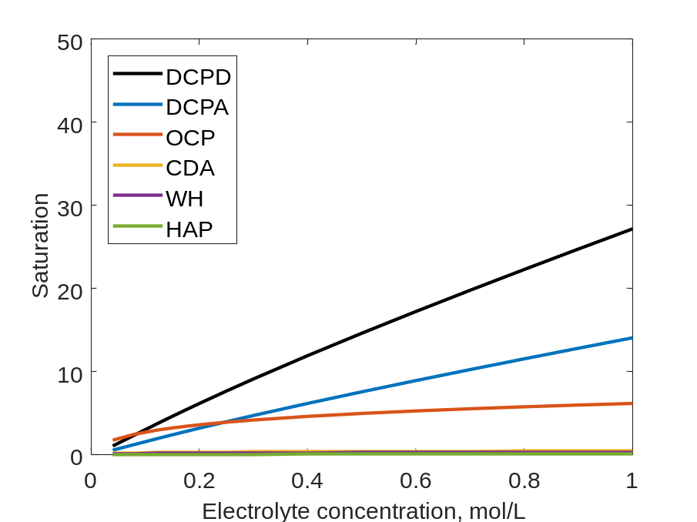
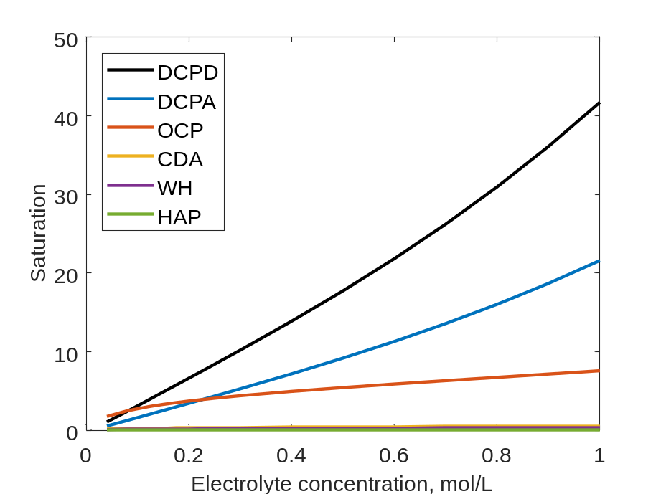
Effect of lactose during concentration
Milk minerals
No lactose
Milk minerals
+ lactose
Lactose has a significant effect on saturation of calcium phosphate when whey permeate is concentrated to 50% solids

Slide 36
Effect of lactose during concentration
Milk minerals
No lactose
DCPD
Milk minerals
+ lactose
Lactose has a significant effect on saturation of calcium phosphate when whey permeate is concentrated to 50% solids

Slide 37
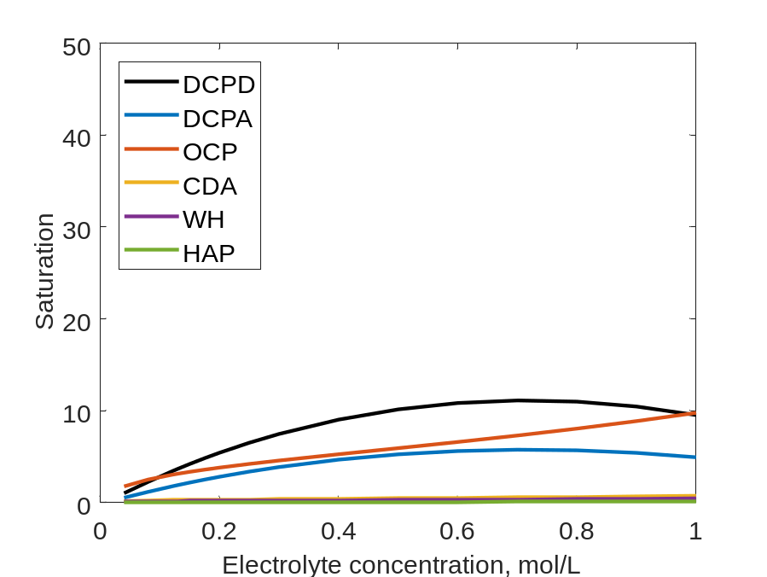
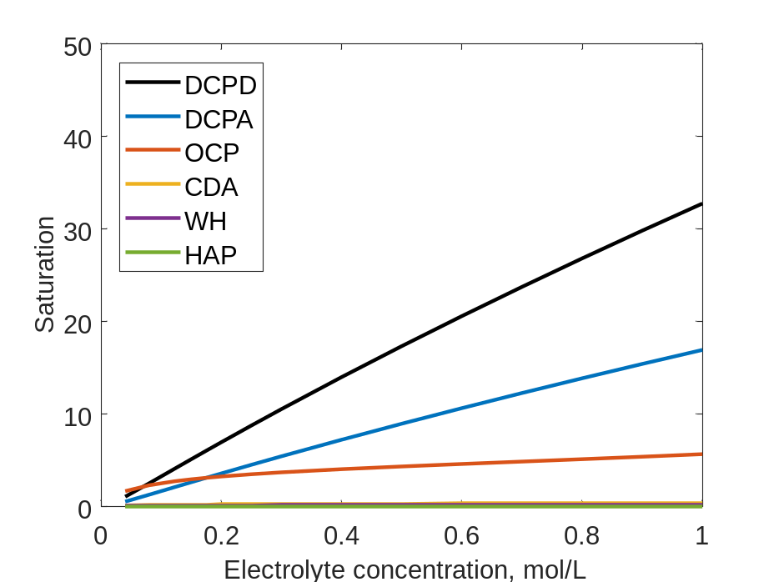
Effect of lactose during concentration
Davies Equation
Extended Debye-Hückel
The Davies equation is very different.
The Extended Debye-Hückel equation is better but with no lactose effect.

Slide 38
Next steps
Add casein to the model system to simulate milk
Dynamics of precipitation in milk systems
  Ca-H-PO₄ precipitation with lactose: experimental and predicted
  Does viscosity affect precipitation?
Uncertainty of K_{sp}, K_{a}, at high concentration
Find the limitations of this approach

Slide 39
Conclusions
The ion equilibria of milk-like systems were modelled and solved using:
  MSA activity model
  Newton’s method
The Davies equation is not as good at higher concentrations.
Extended Debye-Hückel does include lactose effect.
Dynamic precipitation was successfully added using Heun’s method (modified Euler).

