Slide 1
Indices of the quality of glucose control
1001 imperfect choices?
Geoff Chase (w/ the support of a cast of 1000s)

Slide 2
Warnings …
The following topic is contentious, personalised and subject to immense variability in use, misuse and preference
There have been over 1300 studies published on glycemic control with over 1400 different metrics used
  This is a made up “fact” but likely not far off the truth
There will thus be few references to published works on the topic around outcomes or metrics due to so many possibilities
  I think we all know who did what anyway?
Some “shout outs”:
  Eslami et al, Critical Care, 2008, “A systematic review on quality indicators for tight glycaemic control in critically ill patients”
  Eslami et al, Int Care Med, 2009, “Glucose variability measures and their effect on mortality”
    A conclusion: “Glucose variability has been quantified in many different ways, and in each study at least one of them appeared to be associated with mortality…” which about sums it up

Slide 3
Warnings …
I should also note that all of this likely reflects my prejudices and experience as well.
I leave the judgement of separating between my experience and my prejudice to you!

Slide 4
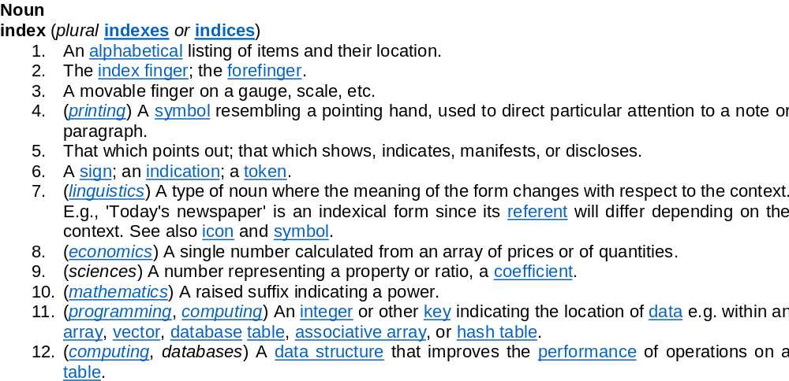
The Beginning: What is an index?
Even the dictionary seems uncertain!

Slide 5
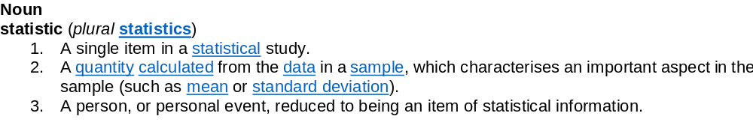
Often used interchangeably with…
The most common way to create an index is one or another statistic
Mean and median are the most common comparators in glycemic control (GC) situations
The big difference is that a statistic requires knowledge of the distribution to be valid or used validly.

Slide 6
Definition: Indices in Medicine
After much searching there was no “medical” definition that didn’t involve fingers, toes or some more abstract anatomical terms
  So, I made one up
Index (noun); (medicine): A single number calculated from an array of clinical data to comprise a single value for comparison or action
  Typically used to evaluate care in terms of eventual outcome (retrospective)
  Used as a diagnostic or status metric in determining care decisions (prospective)
Notes:
  For this discussion, the array is typically blood glucose (BG) values, but can also include insulin and / or nutrition values or data
  Should be equally applicable to patients (who have outcomes like mortality or organ failure) or cohorts (who have aggregated rates or incidence of outcomes)
  Must be amenable for use in statistical comparisons (across cohorts)

Slide 7
Current Indices (wildly abbreviated)
Level:
  Mean
  Median
  Mean Morning/Noon/Night
Variability:
  Normal-based: Std Dev, CONGA
  Non-parametric: IQR, MARD, 90-95% Range, rms, ΔBG, “Glucose Miles”, sum squared differences, … (I grow tired…)
Incidence: (usually of discrete events of “badness”)
  Low: Hypoglycemia (BG < 2.2)
  High: Hyperglycemia (BG > X)
  Variability: Hyper to Hypo events (BG > 10 to BG < 3, eg Bagshaw et al 2009)
Time: (to event)
  BG in band is the most common
Exposure: includes time in an event/band
  Time in/out of bands,
  Cumulative Time in/out of bands
  AUC (hyper or hypo)
Eslami et al found 30 different indicators, not including different ranges and targets within the same index

Slide 8
The case for / against Level
Simplest possible metric
Easily measured
Easily assessed in real-time and can be monitored
Most commonly associated with outcome (eg many papers)
No 1BG level likely matters much to outcome, and level over time is an Exposure metric (to avoid confusion)
  Is one level more important than a similar one (6.1 vs 7.0 for example)? Hard to get a graduated scale of what is “equally good”?
Debate over non-parametric (median) measure of true “middle” and inaccurate parametric (mean) measure of non-normal BG distributions
  One gives you “middle” one gives you “exposure to/around a level” … Which is more important?
Can vary a lot with measurement frequency or interpolation, where in band measures are often less frequent than out of band measures creating a bias depending on protocol
Cannot be evaluated until afterwards – no real-time use

Slide 9
The case for / against Variability
Easily measured
Can be monitored over time
Also very commonly associated with outcome (eg many papers)
What is variability? Variability of the whole distribution or measure to measure rate of change in the time series? Std Dev is the first and definitely not the second (for 1 example)
No agreement on statistical approaches or what defines a normal distribution
Many give the same answer for radically different trajectories
What is the level of variability or range that is “good” or “bad”
All variations from a level are counted, when small ones around a near normal glucose likely have no effect.
Hard to compare - Can vary a lot with measurement frequency or interpolation, particularly for parametric tests (eg Std Dev)
Cannot be evaluated until afterwards – no real-time use

Slide 10
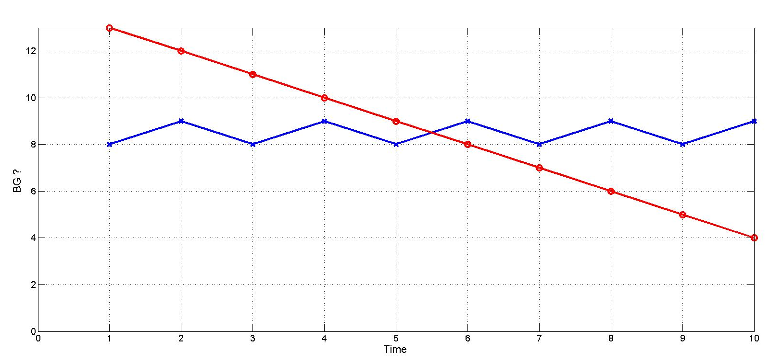
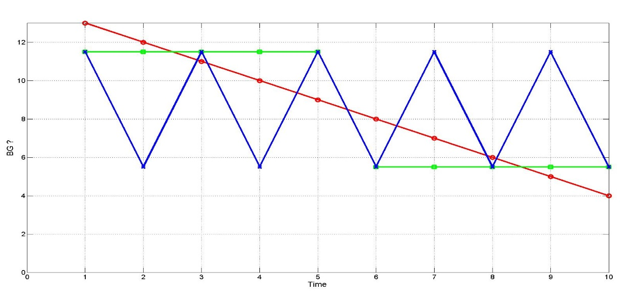
Brief Aside on Variability
Same mean, median
Different sum squared difference
Different standard deviation
There are clinically relevant differences perhaps
Same everything but sum squared differences
Clinically relevant differences?
What matters, overall or measure to measure?

Slide 11
The case for / against Incidence
Easily measured
Easily counted / calculated, especially for hypOglycemia
Also very commonly associated with outcome (eg many papers)
Range measurements can be skewed by measurement intervals
Bagshaw et al (2009) associated poor outcomes with BG < 4.0 in early part of stay (among others), so at what level begins “badness”, or is it many?
HypERglycemia is hard to assess this way
CGMs with noise may over report incidence.

Slide 12
The case for / against Time (to an event)
Easily measured
Easily calculated
Not commonly or otherwise particularly associated with outcome
Protocol dependent
Starting criteria of protocol dependent
Does 10 hours to 8 mmol/L vs 6 hours to the same value matter? Isn't that captured by AUC or time in a band?

Slide 13
The case for / against Exposure
Easily calculated
Cumulatively, they can be calculated / used in real-time requiring no post-hoc analysis
Reflects directly on a dose-response relationship to outcome, and elements are well documented physiologically in this way
Has been associated with outcome (though not frequently) in ICU, although much more well known in diabetes (eg DCCT, HbA1c is a surrogate of this)
Bands say all BG in band are “equal” or similar (van Herpe et al, Glycemic Penalty Index), which likely has physiological merit.
Not commonly associated with outcome in many studies
Time in band is often used but bands are not standardised rendering comparison impossible without all the data
Typical measures don’t account for frequency of exposure as well as severity
Some, like GPI are hard to calculate or/and understand
Measurement frequency and/or interpolation dependent

Slide 14
My Case or The Heresy:
What makes good indices?
Required metrics to measure:
  Safety (from hypoglycemia)
  Performance (exposure to “goodness” in a band)
  Workload (not a glycemic measurement)
Should be measurable and assessable measurement to measurement, as well as retrospectively afterward for comparison
Should be linked to outcome (barring Workload)
Should allow robust statistical comparison between studies
Should be calculated/calculable from hourly interpolated measurements

Slide 15
Safety from Hypoglycemia
Number of patients with 1 or more BG < 2.2 mmol/L
and
Number of patients with 1 or more BG < 4.0 mmol/L
Basis: Bagshaw et al, 2009, Egi et al 2010, Krinsley 2011, Penning et al, 2014, and others
  Multiple events don’t appear to play a further role
Easily measured and monitored, not dependent on distribution
Statistically robust using numbers of yes/no patients for comparisons
Use with CGMs should/could be changed to an exposure metric (Signal et al, 2014) due to noise and drift.

Slide 16
Exposure (to goodness)
%BG (resampled) or time in an intermediate glycemic band
and
Cumulative %BG (resampled) or time in band over time (cTIB)
Basis: Penning et al, 2014 and Signal et al 2013 showed improved odds ratios for cTIB, Chase et al 2010 showed link to organ failure, physiology of hyperglycemia indicates exposure to inflammatory response and hyperglycemia drives dysfunction with similar works in the diabetes field.
Easily measured and monitored, not dependent on distribution, the first one → the second at the end (i.e. same metric!)
Statistically robust using numbers in/out of band for comparisons
Use with CGMs matches rapid measurement and ameliorates noise (as it is an integral) but not drift.

Slide 17
Workload
Measurements per day
Basis: Carayon et al, 2005 and others around workload of GC
Easily measured and monitored, not dependent on distribution
Simple surrogate measure of what is deemed the most time consuming portion of providing GC
Use with CGMs matches rapid measurement and ameliorates noise (as it is an integral) but not drift.

Slide 18
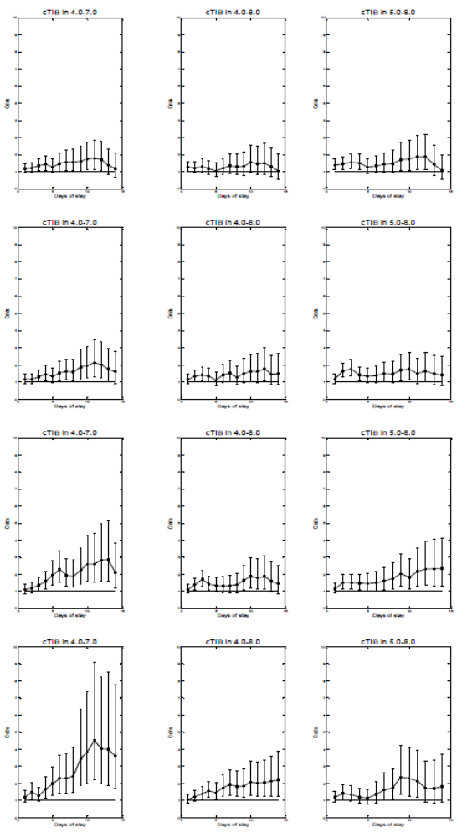
About that “Intermediate Band” and the idea of cTIB (over 1600 patients)
A band defines “good glucose” that are all equal
It also limits by its width, the variability allowed
Wider band = more variability allowed all else equal
Narrower band = less variability allowed
cTIB > 50 % by day
cTIB > 60 % by day
cTIB > 70 % by day
A 4.0-7.0 mmol/L band was better than 5.0-8.0 (same width)
And better than 4.0-8.0 (wider)
Matches results of Arabi et al (Ann. Thor. Med, 2011) and others such as Krinsley when considering the rising OR with rising time in band achieved
cTIB becomes Time in band when the patient is done, and thus, the one → the other
cTIB > 80 % by day

Slide 19
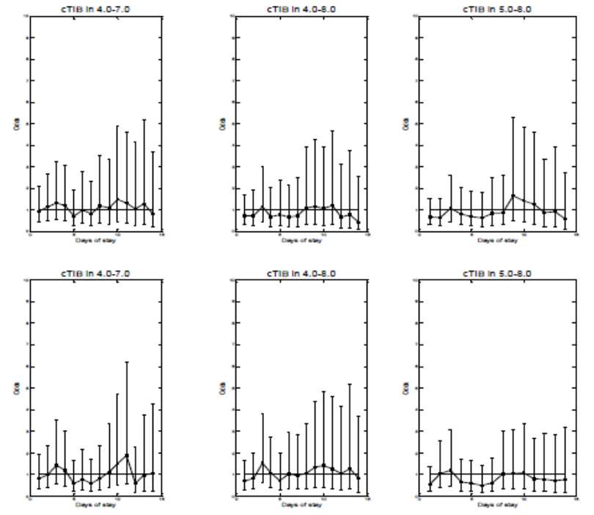
About that “Intermediate Band” and hypoglycemia
Same plots only for those with 1+ severe hypoglycemic event
One hypo → Resets OR to 1.0 and could be said to “render GC ineffective in its entirety”
cTIB > 50 % by day
cTIB > 60 % by day
Same metric linked to organ failure resolution
Independent of how you obtain “good” GC
Does not solve the who needs to receive good GC? question

Slide 20
Summary
There are ~1M possible metrics (again, made up “fact”)
Main issues:
  Parametric vs non-parametric and how to handle them
  Must be linked to clinical outcomes of interest
  What best relates to known physiological effects
  Ease of understanding and interpretation
  Robust statistical comparison is necessary
Suggestion: Safety, Performance and Workload… In that order
  Incidence of severe and light hypoglycemia
  (Cumulative) Time in band (4.0-7.0 and 4.0-8.0 -- the first or both or more, depending on your definition of “good” BG)
  Workload
  This reflects some of my prejudices and own approach, but matches published works and any protocol that did well would show well in these metrics.
CGMs could have both beneficial effects and change some metrics of incidence

