Slide 1
Semi-automated BG control: Currently available technologies
It’s not what you do, it’s how you do it!
Geoff Chase (w/ the support of a cast of 1000s)

Slide 2
Shots across the bow …
The following topic is contentious, personalised and subject to immense variability in use, misuse and preference
Glycemic control has a strong physiological story, but a weak clinical outcome story
  Lots of promise, very little delivery
Automation has improved productivity, efficacy and quality in a wide range of fields delivering products and services… except medicine, and particularly excluding intensive care medicine
  Yet, medicine could (economically) really use these things
  Some feel that automation of key therapies will lead to forgetting how to do them, but is this worse than not having time to do what you remember?
  In contrast, pilots seem to remember how to fly the plane even though they use auto-pilot for a great deal of time → Automating the middle 90%
Equally, medicine has protocolised care, another phrase for “one size fits all
  Impersonalised care?
  The latest trend is personalised care, which also sounds like more work, rather than less.

Slide 3
A bold statement or three
All the technology in an intensive care unit, or all that is used regularly, was there 25-30 years ago
  There are clear improvements, but nothing new
  Many are computerised to store data or present it on nice screens, or analyse it in one or another fashion
  However, the primary interaction I have observed between doctor and advancing technology (around doing the same thing) is ignoring it.
Thus, it seems clear that the technology available is not being used to full advantage
  Or is it? Is this the best we can do?
One could postulate that if technology was used to its fullest then there would be new needs arising, and thus demands, for new technology and capabilities in monitoring or delivery
It’s not the technology but how we use it?

Slide 4
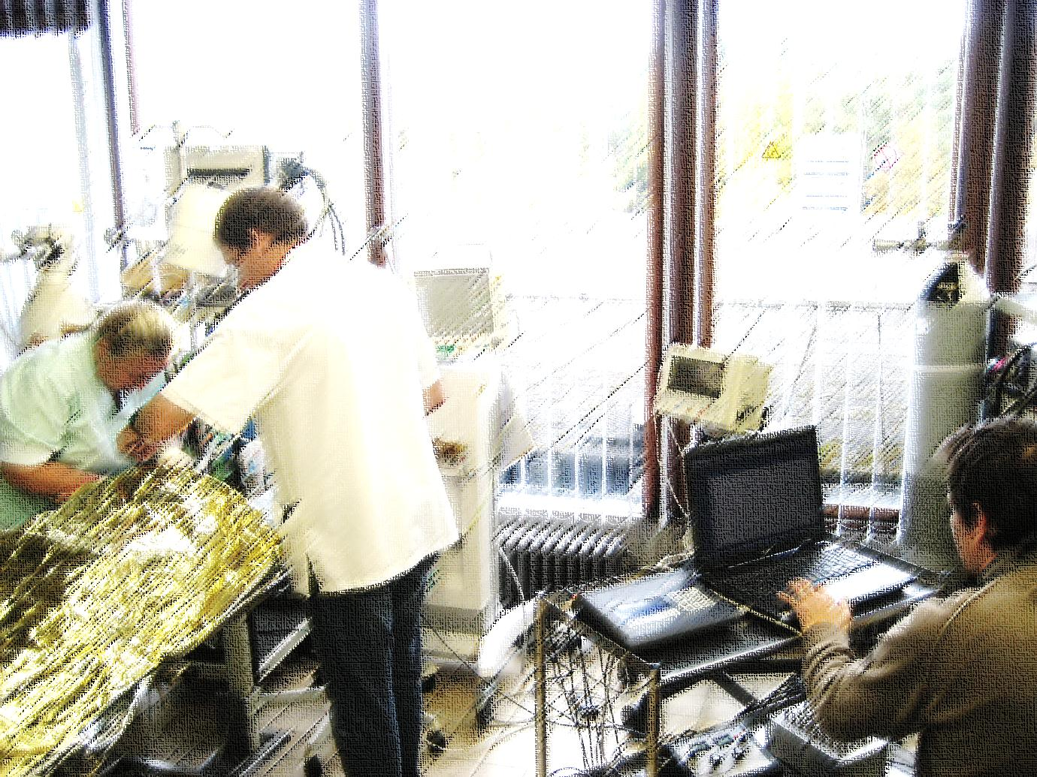
A vision of the future?
Pay no attention to the man with the computer! … Just the computer…

Slide 5

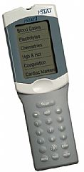
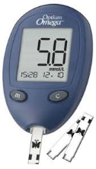
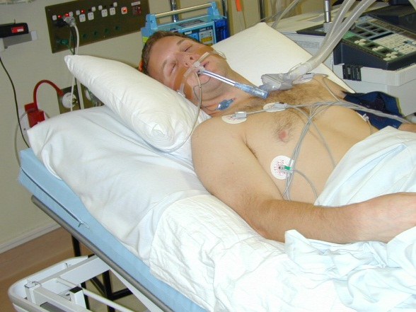
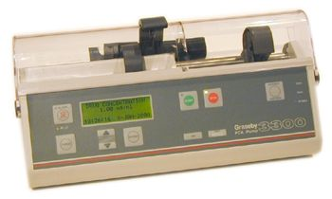
The current “unpersonalised” loop
Current Protocols
Sliding Scales
Web-based
GIK or similar
Some forms of PID and similar
All typically one size fits all
Measured data
Patient management
Standard infuser equipment adjusted by nurses
The gear remains the same
Implication is that it is the protocol that is lacking

Slide 6
Some details for / against
Many clinical protocols are ad-hoc but easily implemented
Simpler schemes on web based computers or otherwise can offer the same functionality as well as some control types (eg PID)
  Difference is use of prior data stored (maybe)
Often offer desired workload (4 hour plus measurement intervals)
  For fear of non-compliance – a recent study we did found over 50% non-compliance in some major studies/protocols – despite the danger of some situations (eg in or near hypoglycemia)
Many ad-hoc protocols are good at raising insulin to combat insulin resistance but not so good at remembering to turn it down until it is in the band or beyond
PID and similar can be adjusted in response to the patient response, but this is often less specific or precise (i.e. not patient specific)
Reactive and not predictive

Slide 7
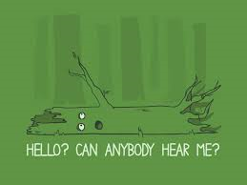

Just a little question to create debate
If a hypoglycemic event occurs during a long measurement interval…
Does it affect mortality?

Slide 8
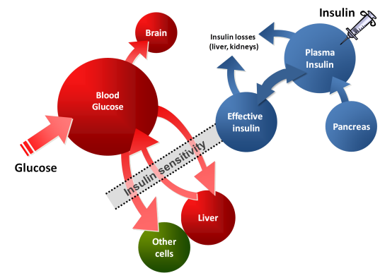
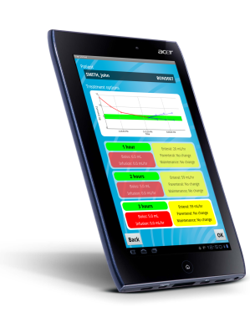
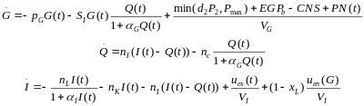
Automation and Glucose Control (GC)
Decision Support System
Measured data
Identify and utilise patient-specific parameters from measurements of response to care – something that changes with condition
Eg: insulin sensitivity
Patient management
Standard infuser equipment adjusted by nurses
The gear remains the same
Patient specific computer models and protocols

Slide 9
Some details for / against
Patient-specific and precisely so
  There are good examples out there (eMPC, STAR, Glucosafe)
Able to manage patient variability directly with various forms of models
More physiological based on validated models so that decisions are based on more precise physiological understanding of patient response at that time
  Both reactive and predictive as a result
Workloads of 1-3 hourly measurements (and sometimes more) but on average 12-16 measures per day is higher than desired clinically
  In contrast, longer means more subject to random behaviours that go unobserved and cause trouble
Greater complexity of protocol = harder to understand, less intuitive dosing compared to experience = non-compliance in some cases
Requires ICT infrastructure not always present or fully able in some ICUs although this is becoming less of an issue.

Slide 10
Managing variability = The case for models
  Fixed dosing systems
  Typical care
  Adaptive control
  Engineering approach
Patient response to insulin
  Controller identifies and manages patient-specific variability
  Fixed protocol treats everyone much the same
Controller
  Variability flows through to BG control
  Variability stopped at controller
Blood Glucose levels
Models offer the opportunity to identify, diagnose and manage variability directly, to guaranteed risk levels.

Slide 11
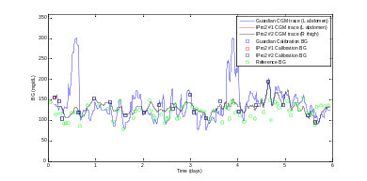
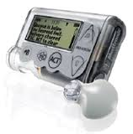
Automation and Workload in GC – Now
Decision Support System
Measured data
Identify and utilise patient-specific parameters
Eg: insulin sensitivity
Patient management
Standard infuser equipment adjusted by nurses
Real-time CGM added for “guard rails” or more…
Remember that tree?

Slide 12
Some details for / against
CGMs add real-time measures → Guard rails enabled on hyper and hypo glycemia
Could modify dosing period so measurements taken when desired and needed rather than every X hours – freeing clinical time and resource
  Typical CGMs require recalibration every 6-8 hours
Now you hear it when the “tree falls” into hypoglycemia
CGMs have higher sensor noise
CGMs can drift, which means guard rails are a “must” in use
CGMs do not readily connect to other software and are heavily patented and otherwise protected against this use.
  FDA and other regulatory agencies only approve them for measurement and not necessarily in this way within a control loop

Slide 13
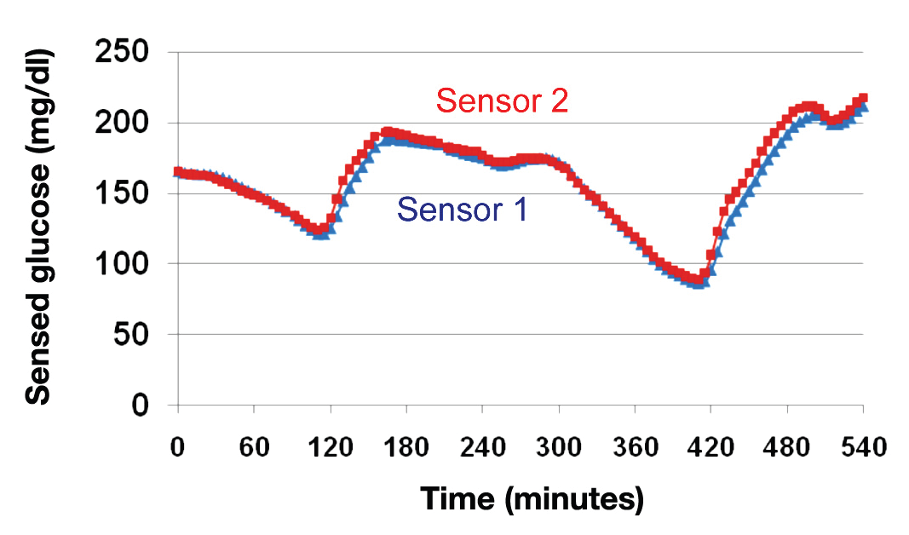
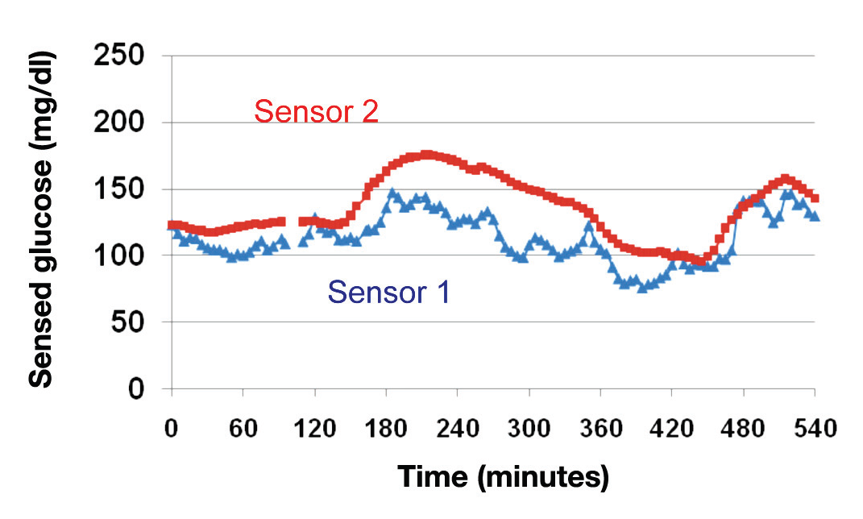
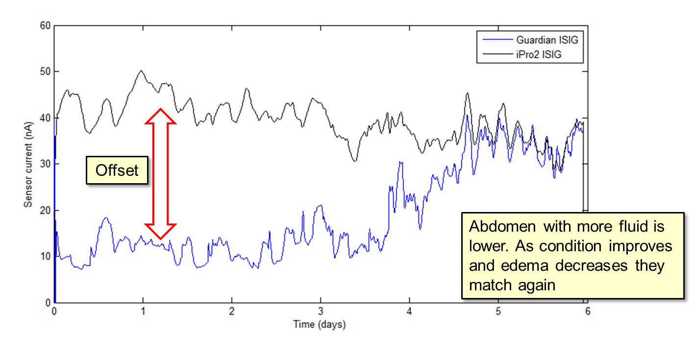
Some truth about CGMs in ICU
Drift is an issue as is accuracy Guard rails would limit such excursions
Can be affected by edema so that placement
is also important
  Sometimes the sensors are almost superimposed
  Other times there is a large mismatch between sensors
  *Figures from: Castle, J and Ward, K (2010) “Amperometric Glucose Sensors: Sources of Error and Potential Benefit of Redundancy”

Slide 14


Automation and Workload in GC – Future
Decision Support System
Measured data
Identify and utilise patient-specific parameters
Eg: insulin sensitivity
Patient management
Standard infuser equipment adjusted by nurses
Nurse is gone! Everything automated
Wireless comms, server storage, cloud storage

Slide 15

Some details for / against
Complete data auditing and storage, which admittedly one can have with the step before that
Workload significantly reduced in managing pumps and sensors
  Auto-pilot for bread and butter therapies and the middle 90% of manageable patients
All the advantages of prior model-based and patient-specific care
All this technology exists today
Resistance to full automation
  Auto-pilot means we can forget how to do things(?)
Stuxnet and Flame = Real risk

Slide 16
Summary
Main Outcomes:
  Need to manage patient-specific (intra- and inter- ) variability drives a need for model-based, patient-specific approaches
  Model validation will thus be a critical factor with the real proof being efficacy (see prior talk on metrics?) in clinical use
    Regulatory issues will also arise with these model-based systems
  Technology offers some solutions in sensing, but automation is the key to managing both quality (models) and workload (CGMs?)
  CGMs still have some limits, but offer real potential within those limits.
  Linking technology offers the future and some significant added advantages
Suggestion: Model-based control and CGM guard rails would still “revolutionise” current care.
  Platform technological approach for a range of therapies in ICU and beyond.

