Slide 1

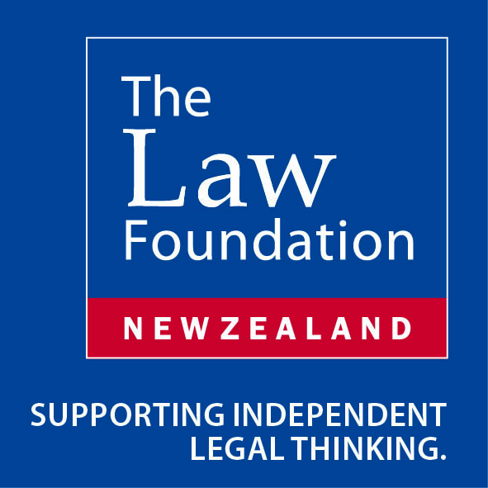
Redefining Parenthood: Beyond Biology?
Dr Rhonda Powell
Lecturer, School of Law
Supported by the New Zealand Law Foundation
Notes:
Role of genetic relationship between intending parents and the surrogate-born child in determining parenthood
Contradictions within the legal position
In surrogacy the usual aspects of motherhood is effectively split between two or more women (surrogate, intending mother, and potentially donor)
Raises questions about the role of genetic connections in the parent-child relationship

Slide 2
Re DMW & KW [2012] NZFC 2915
“I cannot accept … that I should look at the social reality for this child rather than the biological reality. … The point of surrogacy is to maintain a biological link.”
(per Judge Burns at para 34)
Notes:
Intended parents (Mr and Mrs W) from NZ
Donor egg from niece
Child born in Thailand to Thai surrogate
Thai birth certificate: Mr W is father and surrogate is mother
Mr and Mrs W apply for visa to bring child to NZ for purposes of adoption
Immigration NZ required DNA test – no genetic link
Identity of genetic parents unknown
Mr and Mrs W apply to adopt child, with consent of surrogate
Legal issue = “habitual residence” of child
Determined that child not habitually resident in NZ
Adoption needs to take place in Thailand

Slide 3
Genetic connections are sometimes critical
Human Assisted Reproductive Technology (HART) Act 2004 requires Ethics Committee on Assisted Reproductive Technology (ECART) approval for IVF of a surrogate (s16)
Advisory Committee on Assisted Reproductive Technology (ACART) (policy) requires a genetic connection between one or both intending parents and the child for ECART to consent
For international arrangements, Immigration New Zealand (policy) requires a genetic link between at least one intending parent and the child
Notes:
ECART is a ministerial committee established under section 27 of the HART Act that reviews, determines and monitors applications for assisted reproductive procedures and human reproductive research
ACART is has been established under s32 of the HART Act to help formulate government policy and advice with in the field of ART – advises Minister of Health and issues guidelines to ECART

Slide 4
Genetic connections are sometimes irrelevant
Status of Children Act 1969
woman who gives birth is the mother for all purposes, even if donor ovum used
mother’s partner (if consent to ART – presumed) is for all purposes ‘a parent’ even if no genetic contribution
donor only ‘a parent’ if donor is mother’s partner (despite any evidence of paternity)
In New Zealand law, surrogate-born children normally need to be adopted by the intending parents, whether or not they are genetically connected (so parents may have to adopt child born of own gametes)
Notes:
Parental status laws based on reinforcing social relationships and effectively create a legal fiction that the birth mother is the genetic mother, and her partner the genetic partner
May have been considered appropriate on social values in the early 70s but needs to be questioned today because ART is widely accepted and the model of family based on a married heterosexual couple is no longer considered the only acceptable form of family
Eg maternity different from motherhood (eg parental leave laws)
S17 Rule about maternity inserted by the Status of Children Amendment Act 2004 (previous amendments were in 1987)

Slide 5
Genetic connection rules are sometimes inconsistent
Status of Children Act 1969
Paternity may be established by:
marriage to birth mother at time of conception or subsequently
lifetime admission of paternity
declaration of paternity by court
establishment of paternity by evidence:
  entry on registry of births deaths and marriages
  genetic testing
  deed between birth mother and father
Notes:
So for paternity, many ways to establish, but genetics only one way – other ways reinforce fiction of mother’s partner being the father

Slide 6
An alternative: “intentional parenthood”?
Johnson v Calvert 5 Cal 4th 84 (Cal SC ) (1993)
Notes:
Raised by counsel for the family in Re DMW & KW
Johnson v Calvert
surrogate mother and intending mother had competing claims to motherhood under Californian law
dispute between surrogate mother and intending parents over parenthood
resolved on the basis of enforcing the intentions of the parties (not on the basis of genetics)
Dissent by Justice Kennard – both women had claims to legal motherhood
In appropriate to use tort law and contract law concepts in family context
Devalues substantial role of the surrogate mother and the importance of gestational relationships
Should be resolved on the basis of the best interests of the child
Buzzanca v Buzzanca
– child had no genetic relationship with either intending parent or surrogate
Intending parents divorced – mother wanted parental status
Lower court determined that child had no legal parent
intending mother and father granted parental status on grounds that surrogate gave birth to child on their behalf

Slide 7
Fragmentation of parental status: beyond a 2 parent model?
What should be the ongoing responsibilities of each party towards the child?
Which parties should be named on the child’s birth certificate?
What ongoing social support should each of these parties receive?
Gamete donors (x 2) | Mitochondrial DNA donor
Womb donor | Gestational mother
Social parents | ???

Slide 8
What should take priority in determining ‘parenthood’?
Re-enforcing fiction of ‘natural’ parenthood (current NZ model)?
Genetic connection?
Gestational connection?
Intention (contract law model)?
Best interests of the child (family law model)?

Slide 9
Further discussion questions
How important is a biological link between family members? Why?
What can surrogacy learn from adoption about the role of biological links between family members?
Should we recognise different sorts of ‘parents’, some of whom may have a genetic connection to the child and others of whom may not?

Slide 10
Thank you
rhonda.powell@canterbury.ac.nz

