Slide 1
Feasibility of using the Kinect for surface tracking in Radiation Oncology
Steven Marsh, James Eagle, Juergen Meyer and Adrian Clark

Slide 2
Overview
Background motivation for project
Introduce the Kinect cameras
Discuss tracking method options
Present some initial results
Conclusion

Slide 3
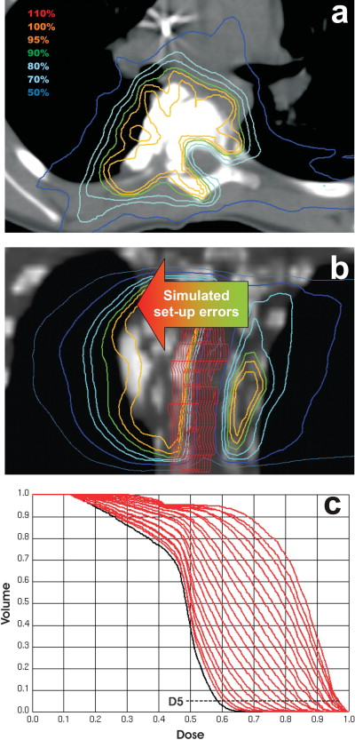
Project motivation
There is a strong focus on highly conformal dose delivery techniques for example, IMRT, IMAT, SBRT and Proton Therapy
These techniques produce high dose gradients and thus, on treatment, patient positioning needs to replicate (as best as possible) that from the planning CT
Cone beam CT allows for verification of patient setup before treatment
However any small shifts and deformations during treatment are more problematic when the treatment plan has high dose gradients

Slide 4
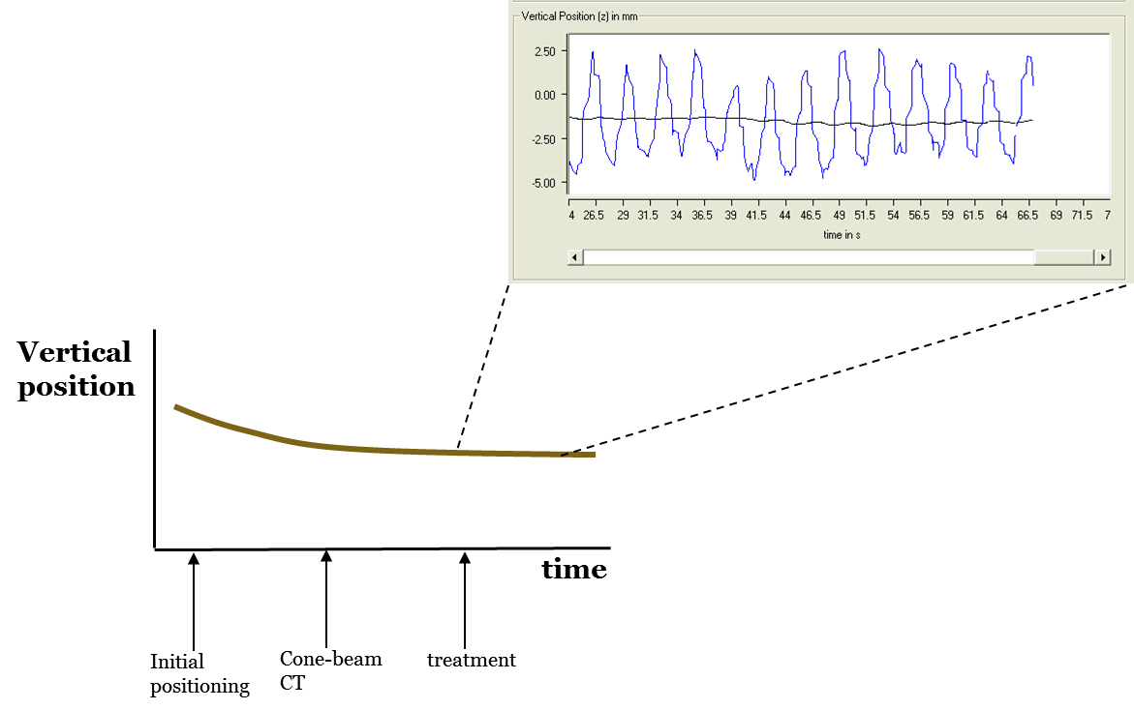
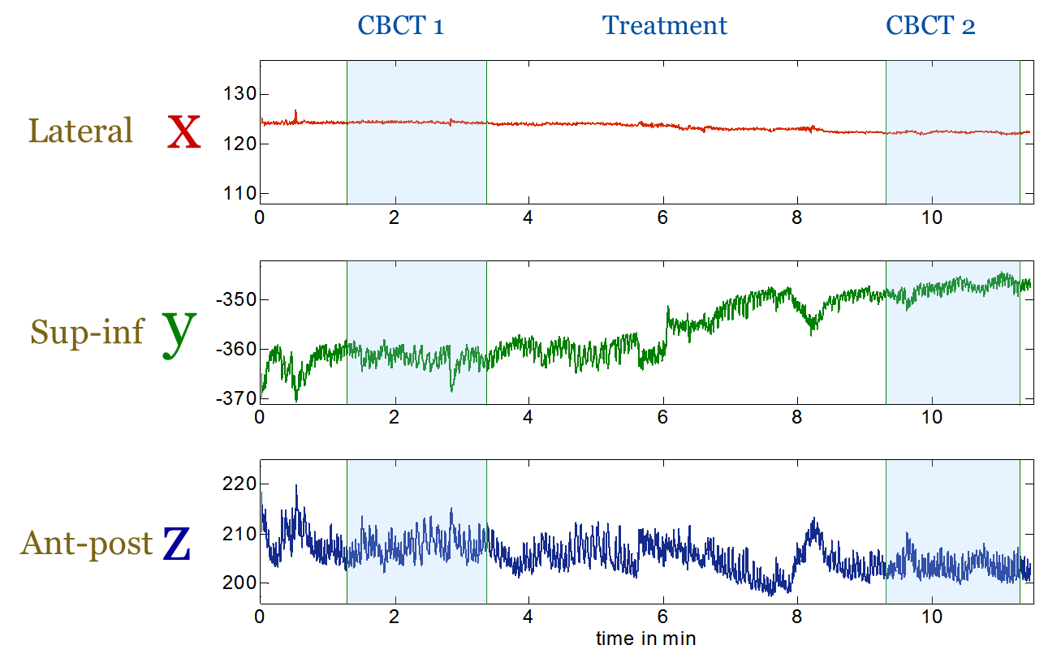
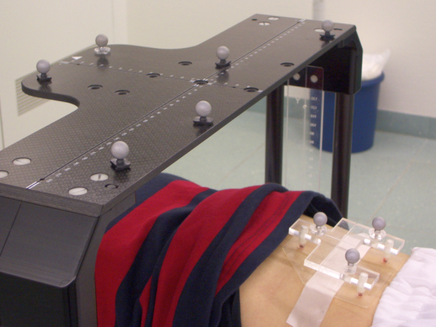
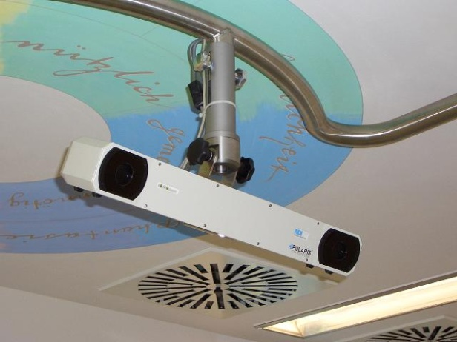
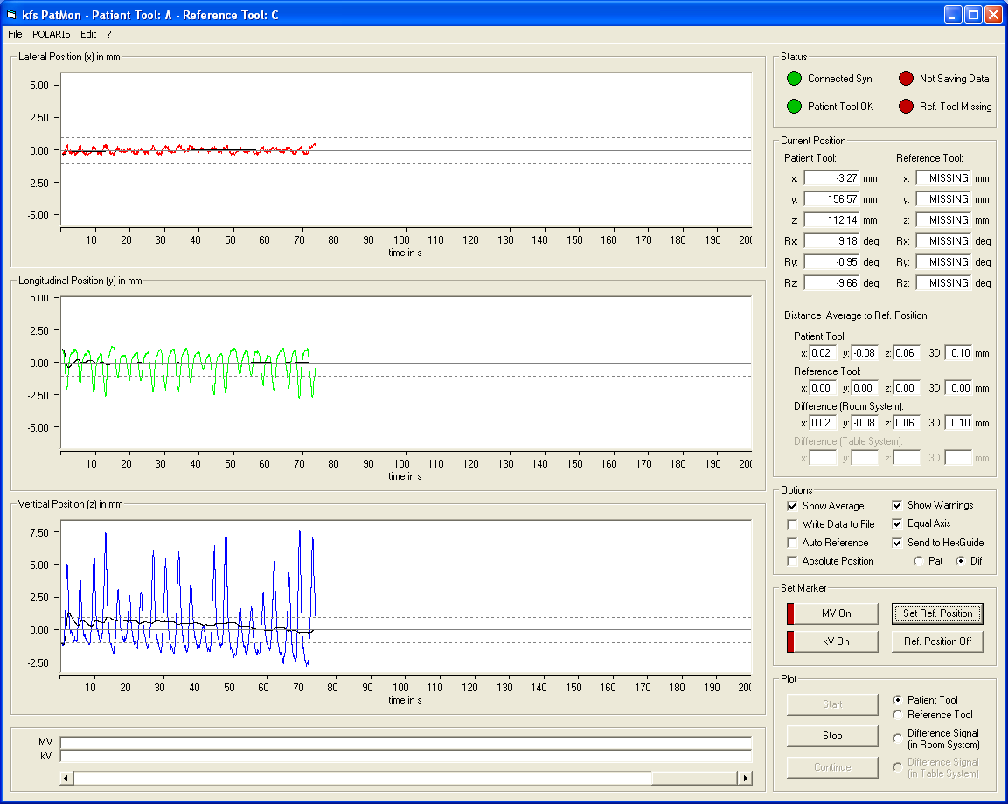
Project motivation
There is currently a lack of patient position monitoring during treatment
Patients are observed to sag or shift during long treatment
Observation verified by difference in setup CB-CT and post treatment
Difference between
the CB-CTs:
Δx = -0.1mm
Δy = 9.9mm
Δz = -2.1mm
Notes:
Results from an optical tracking system developed at Uni Wuerzberg
System showed patient shift in y and z directions
Later verified by the difference detected in the pre and post CBCTs

Slide 5
Project motivation
It would seem there is a current need for patient setup and monitoring tracking throughout treatment
Commercial systems do exist e.g.
  Vision RT-AlignRT
  C-Rad
However these are expensive!!

Slide 6
Project outline
Can a cost-effective solution be developed?
Requirements:
  Need for non-ionising tracking method
  System needs to be low cost
  Simplicity of design so as to not increase therapist’s workload
The Kinect range of depth cameras looked viable.
Thus project was to:
  Look at feasibility of using the Kinect for patient monitoring
  Characterise Kinect 1.0 and 2.0
  Develop software to test the Kinect camera in the clinical environment

Slide 7
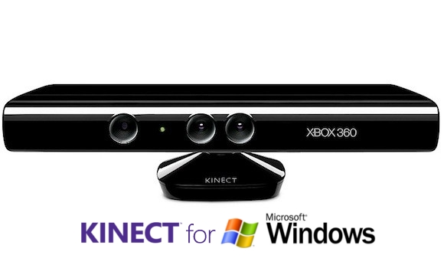
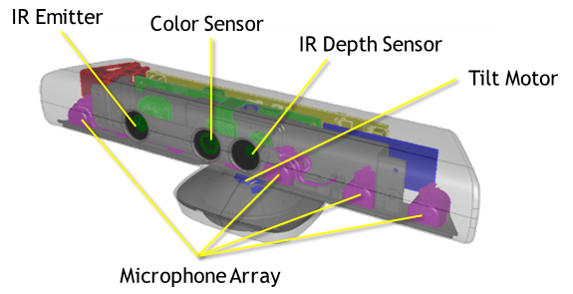
Camera specifications: Kinect 1.0
RGB-D
640 x 480 RGB
320 x 240 Depth
43º vertical by 57º horizontal F.O.V
30 FPS
Depth IR projector and sensor
Structured light pattern used for depth calculation

Slide 8
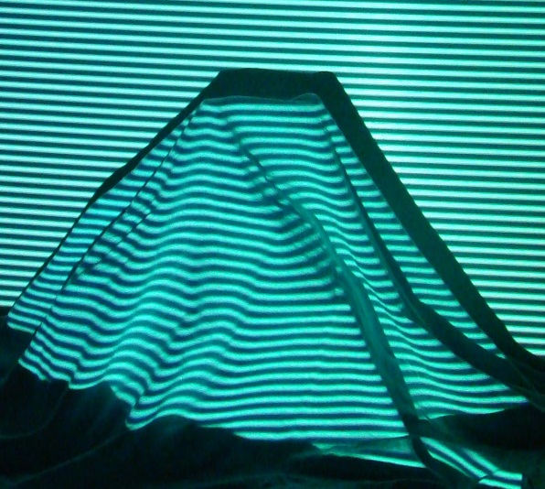
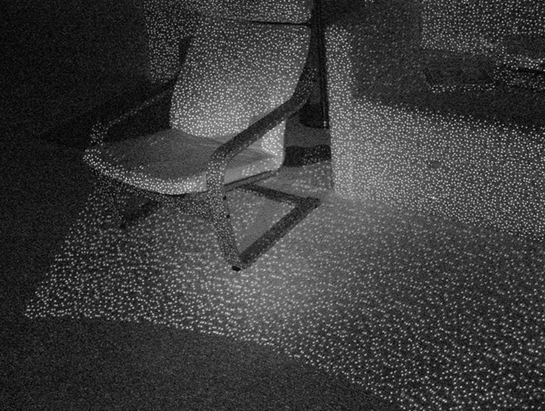
Kinect 1.0 depth sensor
Kinect projects a structured light pattern on local environment
Structured light pattern is deformed by variations in depth
Calculation of depth is done based on the transform between known pattern and measured pattern
Kinect uses propriety pattern
Effective range 0.8-4m

Slide 9
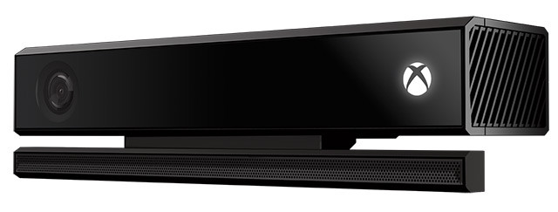
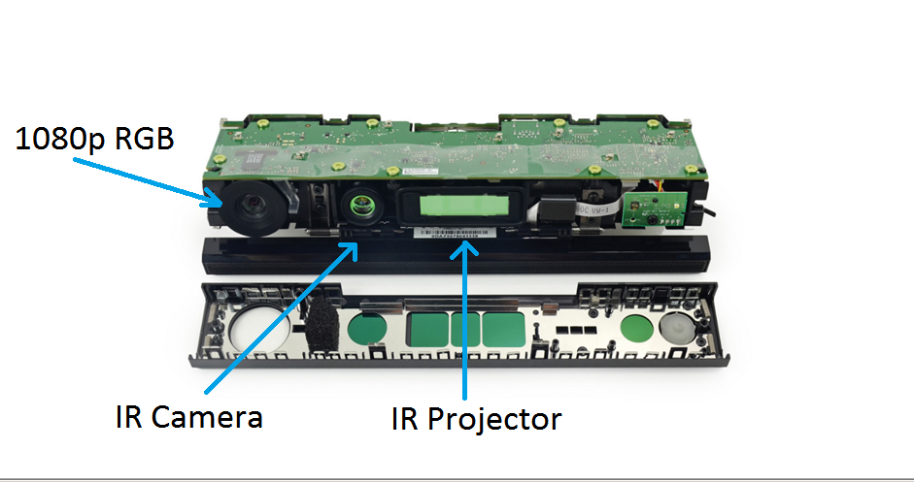
Camera specifications: Kinect 2.0
Alpha development program
1920 x 1080 RGB Camera
512 x 424 Depth Camera
60º vertical by 70º horizontal F.O.V
30 FPS
Depth Camera and IR emitter
Time of Flight(ToF) used for Depth calculation

Slide 10
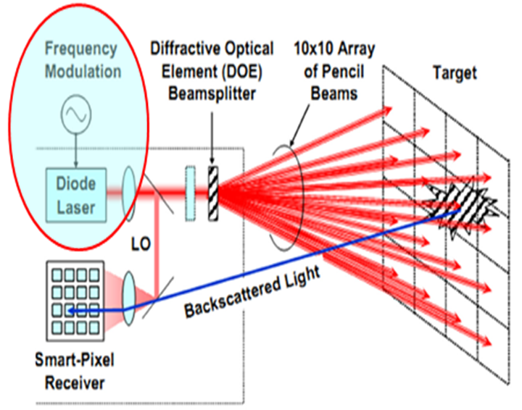
Kinect 2.0 depth sensor
830nm IR laser
Effective range of 0.5-4.5m
Measures the time difference of emitted light and backscattered light to obtain a depth value.
Internal configuration of Kinect 2.0 is unknown as Microsoft has not released this information yet.

Slide 11
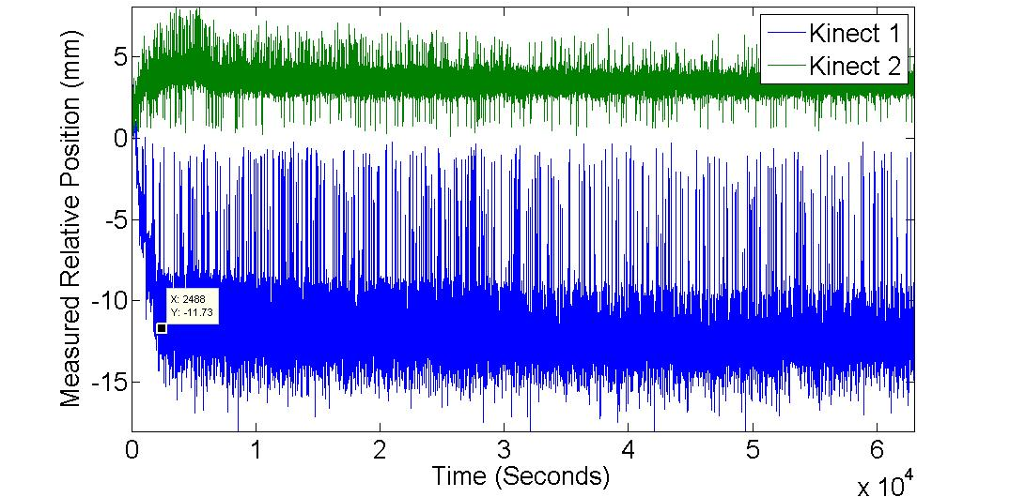
Kinect depth measurement long term stability
Notes:
60 min warmup period

Slide 12
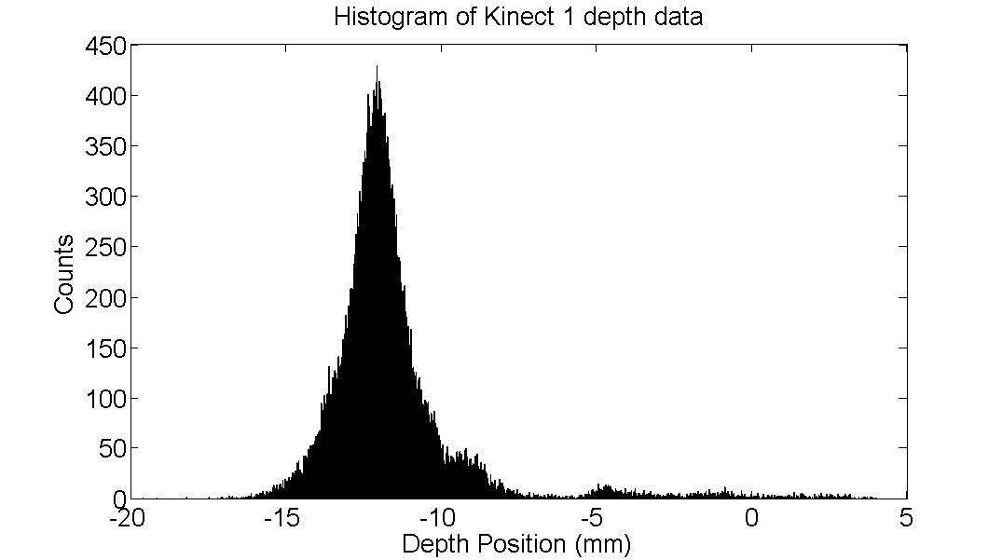
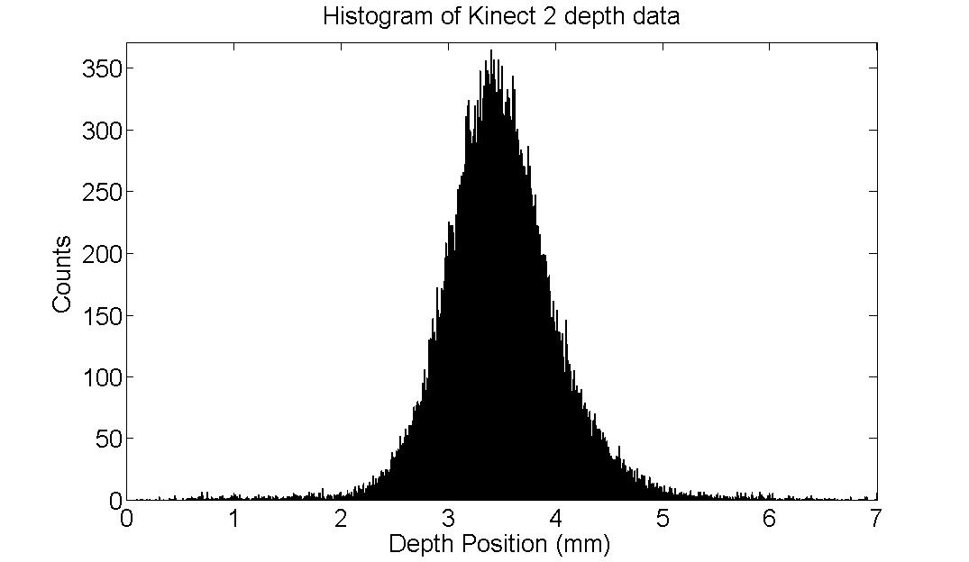
Kinect depth variation
The Kinect v1 has a mean position of -11.5mm and the Kinect v2 has a mean position of 3.5mm
The standard deviation of the Kinect v1 is 2.4mm, while the standard deviation of the Kinect v2 is only 0.6mm
Notes:
The Kinect v1 has a mean position of -11.5mm and the Kinect v2 has a mean position of 3.5mm. The standard deviation of the Kinect v1 is 2.4mm, while the standard deviation of the Kinect v2 is only 0.6mm.
Demonstrates the Kinect 2 has less depth variation

Slide 13
Software development – GUI design
Simplistic Design
Minimal controls
Colour coded for fast and efficient reading
Easy to read graphs
Large number displaying offsets
User defined tolerances
Moving average
Multiple Camera functions

Slide 14
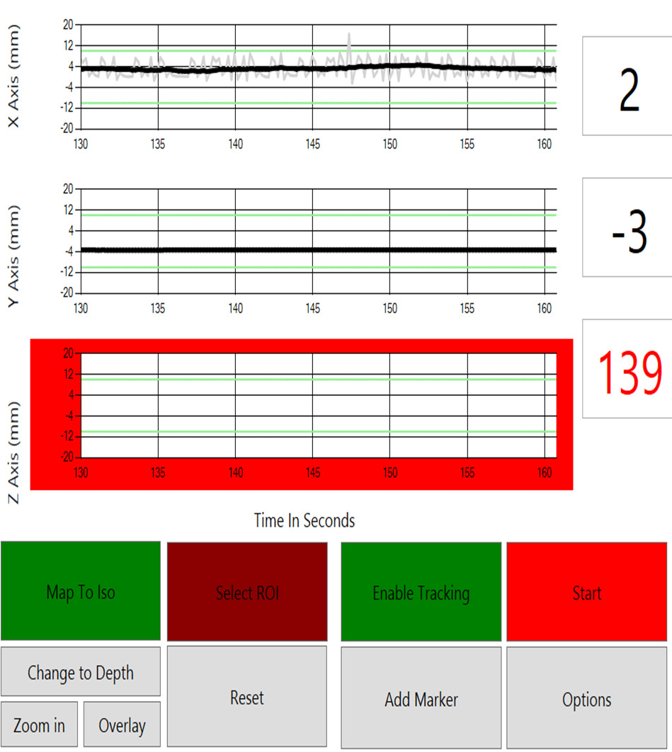
Software development – GUI design

Slide 15
Tracking
Needs to be
  fast,
  accurate,
  lighting independent.
Possible methods include:
  Mean shift (Camshift a variant of this)
    Mode seeking
  Speed Up Robust Features (SURF)
    Local feature detector
  Kinect Fusion
    Microsoft Local feature tracking (Full 3D tracking)
  Least Squares
    Exhaustive search method
Notes:
What happened to camshift ??? Are all above lighting independent?

Slide 16
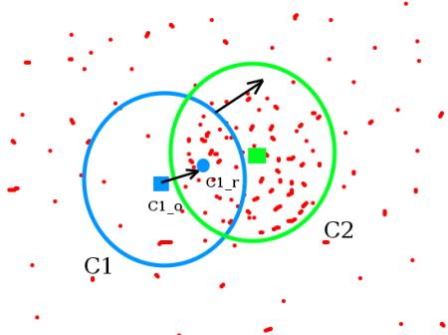
Tracking – mean shift
Algorithm originally proposed by Y Cheng 1995
Histogram produced based on variable to be tracked
Back projection based on histogram
Iterative calculation for mean centre of mass of back projected data found

Slide 17
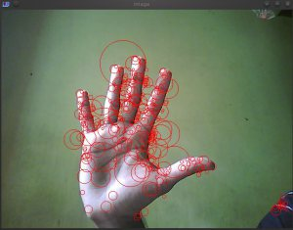
Tracking – speed up robust features (SURF)
Algorithm proposed by H Bay 2008
Extracts key points
Scale and rotation invariant
Was unable to track smooth and flat surfaces

Slide 18
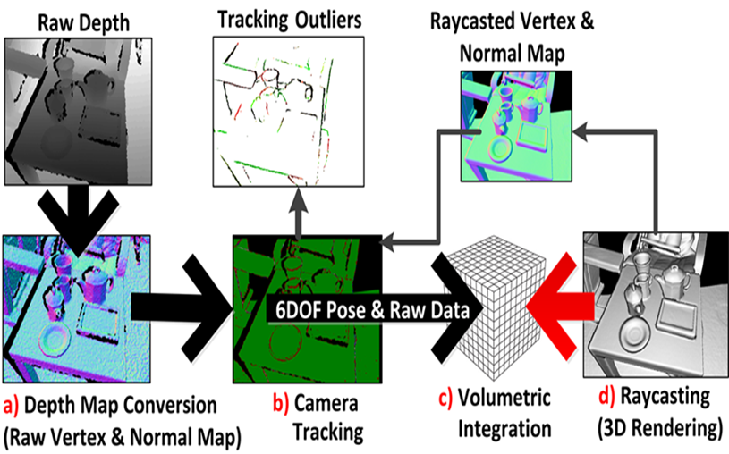
Tracking – Kinect fusion
Developed by Microsoft 2011
Creates 3D model
Tracks camera position based on features tracking
Primarily works with ridged models
Can use ray-traced Iterative closest point matching
No Kinect 2.0 integration until just recently

Slide 19
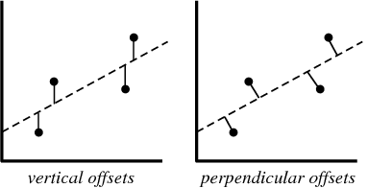
Tracking – least squares fit
Minimises difference between original surface and new surface
High computational time
High accuracy
Two dimensional
Does not track rotations or scale changes

Slide 20
Comparison of tracking algorithms
 | Speed | Accuracy | Ability to deal with deformations | Limitations
Camshift | Moderate | Moderate | High | Requires accurate depth correction.
SURF | Moderate | Low | Moderate | Requires significant variability in scene
Kinect Fusion | Fast | Moderate | Low | Requires lots of variation in scene, develops random rotations when tracking is not accurate
Least Squares | Very Slow | High | Moderate | Tracking will fail if objects speed is too large, requires some variation in scene
All the above methods were tested. The following slides show results for the Least Squares method

Slide 21
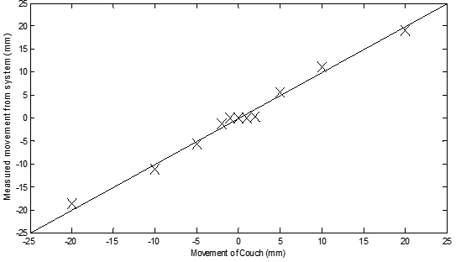
Results – Kinect 2.0 lateral position tracking

Slide 22
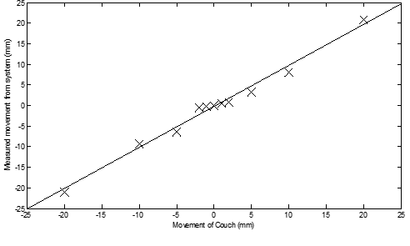
Results – Kinect 2.0 vertical position tracking

Slide 23
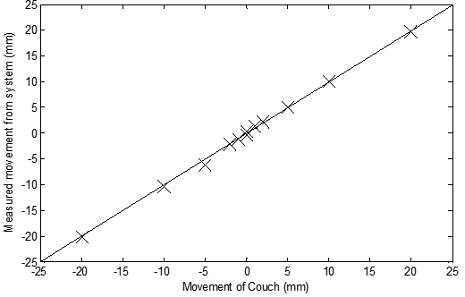
Results – Kinect 2.0 depth position tracking

Slide 24
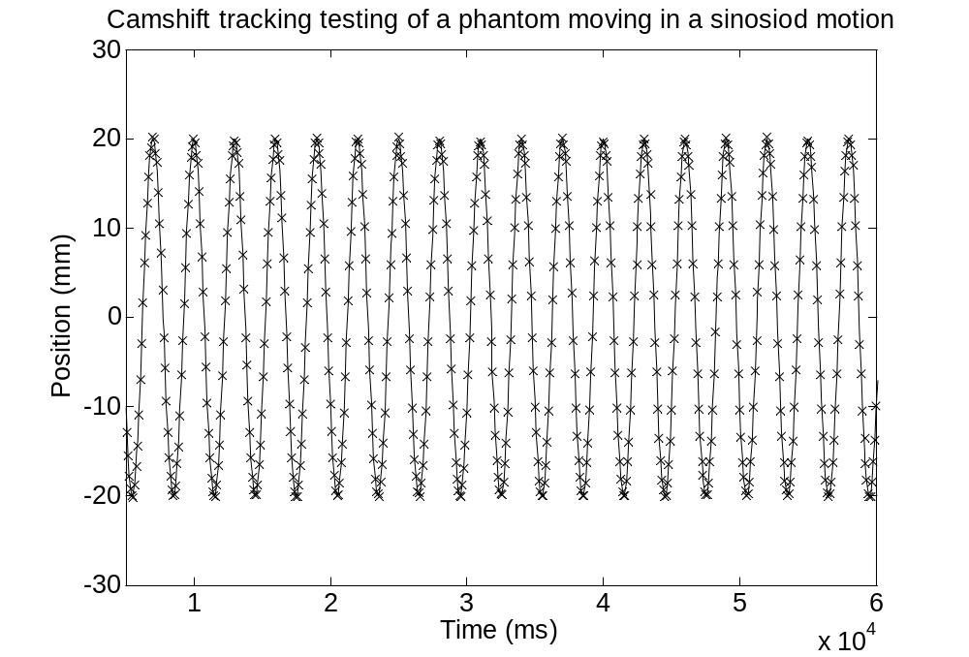
Results – Kinect 2.0 Dynamic tracking
Notes:
Tracking of a phantom showing motion platform (sin curve) and tracked position (x marks)

Slide 25
Tracking summary
 | Standard deviation (mm) | Relative speed | Lighting dependant | Accuracy | Ability to deal with deformations | Degrees of freedom
Camshift | 0.5 | Fast | Yes | Very High | High | 4
SURF | 14.1 | Medium | No | Very Low | Moderate | 4
Kinect Fusion | 3.0 | Slow | No | Medium | Low | 6
Least squares | 1.5 | Fast | No | High | Moderate | 3

Slide 26
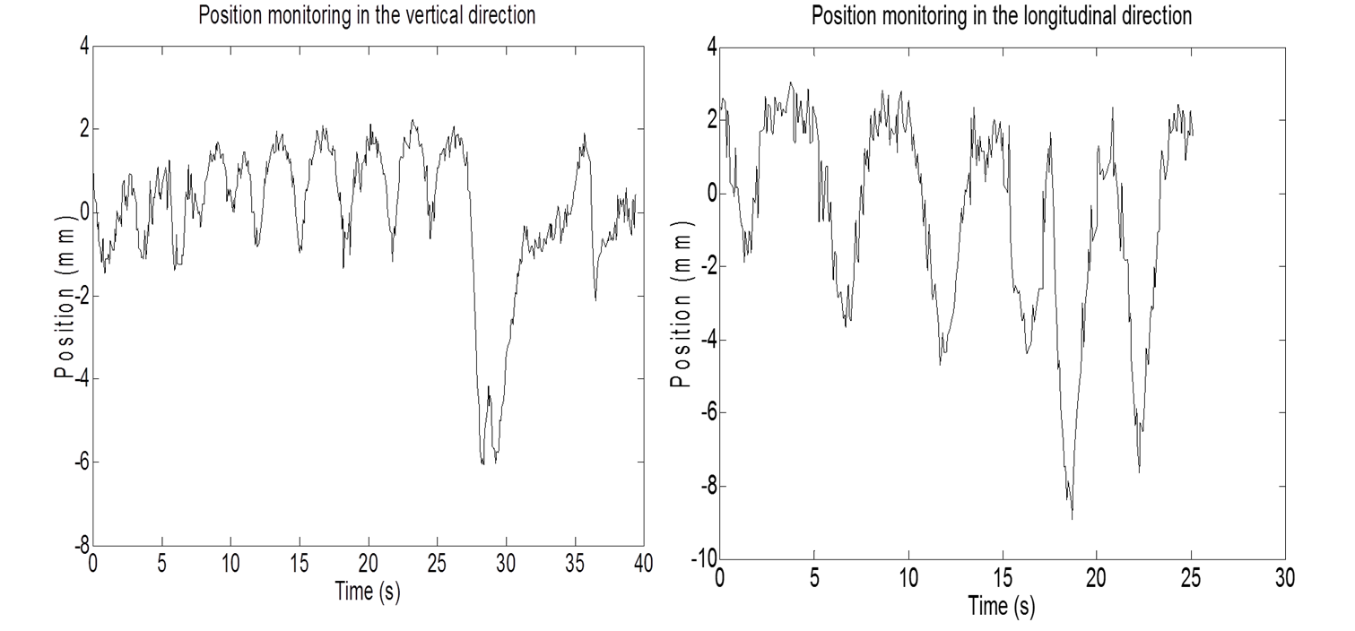
Tracking the motion of a volunteer in a treatment bunker
Baseline movements of a volunteer over 25 seconds

Slide 27
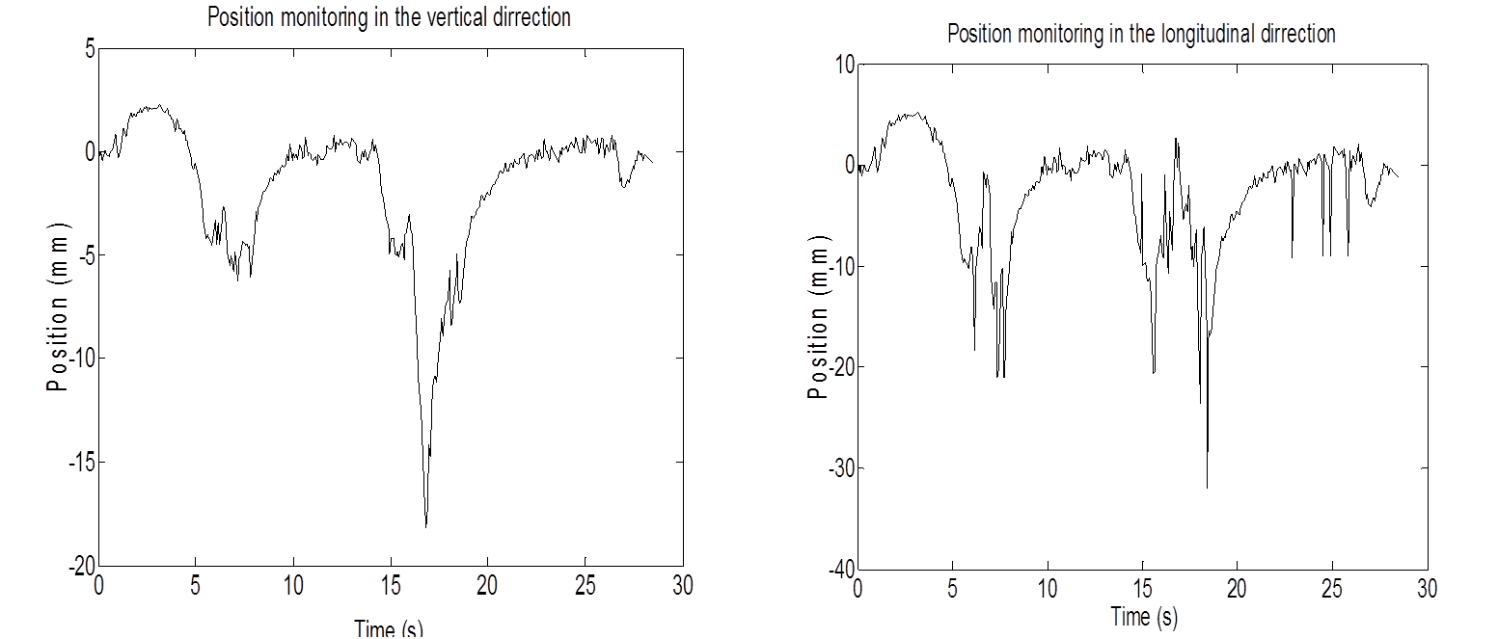
Tracking the motion of a volunteer in a treatment bunker
Volunteer coughing between 15 and 20 seconds

Slide 28
Tracking the motion of a volunteer in a treatment bunker
 | Detectable | Beyond tolerance | Comparison with baseline
Normal breathing | Yes | No | Very similar
Heavy breathing | Yes | Yes | Significantly increased motion
Coughing | Yes | Yes | Large motion during coughing
Looking around | Yes | No | Increased motion
Moving buttocks | Yes | Yes | Massive disruption followed by return to baseline
Talking | Yes | No | Increased motion
Moving Arms | Yes | Yes | Largely increased motion

Slide 29
Conclusions
Kinect V2.0 performs better than Kinect V1.0
Can observe small motions (sub millimeter) in the depth direction
Tracking works accurately in real time
ISO-Center mapping can accurately transform coordinate systems
Horizontal and vertical directions limited by large FOV so only movements larger than 5mm can be detected
Magnification or improvement of the horizontal and vertical resolution could result in this system being used in a clinical environment

Slide 30
Acknowledgements
St George’s Hospital for use of radiation therapy facilities
Microsoft for acceptance into the alpha-testing programme.

